Slide 1
Rhode Island
Department of Education
Title II, Part A
Overview Session
February 9, 2023
Notes:
Mary to introduce

Slide 2
PAFF WIFI Log In:
Connect to URI_Open
Go to rhodywifi.uri.edu
Click Guest Network Access
Username cepswifi@etal.uri.edu
Password: 997655
Click Log In Sponsored Guest

Slide 3

Welcome and Introductions
Notes:
Welcome: 5 min
Mk will Introduce
Dalila Townes
Hilda Potrzeba
Mary Keenan
David Luther
5 mins

Slide 4

Objectives for Today’s Session
  Provide an overview of Title II, Part A-Program
  Deepening understanding of Evidence Base Research
  Review CRP application sections
  Strengthen Evaluation and Monitoring Responses
  Overview of Equitable Services
  Overview of Fiscal requirements
Notes:
MK 2 minutes

Slide 5

Agenda: 9:00 AM-12:00 PM
Welcome
LEA Plan: Purpose and Allowable Uses
Evidence Based Research (EBR)
IV. Consolidated Resource Plan (CRP)
    Data and Data Sources
    Monitoring and Evaluation: Why?
Break
V. Equitable Services
VII. Fiscal Overview
    CRP Fiscal Items
    Supplement/Supplant
    Private Schools
    Transferability
    Carry Over Funds
    Amendment Guidance
VIII. Closure
Notes:
Agenda Minutes:

Slide 6

Spending Your Title II Funds
Notes:
MK:
Frame the days session
Purpose areas and priority/Focus areas

Slide 7
What Does the Data Say?
Notes:
66 LEA traditional and charter
3 transferred funds
8 applications are not approved
10/66 first approval
29/66 second approval
15/66 third or more approval

Slide 8

RIDE Goal:
First Issuance Approval status
Collective Goal:
Get to “YES” and award funds
Approval of CRP Title II, Part A application in a timely manner
Streamline CRP with aligned language and questions
Provide prompt technical assistance (phone, email and in person)
Include current resources in the Document Library
Additional staff support (Hilda Potrzeba)
Host Training Sessions:
  New Title II Coordinators & Superintendents (November 2022)
  Combined LEA and Private School Training (January 2023)
  Title II Monitoring Training (February 2023)
  Expand technical assistance offerings (EBR)
Notes:
MK 3 Mins
Data to support streamlines process

Slide 9
Federal and State LEA Plan Requirements
The federal Elementary and Secondary Education Act (ESEA) requires LEAs to have an approved LEA Plan on file with the state to access their federal funds.
The Consolidated Resource Plan(CRP) has served as the LEA Plan. The CRP provides an opportunity to maximize and coordinate federal resources to improve student achievement.
The State Educational Accountability Act of 2019 (EAA) also requires LEAs to create an LEA Strategic Plan. RIDE has finalized resources such as templates, samples and FAQs to help LEAs and schools meet the EAA requirements.
9
Notes:
MK

Slide 10
Annual Timelines
CRP Application Opens
End of May
CRP Applications Due (with summer or year-round expenses)
Signed CRP Assurances and Related Documents Due
June
June 1: LEA Strategic Plans Due
CRP Applications Due (needing school year only approval)
April–May
Preliminary Funding Released
Jan–March
CRP Amendment Period
Signed CRP Assurances and Related Documents Due
Equitable Services (Private School) Consultation Begins for Next CRP
Final Allocations Available
July 1st
School Improvement Plans Due
10
Notes:
MK
Talking Points
The US Department of Education begins to release preliminary allocations in the late spring each year.
Final allocations are released between September and January each year.

Slide 11
LEA Plan
LEA must provide a plan to determine justification for spending federal funds
Based on comprehensive needs assessment
Addresses academic achievement of students in relation to State academic standards
How to meet those standards
How to meet any other factors as determined by the LEA
ESSA Sec. 1114(b)(6)
Notes:
MK 2mins
Title II, Part A’s Non-Regulatory Guidance for Title II, Part A: Building Systems of Support for Excellent Teaching and Leading, September 2016 states “(w)hile Title II, Part A of the ESEA ,as amended by ESSA, does not require a needs assessment…, such an assessment may help ensure that Title II, Part A funds are used strategically, to maximize educator effectiveness and student outcomes.” (p.31).
It is, however required that stakeholders are engaged yearly to “examine relevant data to understand students’ and educators’ most pressing needs, including the potential root causes of those needs given local context” (p.30).
(Particularly the needs of those children who are failing or at risk of failing)

Slide 12

Title II, Part A Federal Program – Purpose
Increase student achievement consistent with the challenging state academic standards
Improve the quality and effectiveness of teachers, principals, and other school leaders;
Increase the number of teachers, principals, and other school leaders who are effective in improving student academic achievement in schools
Provide low-income and minority students greater access to effective teachers, principals, and other school leaders
Notes:
MK – 3 minutes
Ask the coordinators the purpose of Title II
Add responses to the chat
Then show image

Slide 13

Title II Activities Must Always Be…
Consistent with Title II purpose
Reasonable, necessary and allocable
3. Sustainable
4. Address the learning needs of all students
Notes:
MK 3 mins
Support the Purpose
R, N and A
Sustainable- cannot be one day workshops sustained over time
ALL Learners

Slide 14
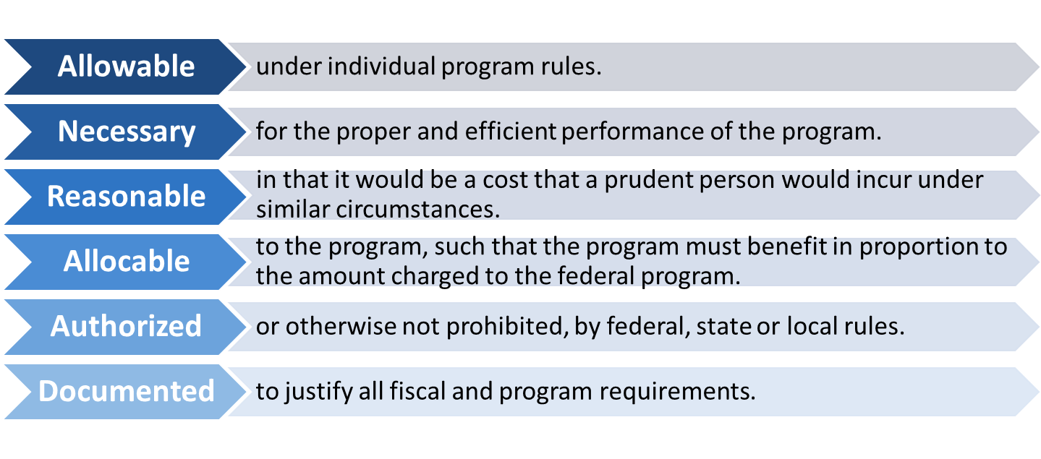
Funding Requests for All Federal Programs Must:
Notes:
MK:
4 min

Slide 15



Local Needs Assessment –Stakeholders
Principals
Paraprofessionals
Parents
Teachers
Private Schools
Notes:
2 min

Slide 16
Identification of Needs – Data Sources
Student Data
Demographics
Achievement and Growth
School Data
Resources
Graduation Rates
Salary
Climate
Survey Works
Curriculum Analysis
Student Surveys
Educator Data
Retention Rates
Experience
Areas of Expertise and Shortage
Job Satisfaction
Teacher Observations/Evaluations
Teacher Surveys
Notes:
MK 3 mins
When you are citing sources of data you must also include the specific data results

Slide 17
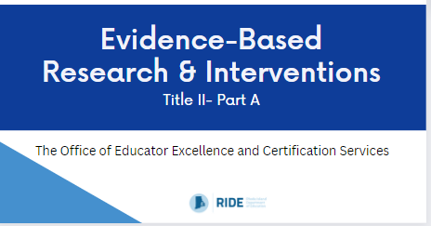
Evidence-Based Research Introduction
Notes:
MK:
Video: 7 min https://drive.google.com/file/d/10BtzaG_-FlOlKrbWo6ivwRpcmUCVq1VJ/view?usp=sharing OR https://vimeo.com/795725400
Debrief the video: 5 min
This is an area where we are struggling with across the board. We are doing this because we want to provide you with a video you can take back with you.
Were there any Aha's from the video? Were there any parts from the video that affirm what your team has already been doing?

Slide 18
Evidence Based Research Requirements (EBR)
Under Every Student Succeeds Act (ESSA)
Evidence-based as a research study that meets the criteria for one of four possible tiers
Title II allocations must be grounded in evidence-based research
LEAs must provide EBR articles for PL activities (at the request of SEA)
A review of evidence is now a standard component of the RIDE Title II Federal Monitoring Desk Audit
Notes:
MK: 2 Mins
Mary will post a quick poll on the comfort level of find EBR articles with each PL activity
Dalila will share link :
file:///C:/Users/keenma/Downloads/Evidence-Based%20Tiers%20(1).pdf
ESSA includes a requirement that Title II dollars be spent in ways that are back by evidence. Effort to both increase the impact of federal dollars and move the field generally to a more evidence-backed approach.
Important given existing threats to Title II funding.
ESSA defines evidence-based as a research study that falls into one of four tiers.
You can use a study that falls into any of the four tiers for an activity funded with Title II dollars, but this is not the case for all Titles.
In order to comply with our requirements under ESSA, RIDE is requiring all LEAs to collect and document evidence, and make this evidence available upon request. Note that there is a document in the document library to help with the organization of evidence.
Review of evidence is included in our monitoring procedures moving forward.
Document Library- slide deck Evidence Based

Slide 19
EBR Tiers
Tier 1
Strong Evidence (Experimental Study)
Tier 2
Moderate Evidence (Quasi-Experimental Study)
Tier 3
Promising Evidence (Correlational Study)
Tier 4 –
Demonstrates a Rationale (Logic Model + Research + Effort to Study)

Slide 20
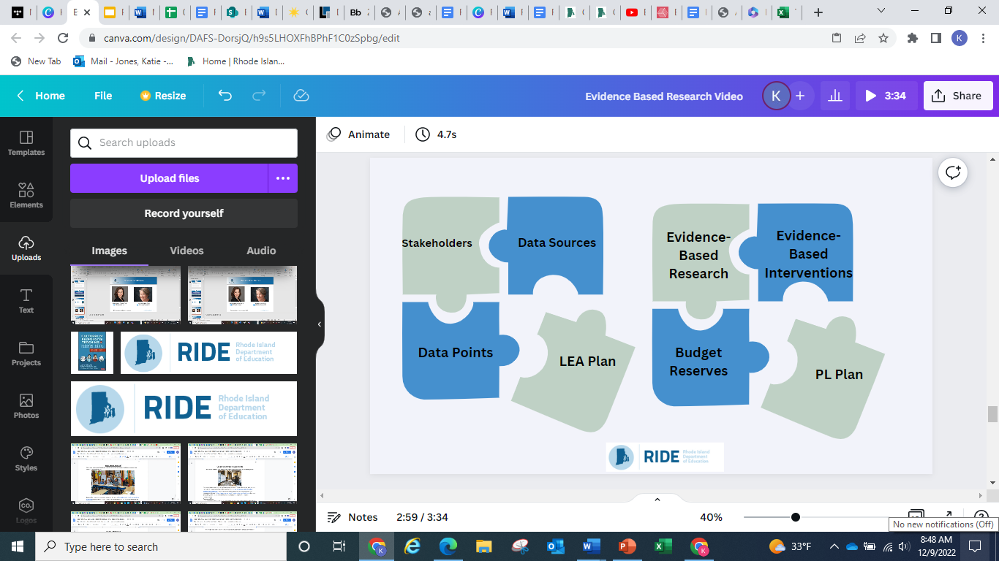
Evidence-Based Research: Bringing It All Together
https://drive.google.com/file/d/10BtzaG_-FlOlKrbWo6ivwRpcmUCVq1VJ/view?usp=sharing
https://vimeo.com/795725400
Notes:
MK:
LEA: EBR article- 10 min
Coordinators will review the article looking for tier criteria

Slide 21
Evidence-Based Research
Do’s | Reconsider
Start with the evidence-based research using curated academic databases, What Works Clearinghouse, etc. | Reconsider finding evidence-based research last and trying to force fit it to the activity
Read the full article and align to the appropriate tier | Finding one criteria and not reading the full research study before determining the tier.
Ensure the evidence-based research article is not just the abstract which doesn’t give you the full details of the study. | Reconsider submitting company promotional materials or overviews of studies instead of the study itself.
Collaborate with fellow Title II coordinators | Reconsider trying to do this on your own! They might have a bank of evidence-based research to share, or collectively create a shared bank
Take the time to review the “Related Documents” resources in Accelegrants | Reconsider making assumptions or guesses. Resources are available.
As a part of your succession planning, RIDE recommends that your evidence-based research articles be stored in the “Related Documents tab under Title-II | Reconsider keeping local only files which might get lost during times of transition.
Notes:
5 min
(database, online journal, or What Works Clearinghouse,..)

Slide 22
Questions???
Notes:
SIENKO – Why is this the only one on this slide format?

Slide 23

Title II, Part A- Reports
Consolidated Resource Plan (CRP)
Annual submission
Grounded in Needs Assessment
LEA budgeted breakdown of use of funds
PL Activities based on research(EBR)
All activities must align to the purpose (4 pillars)
Description of equitable services and supports
Federal Monitoring Audit (March)
Desk Audit
Formative process to monitor, provide feedback and continue growth
Evidence of meeting or working towards requirements in CRP
Verification that activities are grounded in research (EBR )
Opportunity to recalibrate and collaborate with SEA
Notification and application sent out in February
Notes:
MK 4 Mins
Where? Application at SEA and Federal level

Slide 24

Consolidated Resource Plan Application (CRP)
Notes:
HP:

Slide 25

How Can Title II Funds Be Spent?
Reserve Areas in CRP: Identifies area of allocation
2 require PL Worksheet and EBR article
  Professional Learning (16 allowable areas)
  Private Schools
Class Size Reduction statement and EBR article
  Class Size Reduction (RIDE encourages LEAs to phase out CSR)
Other Reserve Areas:
  Certification
  Equitable Access (LEA Plan :Part I)
  Recruitment & Retain
  Administration
Notes:
MK 4 Mins
Add link of allowable areas:
https://ridoe.sharepoint.com/:w:/r/OFFICES/TC/Internal/Shared%20Documents/Title%20IIa/11_2021-2022/Allowable%20Uses%20chart%202022.docx?d=w47066aec284d4b249657a27726cb7804&csf=1&web=1&e=FGccrv
The term 'professional development' means activities that are:
sustained (not stand-alone, 1-day, or short-term workshops)
intensive,
collaborative,
job-embedded,
data-driven, and
classroom focused.”
AND
Provide the knowledge and skills necessary to enable students to succeed in a well rounded education and to meet challenging state standards.

Slide 26
Reserve Dropdown Descriptions
Reserve - choose the appropriate designation from drop down menu for each item: Administration – Funds necessary for program implementation, including indirect costs. Class-Size Reduction – Funds reserved to reduce teacher/student ratios in the classroom. Private Schools – Funds reserved to provide Title II, Part A services to participating (in District) private schools. Professional Learning– Funds reserved to provide PD to teachers, principals, and other school leaders. Recruitment– Funds reserved to recruit and retain pupil services personnel. Certification - Funds reserved to assist Out-of-Area personnel to obtain the required certification for their assigned position. Equitable Access - Funds reserved for equity gap priorities. Note: Any item using the Professional Learning Reserve designation MUST have a Professional Learning Activity Worksheet in the Application Details, Part II: Professional Learning section of the Title II, Part A CRP Application.

Slide 27






Professional Development
The term 'professional development' means activities that are:
sustainable (not stand-alone, 1-day, or short-term workshops)
intensive
Collaborative
job-embedded
data-driven
classroom focused
AND
Provide the knowledge and skills necessary to enable students to succeed in a
well rounded education and to meet challenging state standards.

Slide 28
ESEA shifted program focus from “core academic subjects” to providing a “well-rounded education.” ​
ESEA defines well-rounded education as courses, activities, and programming in subjects such as:
English
Reading
Writing
Science
Technology
Engineering
Mathematics
Civics and Government
Economics
Arts
Music
Career and Technical Education
Health
Computer science
History
Geography
Physical Education
Language arts
Foreign Languages
Well-Rounded Education in ESEA
and any other subject, as determined by the state or local educational agency, with the purpose of providing all students access to an enriched curriculum and educational experience.
ESEA Sec. 1114(b)(7)(ii); 1115(b)(2)(a)

Slide 29
Budget: Cost Basis
Cost Basis - Use number sentences to provide details for the request, such as: ​ item x cost = total​ (item x cost) + (item x cost) + estimated shipping = total ​ hourly rate x # of hours between (duration) = total​ annual salary per contract​
Notes:
HP

Slide 30
Budget: Description
Description - Indicate the position to be funded, items to be purchased or Professional Learning Activity Title (the same title should be used on the Professional Learning Activity Worksheet) AND, if applicable, where (LEA/school name).​
Notes:
HP

Slide 31
Budget: Justification
Justification - Please describe how the request is specific to the goals of the program. Suggested format:​ ​This request for (list item or service) supports the goal of (list professional Learning goal/need described in LEA application) by providing (describe how it is reasonable and necessary to implement the Title II, Part A program).​ ​
Notes:
HP

Slide 32
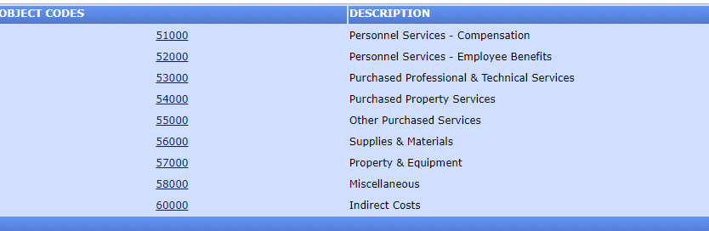
Consolidated Resource Plan Application:
Notes:
HP

Slide 33
Budget Series
Budget Code/ Name | Description | Example
*51000: Personnel Services Compensation | Budgeted allocations for FTE positions and associated compensation for employees of the district. | FTE: Mathematics Specialist Stipends for Teachers (attend) Stipends for Curriculum Trainings (lead) FTE: Induction Coach
*52000: Personnel Services - Employee Benefits | Budgeted allocations for benefits costs relating to personnel positions and salaries | Benefits for Stipends
*53000: Professional & Technical Services | Temporary Services (contractors, vendors) | OTs and Interpreters Training/Professional Learning Services Conference Registration
Notes:
HP:
Note: Payment for consultants and contractors should not be included in this section.

Slide 34
Budget Series Examples
51000​ | Reserve: Unspecified​ | ​
​ | ​ | Amount: $6000.00
​ | Cost Basis: 12 teachers x 10 hours x $50/hr.​
​ | Description: Stipends for Teachers (after school hours)
​ | Justification: To provide stipends for teachers completing LETRS training, Units 5-8. Approximately 10 hours additional planning time.
52000​​ | Reserve: Unspecified​​ | ​​
​​ | ​​ | Amount: $69.60​
​​ | Cost Basis: 1.45% of $40/hour x 12 teachers x 10 hours = $69.60​
​​ | Description: Benefits for Stipends for Unit/Curriculum Unpacking​
​​ | Justification: Benefits for teacher stipends for professional development on new ELA program; 2 teachers/grade level (K-5) and 2 support staff will engage in unit unpacking focused on curriculum implementation in order to serve as leads at their schools​
53000​​ | Reserve: Unspecified​​ | ​​
​​ | ​​ | Amount: $9,600.00​
​​ | Cost Basis: New England Base Camp @ $9,600 contract rate.​
​​ | Description: Teacher Coaching Cycles (New England Base Camp)​​
​​ | Justification: NEB will support individual educators identified by school and district leadership through one-on-one five-step coaching cycles.​
Notes:
HP:

Slide 35
Budget Series
Budget Code/ Name | Description | Example
54000: Property Services​ | Property Services
55000: Other Purchased Services​ | ​Other Purchased Services
*56000: Supplies/Materials | Operating budget​ for PL activity or series | ​General Supplies, Books/Periodicals Technology related supplies
57000: Property and Equipment​ | ​This section includes budgeted expenditures.
*58000: Miscellaneous​ | Miscellaneous | Membership ​Dues/Fees
60000: Indirect Costs​ | ​Indirect Costs | ​
Notes:
HP:

Slide 36
Budget Series Examples
56000​​ | Reserve: Unspecified​​ | ​​
​​ | ​​ | Amount: 2,331.56​
​​ | Cost Basis: 55 professional journals/texts @ approx. $40.00 per text = $2,231.56​
​​ | Description: Supplies and Materials to support PLC​
​​ | Justification: Texts support professional learning: researched-based best teaching and leadership practices and PLCs.​
57000​​ | Reserve: Unspecified​​ | ​​
​​ | ​​ | Amount: $2,200
​​ | Cost Basis: $4,000 for annual district-wide organizational membership in EdLeader21, the national PLC for administrators & teacher leaders​
​​ | Description: Manipulatives for Mathematics 40 sets x $120 = $4,800.00
​​ | Justification: This request supports our goal of increasing knowledge and understanding of Mathematics through hands-on experiences .
58000​​ | Reserve: Unspecified​​ | ​​
​​ | ​​ | Amount: $4,000​​
​​ | Cost Basis: $4,000 for annual district-wide organizational membership in EdLeader21, the national PLC for administrators & teacher leaders​
​​ | Description: Membership fee for national PLC​
​​ | Justification: Professional Learning Community focused on Communication Collaboration Critical Thinking and Creativity that improves administrators' & teachers' knowledge/ skills and enhance students’ academic engagement.​​
Notes:
HP:

Slide 37

Equitable Access
CRP Application Question -Part I:LEA Plan
The Title II, Part A program is designed, among other things, to provide students from low-income families and minority students with greater access to effective teachers, principals, and other school leaders.
Districts MUST describe how they will use Title II funds to address equity gaps
  Address how minority and low-income students are provided access to effective teachers, administrators and other school leaders
  Submit annually within the CRP (LEA Part I)
  SEA may deny Title II funding, if description is not submitted
Notes:
MK 2 mins
What does Equitable Access mean to you?
STATE:
Under ESSA Equity Gaps must be addressed to identify the root causes for the disproportionate rates at which low income and minority students are being served by ineffective, out of field and inexperienced T,P and OSL
2 options
% of funds
Description of how funds are used
Under ESEA sections 1111(g)(1)(B) and 1112(b)(2),
SEAs must :
describe
how low-income and minority children are not served at disproportionate rates by ineffective, out-of-field or inexperienced teachers
And
identify and address any disparities that exist in the rates at which these students are taught by teachers in these categories.
To eliminate any such disparities,
develop and implement strategies that are responsive to the root causes of those disproportionate rates;
Title II, Part A funds can be used
to provide students from low-income families and minority students with greater access to effective teachers, principals, and other school leaders
Ensuring all students have access to high quality learning. Doesn’t mean everyone gets the same thing.
Must address root causes of disproportionate rates of ineffective, out of field and inexperienced t, principals and other school leaders

Slide 38
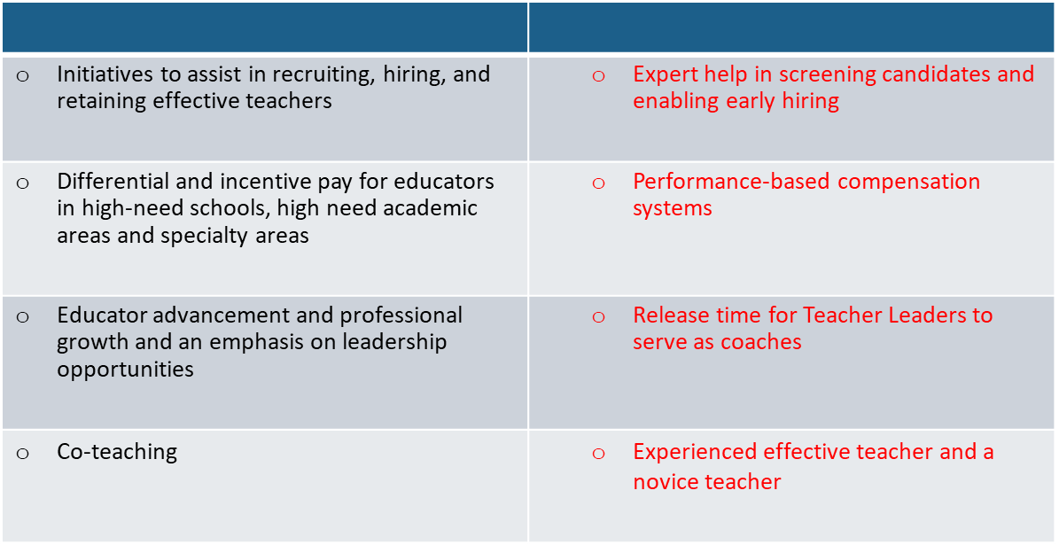
Equitable Access
The Title II, Part A program is designed, among other things, to provide students from low-income families and minority students with greater access to effective teachers, principals, and other school leaders.
Notes:
MK 2 mins

Slide 39
Needs Assessment is Grounded in Data
IMPACT: Monitoring and Evaluation
Data Sources and Data Points
Outcome:
Discontinue
Outcome:
Continue
Outcome:
Adjust
Notes:
MK: 2 mins
Budgeted activity in person started virtual minimum screen time low impact
Feedback by participants was that no useful
Amendment- adjust and add new activity

Slide 40

Evaluate and Monitor
WHY?
Understanding: Is the PL activity accomplishing the goal?
  Allows us to make changes when it’s not working
  Allows us to make the case for effectiveness or ineffectiveness
Regulation: It is required under ESSA.
  LEAs’ must submit an annual application that describe how funds will be used, data aligning to need, and monitoring and evaluation to continually update and improve activities
3. Effectiveness: Should we adjust, continue or discontinue?
  Data provides understanding of impact
Notes:
MK: 2 mins
Generally, everyone wants to do PL for the right reasons. We want this to positively impact students and educators.
Have to be thoughtful about how to evaluate it so we know if what we are doing is working, and so we can change it if it’s not.
Important to make the case about what PL is doing effectively. Title II funding is constantly at risk, as well as PL in local budgets.
ESSA requires a description of how data will be used to improve PL activities
Hard to use data to improve PL activities if you don’t have any data on the effectiveness of those activities

Slide 41
Title II Federal Monitoring Desk Audit
US Department of Education (USDoE) requires state education agencies to monitor Title II, Part A on an on-going basis
Goal is to ensure that LEAs spend funds consistent with Title II, Part A requirements
RIDE is responsible for providing evidence of monitoring activities to USDoE to meet state accountability requirements

Slide 42
Monitoring Process
Monitoring application provides the LEA the opportunity to submit evidence to ensure alignment of Title II Part A funded activities and requirements
Monitoring is for the PREVIOUS school year, not the current one.
LEAs are required to provide evidence that funds were used in the following areas:
  Increase student achievement
  Increase the number of teachers, principals, and other school leaders who are effective in improving student academic achievement in schools
  Improve the quality and effectiveness of teachers, principals, and other school leaders
  Provide low-income and minority students greater access to effective teachers, principals, and other school leaders
4) Audit begins with the CRP application.

Slide 43
Title II, Part A Federal Monitoring Application
The application consists of 6 sections:​
A) Allowable Use of Title II Funds​
B) Professional Learning​
C) RI Teacher and Paraprofessionals​
D) Class-Size Reduction​
E) Non-Public Schools Services​
F) Attestation​

Slide 44
Review Take Aways: Do you have protocols in place?
Professional Learning
Data and data Sources
Connection to Strategic Plan
Inventory Monitoring
Description of property
Hiring and Assignment Certified
Hiring protocol
Verify certification
Collaboration Stakeholder
Monitoring & Evaluation
EBR articles
Impact
Label Title II, Part A
Process for annual tracking
Process for site based inventory
System for disposal of materials based on condition
Hiring & Assignment Non Certified
Assurance of certification when changing assignments
Hiring protocol
Verification of meeting TA standards
Must be entered into PAS-noncertified
Must be entered into PAS-certified
Qualified status

Slide 45
Questions???
Notes:
SIENKO – Why is this the only one on this slide format?

Slide 46

STRETCH Break
Notes:
Update and adjust as needed
Mary will say it’s a 3 min stretch break and give time to come back

Slide 47

Private Schools
Notes:
2 min Poll:
Quick poll to gauge relationship and communication with private schools

Slide 48
What are Equitable Services for Private Schools?
Under ESSA, public LEAs are required to offer services and other benefits to eligible students attending non-public (private) elementary and secondary schools, and their teachers.
Benefits may include supplemental instruction, professional development, parent involvement, or materials and supplies that are equitable to those provided to eligible public-school students, and their teachers.

Slide 49
First Steps
RIDE provides:
LEAs:
Determine private schools’ eligibility to participate
Communicate with private school officials regarding participation (letter of intent)
Private Schools:
Accept or decline the offer to participate in writing
Resources, forms, and sample documents
LEAs with a list of in-district private schools within the Consolidated Resource Plan (CRP)
Technical assistance
Allocations to LEAs
Initiate the consultation process
Update and verify contact information
Upload enrollment information to RIDE

Slide 50
Consultation Process
The goal is to reach an agreement &
the key is to build relationships
Notes:
MK
the goal is to reach agreement
Varies slightly from program to program.

Slide 51
Collective Responsibility
RIDE
Provides training and technical assistance, including resources, tools and guidance
Private Schools
Update staff contacts for the LEA
Shares preliminary and final allocation totals
Reviews and approves funding applications
Provides support when questions arise
Ensures that LEAs maintain documentation
Submit Intent to Participate Letters by deadline
Come prepared for initial consultation each year (e.g., needs assessment data)
Engage in timely, meaningful and ongoing communication
Support program implementation and follow-through
LEAs
Determine private schools’ intent to participate annually
Engage in timely, meaningful, and ongoing consultation
Maintain written documentation of entire consultation process and provide written evidence to RIDE (including signed affirmations)
Maintain fiscal control of funds, supplies, materials and equipment
Own and are responsible for the use of equipment

Slide 52

The Process of Consultation is:
Focused on the needs of eligible private school students, teachers and personnel
Timely and meaningful
Initiated before the LEA makes fiscal decisions
Continuous throughout the design, implementation and assessment of services
The goal of all parties should be to reach agreement on how to provide equitable and effective programs for eligible private school students, teachers, and for some programs, families.

Slide 53
Professional development services and programs must meet the definition of “professional development” in section 8101(42).
Professional Development Requirements
Part of the schools' strategies for providing educators with the knowledge and skills necessary to enable students to succeed in a well-rounded education
Sustained (not stand-alone, one-day, or short-term workshops), intensive, collaborative, job-embedded, data-driven, and classroom-focused
PD must be:
Funded activities must be:
Aligned to state academic standards & student academic achievement standards
High quality, sustainable, intensive, classroom focused
Evidence-Based
Shall be secular, neutral, and non-ideological

Slide 54
General Guidance on Equitable Services for Private Schools
Funds are generated on an equitable basis
A public agency (LEA) must control funds
Services must be secular, neutral, non-ideological, and supplemental
Costs must be allowable, necessary, and reasonable
Private schools do not receive funds
Private school services should start at the same time as the LEA’s program

Slide 55
Private Schools Consultation Timeline
Consultations
WINTER
Dec-Feb
SPRING
Mar-May
SUMMER
June-Aug
FALL
Sept-Nov
Verify private school contacts
Send out Letter of Intent
Collect Letter of Intent
Schedule initial /ongoing consultation & send out consultation template
Conduct ongoing consultation
Review current programs and amend as needed
Prepare Letter of Intent
Meet with private school officials
Provide funding amounts
Discuss consultation topics
Discuss needs assessment
Review Planning template and provide guidance on allowable use of funds
Finalize programs and services
Inform readiness of services and programs for SY 2019-20
Notes:
MK 3 mins
HP add link to chat when prompted
Link: https://ridoe.sharepoint.com/OFFICES/TC/Internal/Shared%20Documents/Title%20IIa/10_2020-2021/Detailed%20Consultation%20Timeline.docx?web=1
Consultation:
Involves communication and discussions on key issues relevant to the equitable participation of private school students, teachers, and other educational personnel in Federal education programs.
LEA must engage in timely and meaningful consultation with private school officials
BEFORE making a decision (such as on ordering materials or hiring staff) that affects the opportunities of private school participate in programs requiring their equitable participation
DURING the design and development of programs (including the process of developing a competitive grant application) and
THROUGHOUT the implementation and assessment of programs

Slide 56
Title II-A- Program
Private schools may use Title II funds to provide professional development activities for educators, principals, and other school leaders to address the specific needs of their students.
Title II-A Funds for Equitable Services must:
Meet the specific needs of students enrolled in a private school, and not the administration of the school
Ensure that the LEA responsible for providing equitable services retains control of the funds
Be an allowable use of Title II, Part A funds

Slide 57
During the Consultation Meetings, LEAs & Private Schools Should:
Utilize data and share information
Ask questions
Seek clarity
Negotiate
Reach agreement and complete documentation

Slide 58
ESEA shifted program focus from “core academic subjects” to providing a “well-rounded education.” ​
ESEA defines well-rounded education as courses, activities, and programming in subjects such as:
English
Reading
Writing
Science
Technology
Engineering
Mathematics
Civics and Government
Economics
Arts
Music
Career and Technical Education
Health
Computer science
History
Geography
Physical Education
Language arts
Foreign Languages
Well-Rounded Education in ESEA
and any other subject, as determined by the state or local educational agency, with the purpose of providing all students access to an enriched curriculum and educational experience.
ESEA Sec. 1114(b)(7)(ii); 1115(b)(2)(a)

Slide 59

Title II-A Funds May Not be Used For :
Class-size Reduction
Costs of a substitute
Nonsecular trainings
Teacher salaries
Section 2103 (b)(3)(D)
Notes:
If the conference contains both secular and non-secular events, the attending teacher, principal or other school leader must provide the LEA with information clearly delineating secular and non-secular activities prior to attending the conference. The LEA will determine the percentage of the conference representing secular professional development in which the teacher participated. The LEA should consider all expenses related to attending the conference (e.g., airfare, hotel registration) to determine the amount to reimburse the teacher for attending the conference.

Slide 60
Examples of Allowable Activities and Services Under Title II-A
Training to improve teacher knowledge & effectiveness
Training on integration of technology into curricula and instruction
Training on how to teach students with different needs
Training on methods to improve student behavior
Leadership training
Training in the use of data and assessment
ESSA, Section 4101
Notes:
MK:
Activities must be supplemental, based on results of needs assessment, with input from stakeholders
including students with disabilities or limited English proficiency, and gifted and talented students.
Leadership development and management training to improve the quality of principals and superintendents

Slide 61
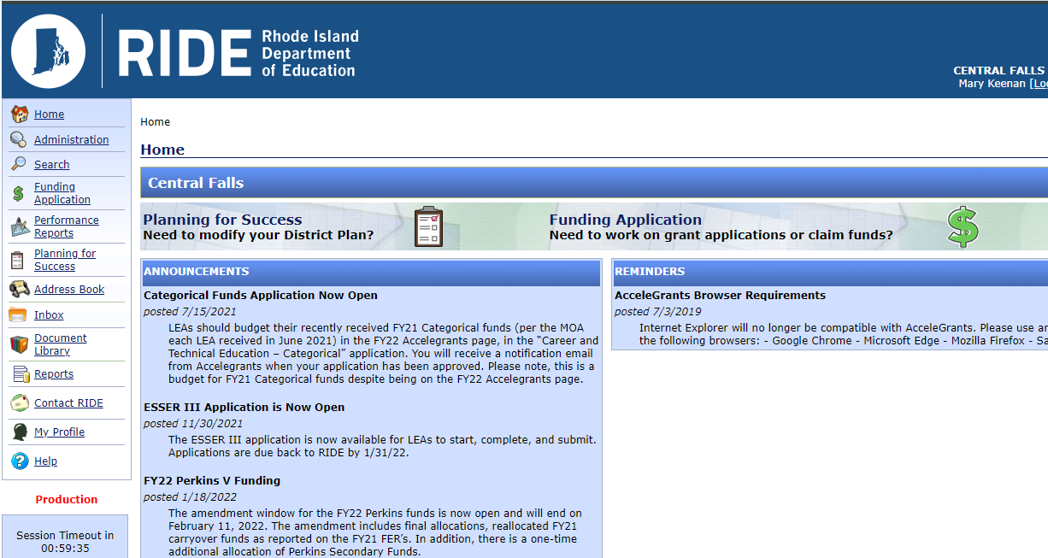
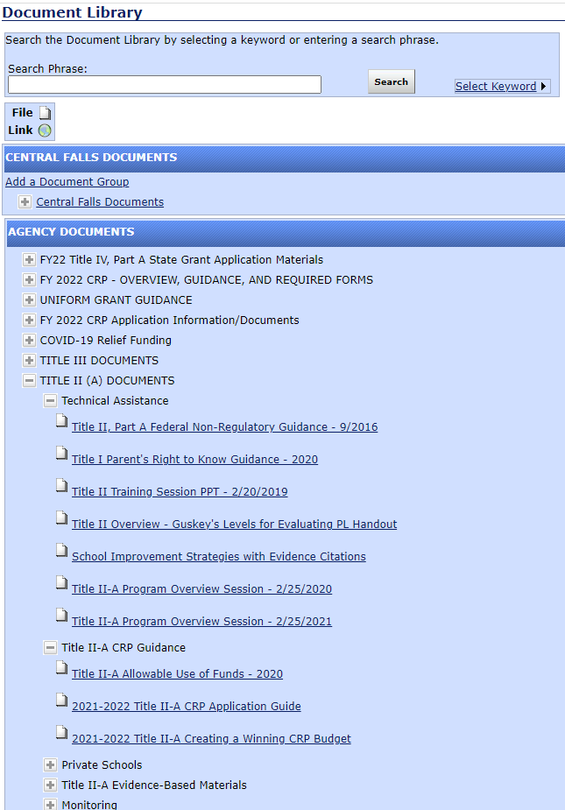

Resources and Supports
Notes:
HP 1min

Slide 62
If the LEA and Private School Disagree…
LEAs and Private Schools are encouraged to:
Work together to reach agreement on behalf of students
Reach out to their federal program liaison at RIDE for support
File a complaint with the Ombud
  A private school has the right to complain to RIDE if:
  Consultation was not meaningful or timely;
  The district did not give due consideration to the views of the private school official; or
  The district failed to make decisions that treat the private school or its students equitably.
Notes:
HP:
the state is required to designate an ombudsman to monitor and enforce the Title I equitable services requirements.
A private school official has the right to complain to the SEA that the LEA did not engage in timely and meaningful consultation or did not give due consideration to the views of the private school official.
▪ The ombudsman is positioned to assist the LEA and private school officials to resolve a concern before it becomes an official complaint.
▪ The ombudsman serves as the primary point of contact for responding to and resolving any complaints regarding equitable services that the SEA receives under its ESEA complaint procedures. ESEA Sections 1117(a)(3)(B), 8501(a)(3)(B), and 8503 ESSA Fiscal Guidance, FAQs N-1 through N-5

Slide 63

The State-designated Ombuds will monitor and enforce private consultation and equitable service requirements to help ensure equitable services are provided to private children, teachers, and other educational personnel.
Rhode Island’s designated Ombuds is:
Anthony Cottone Chief Legal
Rhode Island Department of Education
255 Westminster Street
Providence, RI 02903
(401) 222-8933
ombudsman@ride.ri.gov
ESSA sections 1117(a)(3)(B) and 8501(a)(3)(B)
Notes:
HP1 min
If private school officials believe the district did not meet consultation or other requirements, they may file a complaint with RIDE if:
consultation was not meaningful or timely;
the district did not give due consideration to the views of the private school official; or
the district failed to make decisions that treat the private school or its students equitably.
A formal written complaint must include:
a statement that the SEA (RIDE), the LEA, or other entity receiving federal financial assistance has violated a requirement of a federal statute or regulation that applies to a program requiring equitable participation;
the facts on which the statement is based and the specific statutory or regulatory requirement allegedly violated; and
the signature of the complainant.
ESSA sections 1117(a)(3)(B) and 8501(a)(3)(B)

Slide 64
Questions???

Slide 65

Fiscal Overview
Dalila Townes
Grants and Finance Officer
Dalila.townes@ride.ri.gov
Notes:
DT 1 min
I'll start the fiscal overview with some high level discussion on key items that impact your CRP and then I'll go over some fiscal items that are specific to Title II. I start with going over the items that impact your overall CRP because even if the Title II portion of your application is programmatically and fiscally approvable, it is still just a piece of your overall CRP application - there are general items that would impact all programs and that need to be addressed in order for final approval of the entire application.

Slide 66
Funding Requests for All Federal Programs Must be:
Allowable
Necessary
Reasonable
Consistent
Allocable
Authorized
under individual program rules.
for the proper and efficient performance of the program.
in that it would be a cost that a prudent person would incur under similar circumstances.
charged consistently as an indirect or direct cost across Federal awards.
to the program, such that the program must benefit in proportion to the amount charged to the federal program.
or otherwise not prohibited, by federal, state or local rules.
Documented
to justify all fiscal and program requirements
2 CFP Part 200, Subpart E
Notes:
I'll start with a discussion on allowability. Per 2 CFR 200.403 all costs must meet the general criteria on this slide in order to be allowable under Federal awards
Allowable – The cost must be allowable under the individual program rules (Title II, for example) and it must be allowable under the Uniform Administrative Requirements and Cost Principles for Federal Awards (the 2 CFR 200 series). 2 CFR 200 applies to all Federal programs.
Necessary – The cost must be necessary to fulfill the regulatory requirements for proper and efficient administration of the program. You should consider whether or not this cost is necessary for the operation of the program.
Reasonable – this represents an amount that does not exceed what a prudent person would pay under the same circumstances.
Consistent – Costs must be accorded consistent treatment – a cost must not be assigned to a Federal award as a direct cost if any other cost incurred for the same purpose in like circumstances has been allocated to another Federal award as an indirect cost. Furthermore, if a cost is part of your indirect cost pool that is used in your indirect cost calc, you cannot directly charge that cost.
Allocable – costs are allocated in accordance to the relative benefits received, you can only charge the program its fair share. You must have a reasonable allocation method.
Authorized – the cost must be authorized or otherwise not prohibited by federal, state, or local rules
Lastly, the cost must be adequately documented to justify all fiscal and program requirements.

Slide 67
When may an LEA begin to obligate funds?
The State (SEA) may not authorize an applicant for a sub-grant to obligate funds until the later of the following two dates:
  The date that the funds become available; or
  The date that the applicant (LEA) submits an application to the SEA in substantially approvable form.
Status of: District Superintendent Approved = Submitted
Reimbursement for obligations is subject to RIDE final approval of the application.
Notes:
DT 2 mins
On this slide I will talk about the submission of the CRP application - the items on this slide are applicable to all CRP programs and not just Title II.
An LEA cannot obligate funds until the later of the date the funds become available or the date that LEA submits application to RIDE in substantially approvable form
Typically applications are due no later than June 30th or if you have summer activities the due date is mid May
The project period doesn’t start until you submit your application so its very very important to get your application in on time. For example, lets say funds become available on 7/1 but you don’t submit your application until 10/1, those expenditures between 7/1 and 10/1 would not be allowable and you would have to fund them with local dollars. Again, the takeway here is ensure you are submitting a timely application.
A key item to remember is that an application is not considered submitted until its in District Superintendent Approved status which means its gone through all of the LEA levels of approval. Simply having an application in Draft Started or any approval level below Superintendent Approved does not mean the application has been submitted.
Also remember that when the application is opened its in "Not started" status, in order to begin making changes you need to move it to "Draft started" to make changes
While you may obligate funds before the application is in final approved status, you cannot submit for reimbursement until the application is final approved by RIDE.

Slide 68
Don't forget the required documents!
Signed Assurance Affirmations
Request to Obligate Federal Funds
Process for the Development of the CRP Application
All can be found in the document library. Submit to RIDE when submitting the consolidated application.
Notes:
DT 2 mins
In order to prevent delays in the RIDE approval process, don't forget to submit all the required documents. These required documents aren't specific to Title II and apply to your overall CRP application.
Within the document library (which Mary showed you how to get to a few slides back), there is a section called FY23 CRP- Overview, Guidance and Required Forms. Within this section there is a Instructions for CRP submission document which mentions the three documents on this slide and where to send the documents
The Assurances Affirmations – In this document you are making various assurances that apply to your overall CRP and each individual program in order to ensure compliance with the applicable Federal statutes, regulations etc
The Request to Obligate Federal Funds - on this form you indicate whether you have summer activities and for which programs. Its really important to submit this timely so that RIDE knows when you are beginning your activities so that we can plan and focus on the review of your summer activities and getting those approved timely
The Process for the development of the CRP application fulfills the Federal requirement to document who participated in the application development such as community members, parents, teachers, students etc

Slide 69
Why is my CRP application not final approved?
All Required Documents are not submitted to RIDE
Application has not been resubmitted
(Superintendent Approved status)
Prior Year Final Expenditure Report (FER) issue(s)
  Late Reporting (due by August 15th)
  Refund(s) Due back to RIDE
  E.I.S. Reporting discrepancies (vs. UCOA file)
Overdue IDEA MOE Compliance Test Reporting
Issue(s) with private school component
  Equitable Share Calculator (Update when Amending!!!)
Notes:
DT 4 mins
On this slide I'll go over what factors might be holding up your CRP application:
The first bullet, make sure you submit all of the required documents I discussed on the previous slide
Confirm the status of the application and ensure any resubmitted applications are in Superintendent Approved status. RIDE may have returned the application to you for edits and even if you've made the required changes unless its in Superintendent Approved status it will not trigger another RIDE review and ultimately RIDE final approval
Even if we are able to get through the programmatic and fiscal reviews the application won't be final approved if your FER hasn’t been submitted or if there are certain issues related to FER
During the initial application process RIDE fiscal inputs preliminary allocations which include an amount for carryover – carryover is comprised of two components 1) unapplied amount from PY and 2)unspent from PY. Without the FER RIDE does not know the unspent amount/final carryover amount.
Additionally, even if the FER is submitted you cannot have any refunds due to RIDE, this will hold up final approval
If there are discrepancies on between reporting on the FER for IDEA Early Intervening Services and the UCOA file, this will hold up the process
If you are behind on other reporting like the IDEA MOE compliance report
And lastly if there is an issue with the private school proportionate share calculator
A common issue we see is that the equitable share calculator is not updated at amendment time. At the time of the initial application, the allocation and funds available are preliminary, by amendment time allocations are finalized and the calculator needs to be updated for the final allocation amounts

Slide 70

Supplement-Not Supplant
It is likely funds are supplemental if:
The activity is not required by federal, state or local laws
The activity was not paid for with state, local, or other federal funds in the prior year.
Each program may have additional requirements to determine supplement vs. supplant
&
Notes:
Title II funds must supplement ( be in addition to services that an LEA is required to provide to all its student) and not supplant (or replace), funds available from State and local sources for the education of students participating in federal programs .
This leads to the two questions to ask yourself to determine if funds are supplemental or if supplanting has occurred.
•Is it required under other Federal, State or Local law? If you are required to do the activity anyways then the reasoning behind it is why should the Federal government be paying for it?
•Was the activity paid for with State, Local or other Federal funds in the previous year?
If answer to both questions are no then the funds are most likely supplemental.
Please note that each program may have additional requirements to determine supplement vs supplant

Slide 71
Private School Proportionate Share Calculator
Calculator assists LEAs determine proportionate share of each eligible participating private school.
  To be eligible, each private school must be RIDE approved (annual process).
Use of private school student counts from October 1st of the previous school year.
Counts include all students (K to 12) regardless of district of residency.
Notes:
DT
The private school proportionate share calculator determines the districts minimum required reserve of Title II funds for equitable services for participating private schools located within the districts boundaries. In order to be an eligible participating private school the private school must be RIDE approved which is an annual process.
There is an Enrollment Counts tab of the calculator that has the enrollment counts for the district and the eligible private schools within the district. This is based on October 1 data of the previous school year and includes all students (K to 12).
There are a couple items I'd like to point out here, you may see more schools listed in the private school section of your Accelegrants application than you do not see on the enrollment counts tab of your proportionate calculator. That’s because the proportionate share calculator includes only those private schools that have been RIDE approved for the current year.
Additionally, if there is a school in the private school section of the accelegrants application that has been closed let David Luther know and he can remove that school from Accelegrants.

Slide 72
Private School Proportionate Share Calculator
Private School Proportionate Share based upon LEAs Title II allocation
Transfer of funds in or out of Title II will need to be accounted for within calculator.
A change in the amount allocated will require an update to the private school share calculation – such as at amendment time.
Must obligate all (private school) funds in the year made available
LEA may take administrative costs off the top.
Such as Indirect Cost Recovery
Notes:
The calculation is based on the Title II allocation, and you adjust for carryover and transfers in and out of title II. Any change in the overall allocation/carryover/transfers will also impact the private school share! This is of particular note at amendment time when the allocations have changed. Again, this is an issue we often see overlooked by LEAs. I talked about it a couple slides back and it is worth another mention here as well.
As the district you are trying to get the private schools to utilize all of the funds they have in the year its made available. You want to ensure that you are appropriately and timely consulting with them and seeing what their needs are. Private school consultation is an ongoing process, you want to be sure you capture any changes in their needs – for example at amendment time you want to confirm if there any adjustments that need to be made to the budgeted private school line items.
LEAs can assess necessary and administrative costs to address the fact that there is an administrative cost associated with managing the private school funds. The simplest way to do this is through the indirect cost rate - the proportionate share calculator has a section where you would input the total administrative cost for Title II program. This essentially takes the administrative costs off the top or in other words the beginning of the equation – before the amount required to be reserved for private schools is calculated.

Slide 73
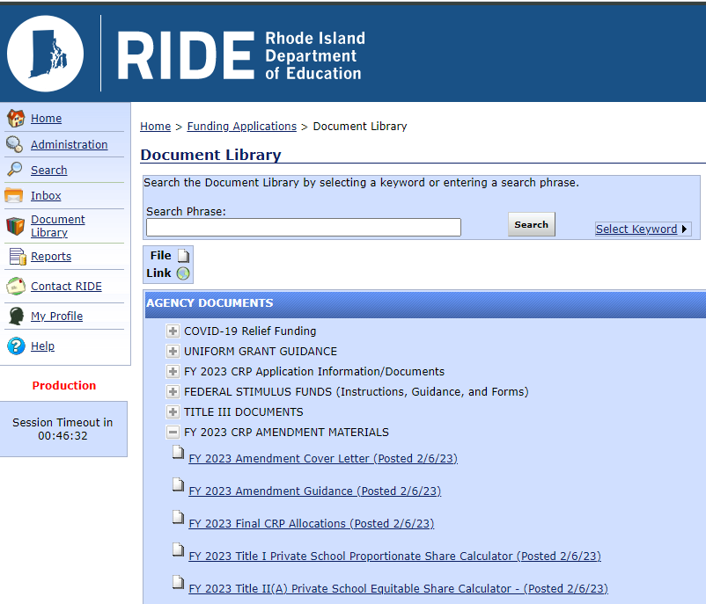
Proportionate Share Calculator
Notes:
DT 1 min
On this slide is a picture of where you can find the proportionate share calculator within the document library.
As we are currently in the amendment period, I am specifically referencing the 2023 CRP Amendment Materials. It is called FY23 Title II(A) Private School Equitable Share Calculator. If it was the initial application time it would be in the FY 2023 CRP Application/Documents section.

Slide 74
Transferability
Within the consolidated application, LEAs may transfer up to 100% of their Title II, Part A allocation and up to 100% of their Title IV, Part A allocation to the following programs:
O Title I, Part A – Disadvantaged Youth*
O Title I, Part D – Neglected and Delinquent*
O Title II, Part A – Supporting Effective Instruction
O Title III, Part A – English Language Acquisition*
O Title IV, Part A – Student Support and Academic Enrichment
* Funds cannot be transferred out of these programs including any funds transferred in.
Notes:
3 minutes
Transferability allows you to move funds between programs – however there are restrictions.
You can transfer 100% of your Title II & Title IV funds into the programs on this slide – Title I Part A, Title I, Part D, Title II (If you are transferring in from Title IV) Title III, Part A, Title IV.
One of the biggest restrictions is that once you transfer funds into Title I or Title III, you cannot transfer these funds out. Even during amendment time, you can increase the transfer amount to these programs but you cannot decrease the transfer amount.
LEAs should only be transferring the amount up to what is needed in the program. RIDE doesn’t recommend blanket transferring funds if you do you have a need for it in the other program.
You would make the election to transfer in the allocation transfers section of the application

Slide 75
Transferability (cont.)
Private Schools
Transferring funds between programs impacts your private schools.
The LEA must update the Proportionate Share Calculator to reflect transfer of funds; either going out of Title II or going into Title II.
Notes:
1 minutes
Additionally, transfers between programs also impact the equitable share for private schools. For example, lets say you are transferring money into Title II from Title IV, there is now a larger pot of Title II funds available and as such the required reserve for private schools is larger. Alternatively, if you are transferring money out of Title II and into one of the other programs, there are less Title II funds available in the overall pot and therefore less funding available to private schools. There are lines within the calculator to reflect transfers in/transfers out. This further expands upon a point I made a couple slides back where any change in allocation, transfers carryover etc. triggers an update to the proportionate share calculator.

Slide 76
Period of Availability & Carryover
Title II(A) funds are available for 27 months
First In First Out (FIFO) Approach
LEAs are encouraged to apply for all available funds
Unlike Title I (A) funds - no restriction on the percentage that can be carried over within the 27-month period of availability
Account for Private School funds separately and allow for similar carryover, if necessary
Fiscal Year | Period of Availability
FY 2022 | 7/1/2021 - 9/30/2023
FY 2023 | 7/1/2022 - 9/30/2024
Notes:
3 min
Title II (A) funds are available for 27 months – we currently have 2 years open
The 2022 funds are available until 9/30/23 and the 2023 funds until 9/30/24
Funds are used on a first in first out basis, so you are using up your old funds first
RIDE encourages LEAs to apply for all available funds
You can carry over all of your title II funds within the 27 month period of availability – this is pointed out in the slide because this is unlike Title I where you have to obligate or spend 85% of funds within the first 15 mos.
Lastly business officers should be accounting for private school funds separately

Slide 77
2023 Amendment Guidance
2023 Amendment Period: February 6th- March 20th
When to submit a CRP Amendment:
Decrease in available funds
If LEA cumulative anticipated change(s) within or among objects of expenditure (Budget Series) exceeds 10% of the total approved budget
If LEA cumulative anticipated change(s) within or among objects of expenditure (Budget Series) exceeds Over $100,000.00, whichever amount is less
Notes:
The 2023 amendment period opened February 6th and LEAs can submit an amendment until March 20th
So when/why might you need an amendment?
As a general rule, any proposed change in the total approved budget amount and/or significant change in the scope, goals, or intent of an approved program will require an amendment request.
Final allocations and prior year unspent has been loaded into the applications. Many times (but not always) this might result in an increase in funds (remember the original application is based on a preliminary allocation) but sometimes it results in a decrease in funds. If the change in the total amount of available funds has caused the currently approved budget to exceed the total amount of available funds – in other words you're over budgeted, you will need to submit an amendment. So for example, if you previously budgeted for $50,000 and your available funds is updated to $49,000, you will need to submit an amendment. You are not required to amend for an increase in funds – however just keep in mind that you cannot spend on the increase until it is budgeted. So for example if your previously approved budget was $50K and you now have available funds of $55K, you can only request for reimbursement up to the $50K approved budgeted amount. The remaining $5K unbudgeted will be carried over into your next year's application and you can budget for it at that time.
An amendment is required If the LEA has changes within or among objects of expenditure (ex: 51000 series for compensation, 52000 series for benefits, 53000 for purchased services) that exceed 10% of the total approved budget or if that change exceeds $100,000 within the budget series, whichever is lower. To clarify – within the object series means the individual line items that make up each budget series, for example the individual line items budgeted in 53000 purchased professional services.
For example, let’s say your total budgeted amount is 500,000 and you are increasing one line item within purchased services by 55,000 and decreasing other line items within the 53000 series, that would be a change within the object of expenditure that requires an amendment
Among the objects of expenditure means a change between different budget category series. In this example let’s say you’re approved budget is $1.5M and you are making a change to 53000 by increasing the line items by $125,000 and 55000 by decreasing line items by $125,000. This is an example of an anticipated change among objects of expenditure that requires an amendment because it is over $100,000

Slide 78
2023 Amendment Guidance
10% Flexibility Rule
  Prior approved line items/activities
  The flexibility is not meant for new or unapproved activities
  New line items/activities require an amendment
Don't forget to update Private School proportionate share calculator & budgets!
See FY23 Amendment Guidance Document within Document Library
Notes:
DT
On the last slide I gave a few examples of when you need to submit an amendment – however, in certain situations you may not need an amendment and can apply the 10% flexibility rule.
If your total changes within and among the budget series is less than $100,000 and does not exceed 10% of the total approved budget you can apply the 10% flexibility rule rather than submit an amendment. When you request for reimbursement within accelegrants you would reflect the change there.
The caveat with the flexibility rule is that this can only be used for changes with prior approved line items/activities. This is not meant for new or unapproved activities. If you are adding any new activities or line items you will need to submit an amendment
I've mentioned this on multiple slides but don’t forget to update the private school proportionate share calculator for changes in allocation/carryover etc at amendment time. Additionally, any amendment required to private school budgets should also be made at this time, as a reminder private school consultation is an ongoing process and you should be meeting with the private schools to ensure needs are being met, which includes review and assessment of budget and spending and amending as necessary.
The guidance I've given here is high level and not exhaustive – there is a detailed amendment guidance document for your reference that goes over in detail the amendment requirements.

Slide 79

Questions
Notes:
100 of 120 minutes

Slide 80
Thank You for Your Participation!
RIDE Title II, Part A Program and Fiscal Contacts
Title II, Part A Program
mary.keenan@ride.ri.gov 401-222-8497
hilda.potrzeba@ride.ri.gov 401-222-8891
Title II, Part A Fiscal Support
dalila.townes@ride.ri.gov 401-222-8171
David.luther@rode.ri.gov 401-222-4652
Notes:
2 min

Slide 81

Final Thought..
Notes:
2 min
Began the session reflection on a picture of a road that made us think about difficulties, barriers … in the Title II process
I want to end with this final thought by Henry Ford
We are making an impact in supporting teachers and administrators in providing meaningful PL
As we continue to work together, we will grow together and impact even greater impact together….

