Slide 1
Establishing the Attendance Team
Can an existing team address attendance?
Principals can consider dividing up the functions across multiple teams, adding all of the functions to an existing team or establishing a new team.
For example, a school climate team can be responsible for Tier 1 strategies which focus on whole school strategies such as establishing a positive and engaging school climate and promoting good and improved attendance.
An existing team that looks at academic data and/or behavioral or health issues can become responsible for Tier 2 and Tier 3 strategies which focus on the needs of students, since poor attendance may be a factor for low academic achievement and behavioral health issues.
If the attendance strategy is implemented across different teams, it is important to have a system for communication between the teams.

Slide 2
Establishing the Attendance Team
Tool: Map of School Teams
See Map of School Teams
Do you have a list of every school team?

Slide 3
Establishing the Attendance Team
Team members should be able to relay the perspectives of the student demographics. They should also incorporate input from families, students, and the community.
Teams working on improving student attendance could include the school’s:
Principal
Counselor
Social worker
Administrative support staff
Special education staff
Teachers
Early education staff
Expanded learning program staff
Nurse
Members of leadership team
What other stakeholders do you think should be on the attendance team?

Slide 4
Set Norms, Expectations, Roles, and Responsibilities
Group Norms
Effective teams have established group norms which are negotiated and established as the first step in the team process.
Norms define the habits and expectations for how the team will function, including how to share resources, processes for communication and accountability for follow through on team action items.

Slide 5
Example Norms
We commit to share strategies, practices, tools, and resources to support the success of all educators and students.
We will maintain confidentiality. Data are public, but what’s said (posted) here remains private as we discuss the complex issues and craft knowledge of technology, teaching, learning and leadership.
We will never speak (post) from the place of evaluation – positively or negatively – about our individual results; instead, we will speak of (post about) which areas of professional development use, which subgroups, and which research based best practices are required to support continued learning.
We will speak (post) about learners, educators and leaders respectfully, supportively, and positively at all times – as if they are in our midst during our discussion. We will focus on their assets and capabilities as we strive to address gaps or concerns.

Slide 6
Guidelines for Creating Team Norms
Do you have an example of a norm that your team(s) use?
See Guidelines for Creating Team Norms

Slide 7
Set Norms, Expectations, Roles, and Responsibilities
Roles and Responsibilities
Effective teams ensure that each team member has a clearly defined role and has the capacity to perform their role.
Team Leader
Meeting Facilitator
Data Coordinator
Note Taker
All team members should have access to a common system that monitors student outcomes, records interactions and interventions, and tracks progress on agreed upon tasks.

Slide 8
Set Norms, Expectations, Roles, and Responsibilities
Meeting Frequency & Agenda
Team regularly meets, more when rates are higher
Every meeting includes time for strategy monitoring
The team should meet regularly (ideally weekly when chronic absence rates exceed 10%) to review the school’s attendance data and coordinate schoolwide efforts to reduce chronic absence
The team agenda should ensure that there is time to review and monitor the team’s attendance strategy so that the team does not become overly focused on individual students with the highest levels of absence
Consider reserving Tier 3 students for a sub-committee of members who are directly responsible for their intervention plans if the team does not have longer than 60 minutes to meet.

Slide 9
Determine Standard Meeting Agenda and Frequency
Sample Agenda
School Attendance Team Agenda
December 1, 2023
1. Aggregate data trends
High level picture of all students by tier and by attendance categories (satisfactory, at-risk, moderately chronically absent, severely chronically absent, extremely chronically absent). Is it getting better or worse?
2. Unpacking patterns
Identify any patterns or trends across groups of students. What insights does the team have about common barriers or what might be contributing to positive outliers?
3. Tiered system of support
Strategies for strengthening your tiered system of support. Take a year-long approach. Discuss possible solutions to the barriers students are experiencing and identify systematic interventions (example: walking school bus).
4. Students needing tier 2 or tier 3 supports
Review individual students as a team; determine who follows-up with individual or groups of student(s) and/or families. Outreach to students and families to determine barriers/causes for absence, assign interventions and offer appropriate resources.
5. Meeting Decision and Next Steps
Summarize decisions and assign responsibility for next steps.
What other agenda item should be considered? Should it be a standing item?
See Sample Agenda (p. 5)

Slide 10
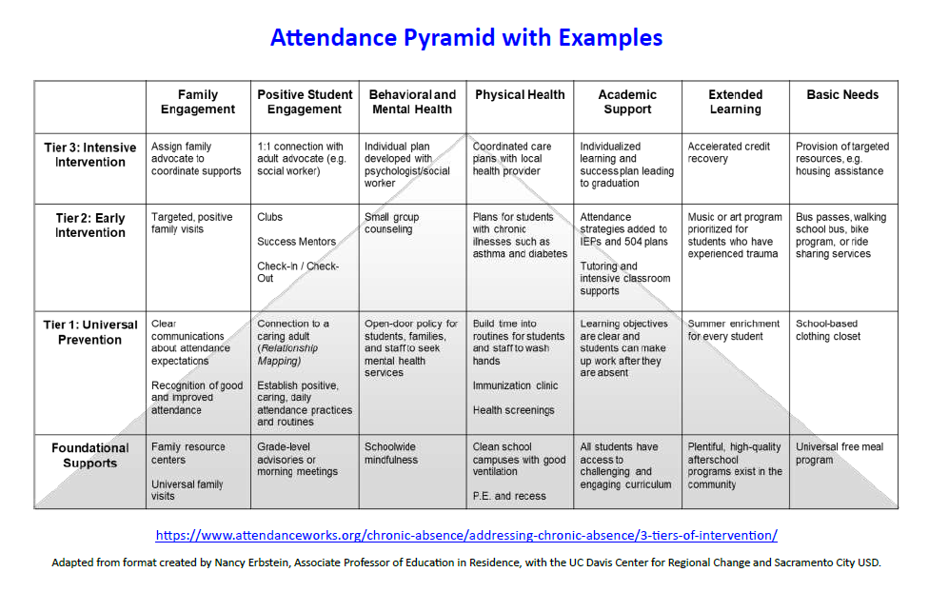
Assess the Attendance Practices
School Team: Attendance Pyramid
See Blank Attendance Pyramid and with Examples
Have you taken an inventory of your intervention and prevention strategies?

Slide 11
Develop the Blueprint for the
Attendance Improvement Plan
Attendance Activities School Year Plan (K-12)
The rows of this planning tool are:
School Team, Foundational Whole School Supports,
Tier I,
Tier 2,
and Tier 3.
The column headers are the time periods:
Summer, Welcome Back, Ongoing, Fall Semester, Winter Semester, Spring Semester, and End of Year.
See BLANK Attendance Activities School Year Plan and with Examples
Do you have an attendance activity school year plan?

Slide 12
How to establish a team to improve school attendance?
Avoid Common Pitfalls
× Establish a team that operates in isolation
× Fail to rally the whole school to support prevention and early intervention
× Focus only on students with the most absences
× Case management as the sole strategy
× Jumping to solutions without sufficient understanding of factors behind absences
× Team composition does not reflect the demographics, perspectives or cultural realities of the student population

Slide 13
PART II: Using Research and Tools to
Build a Plan for Attendance Success
Welcome
Continuous Growth & Improvement
An Effective School Team to Improve Attendance
Attendance for Success Act: Shifting to Prevention & Intervention
Wrap Up
Attendance Teams at Work
13

Slide 14
Prior Years of Chronic Absenteeism
Students who missed 10% of school in the prior school year should be prioritized for extra outreach and support for the current school year and the upcoming summer.
A wealth of research shows that chronic absence in the prior year indicates students, starting in kindergarten, were more likely to fall behind in reading, experience lower achievement in middle school and less likely to graduate from high school.
Keep in mind that large numbers of students chronically absent in a particular grade, student group or school can indicate a need for intensified investments in foundational and tier 1 supports, not just expanded early intervention.
https://www.attendanceworks.org/chronic-absence/addressing-chronic-absence/monitoring-attendance-in-distance-learning/​
Notes:
As we have shared many times, Attendance Works is an outstanding resource of evidence based research, interventions and considerations for chronic absenteeism.
Attendance Works tells us that the students that have prior YEARS of chronic absenteeism should be prioritized for extra outreach and support
They also tell us that the students are more likely to experience lower achievement – and are less likely to graduate.
Finally, we know that they will indicate the need for intensified investments in the foundational work AS WELL AS the interventions.
Our work here today is based on this premise.

Slide 15
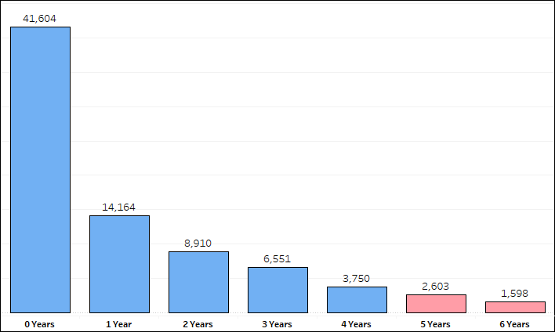
Number of RI Students
Chronically Absent for Multiple Years
Note: Data are from 2017 – 2023.
4,202 Students 5+ Years Chronically Absent
https://www.attendanceworks.org/chronic-absence/addressing-chronic-absence/monitoring-attendance-in-distance-learning/​
Notes:
When we examined the students that were enrolled in our schools – and analyze how many years they are chronically absent it breaks down in this way.
Please note that this information is from 2017 – 2023.
This does NOT include the current school.
Of course, this is not telling us if these students are still chronically absent today (this current school year).

Slide 16
Examining Current Students in Grades 5-12
INTERVENTION
3,194 students
ARE 5+ years chronically absent & ARE chronically absent this year
4%
16,144 students
NOT 5+ years chronically absent & ARE chronically absent this year
21%
PREVENTION & MONITORING
1%
ARE 5+ years chronically absent & NOT chronically absent this year
1,008 students
74%
58,834 students
NOT 5+ years chronically absent & NOT chronically absent this year
5+ years
*As of April 2024
Notes:
As we considered our currently enrolled students we thought about them in four categories.
Students that are NOT 5+ years CA and NOT CA this year
Students that are 5+ years CA and NOT CA this year
Students that are NOT 5+ years CA but ARE CA this year
Students that are 5+ years CA and ARE CA this year.
It is important to understand that how we would approach each of these situations may be different.
In fact, students we will want to break out some for prevention and monitoring and others for interventions.

Slide 17
Examining Current Students in Grades 5-12
3,194 students
ARE 5+ years chronically absent & ARE chronically absent this year
4%
16,144 students
NOT 5+ years chronically absent & ARE chronically absent this year
21%
1%
ARE 5+ years chronically absent & NOT chronically absent this year
1,008 students
74%
58,834 students
NOT 5+ years chronically absent & NOT chronically absent this year
5+ years
*As of April 2024
Notes:
Today we will focus on those students that are 5+ years chronically absent.
We will consider students that need to be monitored because this year they are NOT CA and those students that require interventions because this year they continue to struggle and are still CA.

Slide 18
Students Grades 5-12
5+ Years Chronically Absent
At Each Grade Level
All students in grades 5 through 12 break down by:
There are 4,202 students in grades 5-12 that have been chronically absent for 5+ years. They are:
5+ years
Notes:
Here we first see the breakdown of ALL students. We see how this is just a very small portion of our enrolled students.
When we break the 5+ years CA students down by grade level we see that the upper elementary, middle school and early high school are all impacted.
This population is NOT just at our high schools.

Slide 19
Students Grades 5-12
5+ Years Chronically Absent
By Race
All students in grades 5 through 12 break down by:
There are 4,202 students in grades 5-12 that have been chronically absent for 5+ years. They are:
5+ years
Notes:
Here we first see the breakdown of ALL students. Again, this is a small portion – 4202 students.
When we break the 5+ years CA students down by ethnicity we see that our Hispanic and white subgroups are the highest.

Slide 20
Students Grades 5-12
5+ Years Chronically Absent
By Subgroups
All students in grades 5 through 12 break down by:
There are 4,202 students in grades 5-12 that have been chronically absent for 5+ years. They are:
5+ years
Notes:
Finally here we first see the breakdown of ALL students by commonly examined subgroups that are disadvantaged and require our assistance at all times. Again, this is a small portion – 4202 students.
When we break the 5+ years CA students down by each of these we see that our free and reduced lunch/economically disadvantaged subgroup the largest portion of this population. It is important to share that in the state 90% of this subgroup do NOT have a 5+ years of chronic absenteeism. It is just that when we drill into these 4202 they are 75% of the group. This is not what we see when we examine national data trends. It is critical that RI understand what is happening here and what barrier exist.

Slide 21
A School’s Analysis of Students Who Have
5+ Years of Chronic Absenteeism
What are the reasons that the students are absent? And how can we prioritize our interventions for each student?
Students who missed 10% of school in the prior school year should be prioritized for extra outreach and support for the current school year and the upcoming summer.
A wealth of research shows that chronic absence in the prior year indicates students, starting in kindergarten, were more likely to fall behind in reading, experience lower achievement in middle school and less likely to graduate from high school.
Keep in mind that large numbers of students chronically absent in a particular grade, student group or school can indicate a need for intensified investments in foundational and tier 1 supports, not just expanded early intervention.
Have the multiple years of chronic absenteeism impacted their achievement?
Have any patterns or trends been identified when reviewing the reasons these students are absent? What investments are needed to support them?
https://www.attendanceworks.org/chronic-absence/addressing-chronic-absence/monitoring-attendance-in-distance-learning/​
Notes:
For the last month we have worked with schools to drill into this 5+ years CA population.
We have sat with teams and thought about the four reasons for CA. As a reminder these are aversion, barriers, disengagement, and misconceptions.
At the beginning of this section we talked about the prior years CA considerations from attendance works.
To examine this group of students we turned this points into essential questions. These questions framed our analysis.
Today we have three principals with us that will outline their trends and takeaways.
I would like to thank them in advance and share how privileged I am to have them with us today.
Scituate High School Principal Michael Hassell is not only an amazing leader in his building but also across the state – as the President of RIASP he is inspiring and leading for an entire state.
He brought his team to the table for us and thoughtfully unpacked this in great detail.
Nowell Academy also has a remarkable leader with Michael Templeton.
You walk in the door and can immediately tell that they make magic happen for their students.
With a very challenging population, the lift is heavy but they think out of the box to bring success to their students– and he will share this with us.
First, we will be led off by Kimberly Komocar from Young Woods Elementary School in Providence.
Her systemic model is based on ensuring success for every student – and working with her attendance team is no different. They have already embedded the elements of the Act that we discussed early AND the best prattices from Attendance Works.

Slide 22
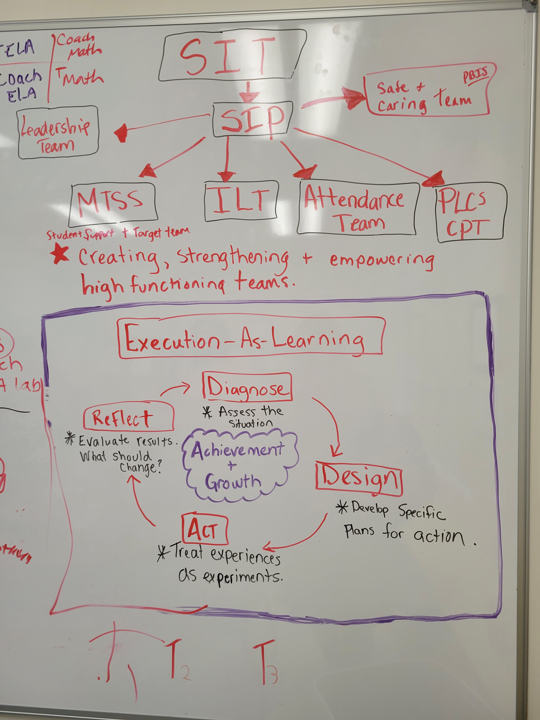
A School’s Analysis of Students Who Are
5+ Years Chronically Absent
Determining the Underlying Issues for Students 5+ Years Chronically Absent
Young Woods
Elementary School
SIT = school improvement team
SIP = school improvement plan
MTSS = multi-tiered system of supports
ILT = instructional leadership team
PLC = professional learning community
CPT = common planning time
Notes:
Before I pass this off to Kim, I wanted to share what is on her whiteboard in her office –and where her Attendance Team meets.
This outlines the connections to all of her main bodies of work.
We see here attendance team in the center – as part of their beating heart!

Slide 23
Finding Solutions & Building Capacity

Slide 24
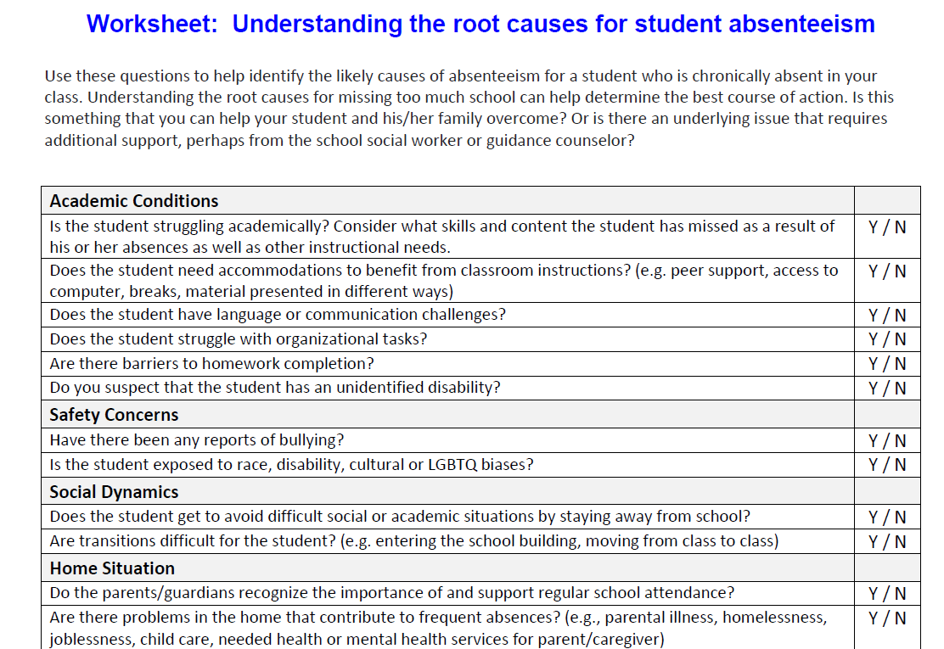
Student Interventions
School Team: Understanding the root causes for student absenteeism
See Root Causes for Student Absenteeism
How do you analyze the root cause of a student’s absenteeism?

Slide 25
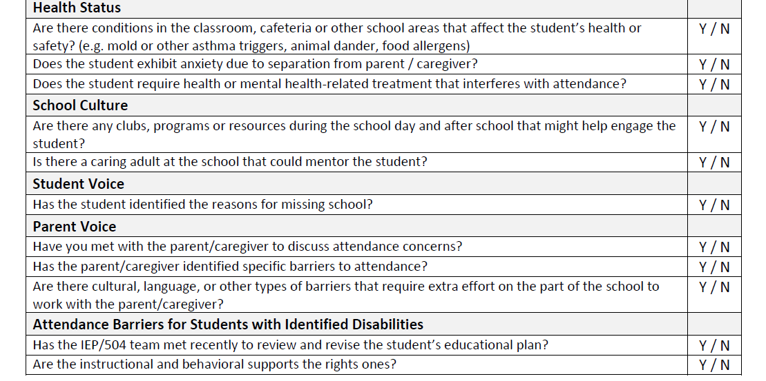
Student Interventions
School Team: Understanding the root causes for student absenteeism

Slide 26
A School’s Analysis of Students Who Are
5+ Years Chronically Absent
Determining the Underlying Issues for Students 5+ Years Chronically Absent
Young Woods
Elementary School
The students in this school that are chronically absent for 5+ years are:
66% Hispanic | 0% MLL | 100% FRL | 33% Differently abled
Process: The school MTSS/attendance team finds the root cause for student absenteeism. They identify the greatest areas of need for each student. Intervention plans are developed while the impact on learning is simultaneously analyzed. The school also has a significant focus (attendance initiative plan) on the prevention of absenteeism. This began with an audit of each tier.
Barriers | Aversion
Disengagement | Misconceptions
•Family responsibilities
•Chronic illness
•Trauma/ACES
•Lives in another town
•Struggling academically
•Struggling behaviorally
•Bus anxiety
Notes:
Takeaways & Trends
There is a need to have access to the prior year’s CA data by students for principals and teams at the beginning of the year. This will allow them to provide monitoring. It is also critical to the MTSS process to have this level of information for part of the screening process.
The process and needs – while this is focused on tier 3 students, we need to have all tiers in place for them to be successful. This year it began with an audit of what was in place and making sure that all critical areas were available at every level (see pyramid).
It is critical to have systems in place because otherwise we miss student and not be able to ensure success for all students.

Slide 27
A School’s Analysis of Students Who Are
5+ Years Chronically Absent
Determining the Underlying Issues for Students 5+ Years Chronically Absent
Scituate High School
The students in this school that are chronically absent for 5+ years are:
0% Hispanic | 0% MLL | 25% FRL | 25% Differently Abled
Barriers | Aversion
Disengagement | Misconceptions
Process: The school MTSS/attendance team finds the root cause for student absenteeism. They identify the areas of most need and then determine what intervention is needed for each student.
Financial and emotional struggles
Transportation
Anxiety
Impacted by suspensions and behavior
Social functioning is higher than others in class, but academic struggle
Likes trades not academics
Can still be successful with poor attendance
Absences will not add up
Will be pushed through the system – now not graduating
Notes:
Takeaways & Trends
There is a stigma with seeking social-emotional/mental health supports
Mental health supports (wrap-around – IE Tides) are not often available locally. Students and families need to travel 2 to 3 towns away. This is another barrier
Counselors and mental health professionals. do not want to become the attendance police and be the only ones to have difficult conversation with parents about needing to bring their child to school.
There are not enough resources in the school for mental health support – for example, sharing across the high school and middle school.
While making up work and retakes is best practice this also gives the message that it is okay to miss the work initially.
Policy and legislation will help. Need to make sure that policy and data practices are implemented with fidelity.

Slide 28
A School’s Analysis of Students Who Are
5+ Years Chronically Absent
Determining the Underlying Issues for Students 5+ Years Chronically Absent
Nowell Academy
The students in this school that are chronically absent for 5+ years are:
56% Hispanic | 4% MLL | 98% FRL | 17% Differently abled
Barriers | Aversion
Disengagement | Misconceptions
Family death
Trauma/ACES
Transportation
Anxiety
Mental health
Caretaker family member or child
Works full time
Homeless and family conflict
Depression, anxiety, mental health
Severe social anxiety
Process: The school attendance team finds the root cause for student absenteeism. They identify the areas of most need and then determine what intervention is needed for each student.
Each day a phone call is made (by a person) to any absent student.
Childcare
DCYF, mental health
Unclear/unknown – under review
Notes:
Takeaways & Trends
Each student needs to be individually analyzed and then have a specific plan outlined to meet their needs. It is like writing an IEP for each student.
Staff member is each assigned a student and helps to encourage their attendance. They make phone calls home to them on the day they miss.
A large focus on incentives.
Strong attendance team oversees this work.
Most students are chronically absent for multiple years. There is a need for more partnerships.
The entire schedule is developed so that if a student misses school then can quickly catch up and not be overwhelmed.

Slide 29
PART II: Using Research and Tools to
Build a Plan for Attendance Success
Welcome
Continuous Growth & Improvement
An Effective School Team to Improve Attendance
Attendance Teams at Work
Attendance for Success Act: Shifting to Prevention & Intervention
Wrap Up
29

Slide 30
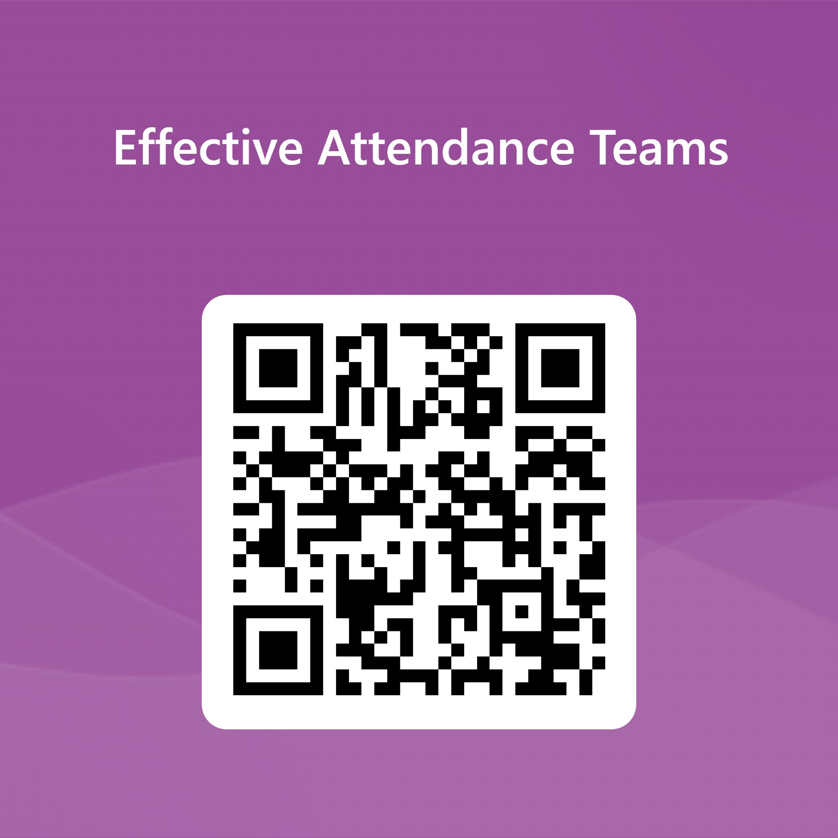
PART II: Using Research and Tools to
Build a Plan for Attendance Success
Link to Session Feedback Form
https://forms.office.com/r/KGhg7de4Dh

Slide 31
References & Appreciation
https://ride.ri.gov/students-families/attendance-matters-ri
https://www.attendancemattersri.org/about
https://www.attendanceworks.org/

