Slide 1
Overview of AcceleGrants/ABE Application Process Rhode Island Department of Elementary and Secondary Education May 13, 2016
Presenters:
David Luther Lisa Ellis
Phone: (401) 222-4652 Phone: (401) 222-8954
David.Luther@ride.ri.gov Lisa.Ellis@ride.ri.gov

Slide 2
What is AcceleGrants?
RIDE’s eGrants system
HMB, Inc – Westerville, Ohio
System currently used by 12 States
In use by RIDE since 2008:
Consolidated Programs (CRP)
Perkins/Vocational Education
Race to the Top (RTTT)
Various ARRA Programs
Web Site: http://gms.ride.ri.gov

Slide 3
Benefits of an eGrant Process
Reduces errors
Tracking of workflow and status
Improved fiscal controls
Improved communication
Easier access to additional resources/help
Faster application approvals
Timely distribution of funds
Access by public to grant information

Slide 4
AcceleGrants Major Features
Grant Applications
Grant Amendments
Expenditure Reimbursement Processing
Quarterly Expenditure Reporting (IER)
Final Expenditure Reporting (FER)
Performance Reporting
Custom Report Generation

Slide 5
Grantee System User Roles
Input Roles:
Program and Financial Input
Approver Roles:
ABE Program Coordinator
District Business Manager
District Superintendent (Authorizing Authority)
Administrator:
District System Administrator
Individual Users can be assigned one or more roles

Slide 6
Setting Up System User Accounts
Designate District System Administrator
System User Accounts
User Name – First Initial & Last Name
John Smith – JSMITH
User sets and re-sets own password
Information Needed
Name (First & Last)
Email Address
Phone Number
Fax (Optional)
Role or Roles to be Assigned in System
One User Account per Individual Please

Slide 7
Workflow
Ordered set of steps by which a funding application is submitted and approved
Workflow Steps:
Draft Not Started
Draft Started
Draft Completed
ABE Coordinator Approval
Business Manager Approval
Authorized Representative Approval
RIDE Program Officer Approval
RIDE Fiscal Officer Approval
RIDE Final Approval

Slide 8
Document Library
Two Areas (1) Agency/RIDE & (2) Grantee
(1) Repository for additional information
Guidance Documents
Supplemental Forms
Links to web-based resources
(2) Allows Districts to upload documents outside of application but within AcceleGrants
ABE Quarterly Program Reports

Slide 9
ABE Application
Grantees may receive Adult Education funding from one or more funding sources:
WIOA-ABE
EL Civics
JDF
General Revenue
WIOA-ABE, EL Civics, JDF, and General Revenue will only require the completion of each funded budget section.
Most of the Application found in Local Match Section
Match Budget
Basic Program Information Guide
Important Documents
Review Details

Slide 10
FY 2017 Adult Education Application Timeline
FY 2017 Application should be available to begin work on or about Tuesday, May 17th.
Check Address Book to Insure that your agency system users are loaded and correct.
Select Fiscal Year 2017!
Change/Move Application Status to “Draft Started”
Grantees can begin to completed the “Basic Program Information Guide”
Grantees can download Important Documents, complete and upload into Related Documents Section of AcceleGrants
Estimated Match Budget available for input
25% of FY 2016 Total Funding Level

Slide 11
FY 2017 Adult Education Application Timeline Continued
On or Before June 10, 2016 – ABE, EL Civics, JDF, and General Revenue Allocations will be loaded into AcceleGrants. Total Required Match will be recalculated and loaded into AcceleGrants
Complete all funded budgets and Basic Program Information Guide and upload all necessary documents into related documents sections.
Application Due Dates:
June 24th (For Applications with Summer Activities)
July 25th (For Applications without Summer Activities)
Ensure that no system errors exist
Warnings okay
Move Application status to District Superintendent/Authorized Approved
Application Submitted to RIDE!
RIDE Program and Fiscal Reviews Begin
Substantial Approval Letters Issued (as Necessary)

Slide 12
FY 2017 Adult Education Application Timeline Continued
Grantees - Check Review Details Page
Grantees - Respond to RIDE Reviewer Questions in Review Details Page
If application is returned to applicant agency, make changes based upon the reviewers comments
Move status back to District Superintendent/Authorized Agent Approved!
RIDE Program and Fiscal Reviewers okay Application
Final Approval by RIDE’s ABE Coordinator
Status moved “RIDE Final Approved”
Notification of Grant Award Issued to Grantees
Grantees can commence expenditure reimbursement process after application is final approved by RIDE
Complete Quarterly Expenditure Reports
Due 15 days after the end of each Quarter

Slide 13
FY 2017 Adult Education Application Timeline Continued
Complete Quarterly Program Reports
Download Reports from Application in AcceleGrants (Part of Important Documents Section)
Upload completed Reports to Document Library (Grantee Section)
Submit Amendment to Approved Application (Optional)
RIDE will provide timeline and guidance for Amendment Requests
When submitting an amendment, system will create a copy of the approved application.
Make changes as necessary
System will flag all changes made with a delta symbol
Submit same way as initial application (District Superintendent/Authorized Agent Approved)
June 30, 2017 – FY 2017 Project Period Ends
By June 30, 2017 Request all outstanding reimbursements
No Later than August 15, 2017 Complete Final Expenditure Report (FER) Due
Due 15 days after closeout of all outstanding obligations

Slide 14
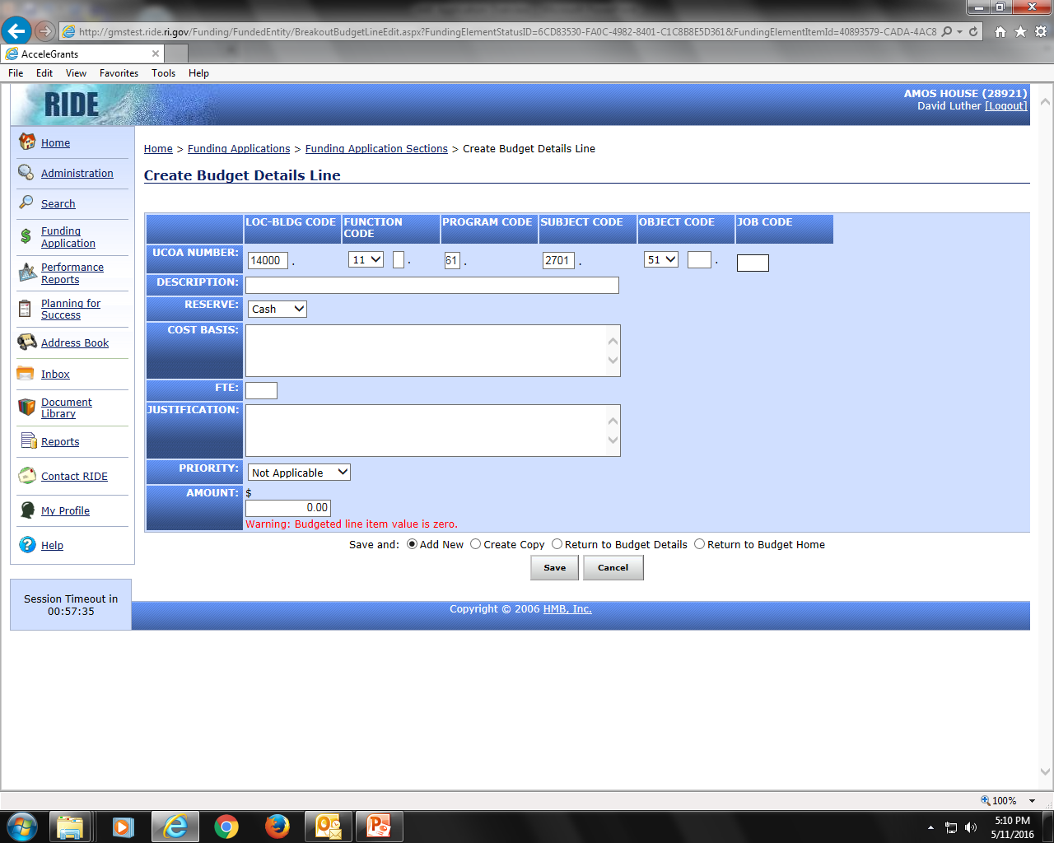
Budget Details Screen Shot

Slide 15
Building an Approvable Budget
Budget Details – Make Clear & Concise
Description: (What) is being paid for
Cost Basis: (How) total cost was determined (rate, units, time frame)
Justification: (Why) describe/link back to program
Identify # of FTE’s for Salaried Personnel and their related benefits only
Budget items must be allowable, reasonable, necessary, and allocable.
Reserves
Match – Cash or In-Kind
ABE, EL Civics, JDF, General Revenue – Unassigned or Administration

Slide 16
Building an Approvable Budget
Combine Benefit Costs for each Compensation line.
Include Taxes (FICA/Medicare) on Substitutes & Stipends
# FTE’s Salary = # FTE’s Fringe Benefits
Indirect Cost Rates
Must have approved rate loaded into system in order to recover indirect costs
Provide RIDE with copy of approved indirect cost agreement
Indirect Costs are an Administrative Cost
Budget Copy Function Available Next Year (2017 into 2018)
Need additional guidance? Budget and UCOA Guidance Documents are located in Document Library

Slide 17
Helpful Hints
User Account Management – Log-in/Log-off
Save your work! – Don’t get timed out!
Check for system validations – Errors & Warnings
Know the status of your application
Check review status – Review Details Page

Slide 18
Need Assistance?
For ABE Application Program Related Technical Assistance contact:
Kim Chouinard
Nancy Labonte
Philip Less
For ABE Application Fiscal Related Technical Assistance contact:
Lisa Ellis
For AcceleGrants System Related Technical Assistance contact:
David Luther
Billy Trimble

