Slide 1
A Brief Outline of RIDE’s Attendance Tools
Spring 2024

Slide 2
Student Attendance and Academic Success Planning
What tools are available to support our work to reduce chronic absenteeism?
What are the reasons students are chronically absent?
What is chronic absenteeism?
How can we shift from a punitive approach to prevention and intervention?

Slide 3
RIDE Data Tools
New and enhanced data tools provide a comprehensive overview of attendance and absenteeism rates across a variety of demographics and feature real-time reporting capabilities and interactive visualizations.
With detailed data analysis, schools and other stakeholders can pinpoint the students most at risk of chronic absenteeism and develop targeted interventions to address their unique needs.
3

Slide 4
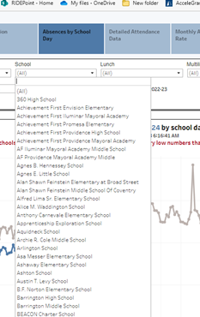
Reminders for Using RIDE Data Tools
Most tools have a filter
4

Slide 5
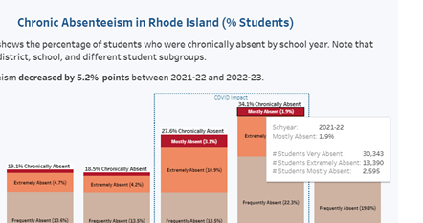
Reminders for Using RIDE Data Tools
Menus pop out when you hover over
5

Slide 6
Reminders for Using RIDE Data Tools
There are various tools at the bottom of the interactive visualizations:
Undo
Redo
Reset view
Refresh data in this view
Replay animation
Choose format to download
See in full screen
Share
6

Slide 7
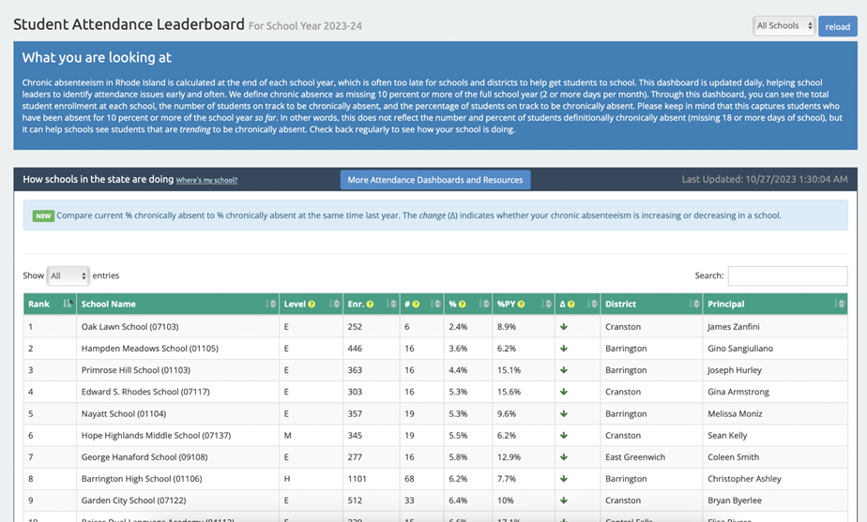
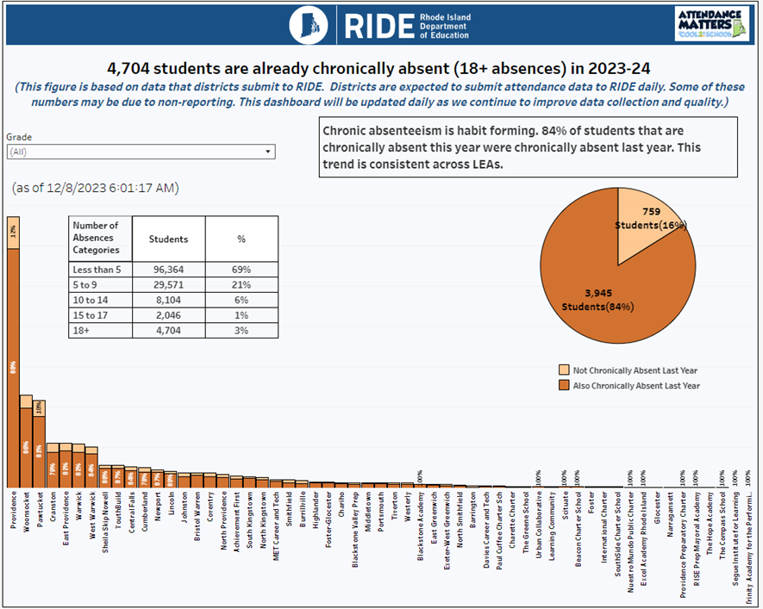
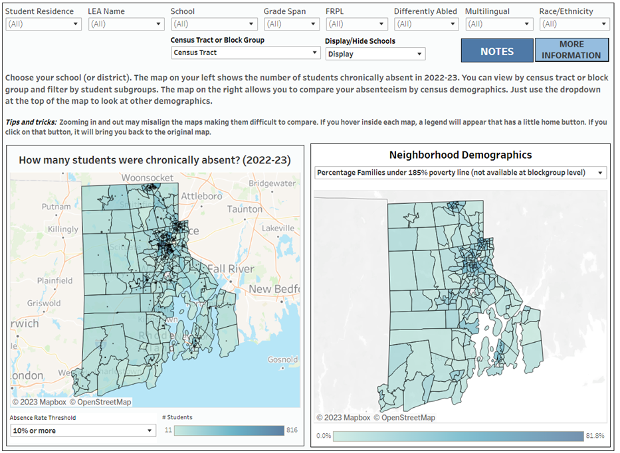
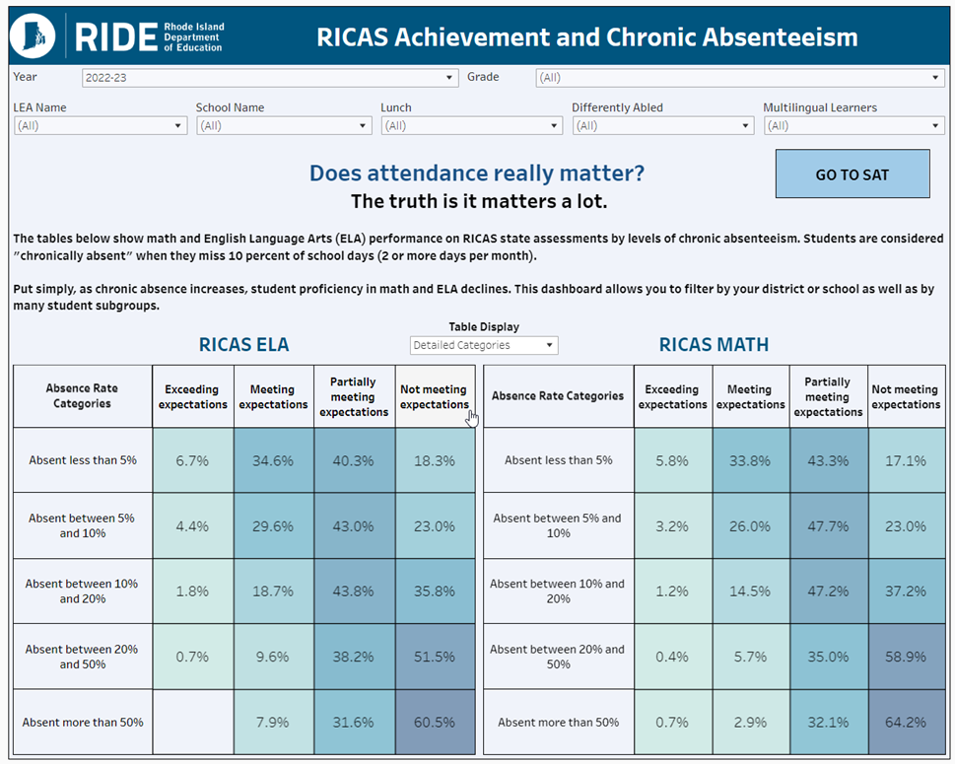
Attendance Tools
RIDE has developed multiple dashboards to help the Rhode Island school community understand, explore, and address chronic absenteeism.
Attendance Leaderboard | Daily Chronic Absenteeism Update
Updated daily to help address chronic absenteeism early and often | Students that are already chronically absent this year AND were last year
Attendance Community Dashboard | Chronic Absenteeism and Achievement
Examine chronic absenteeism by census tract or block group while filtering by various demographics | View the impact of chronic absenteeism on state assessments

Slide 8
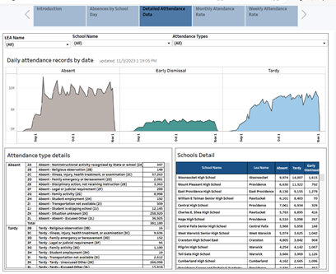
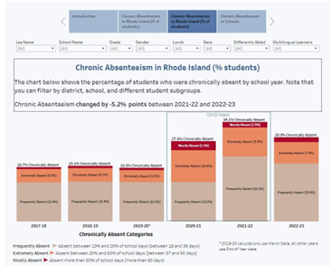
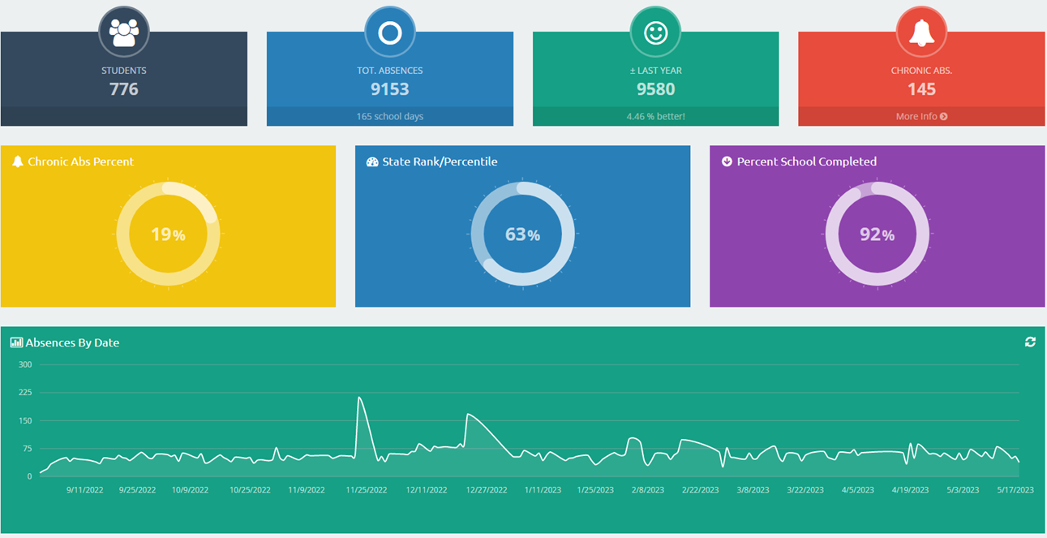
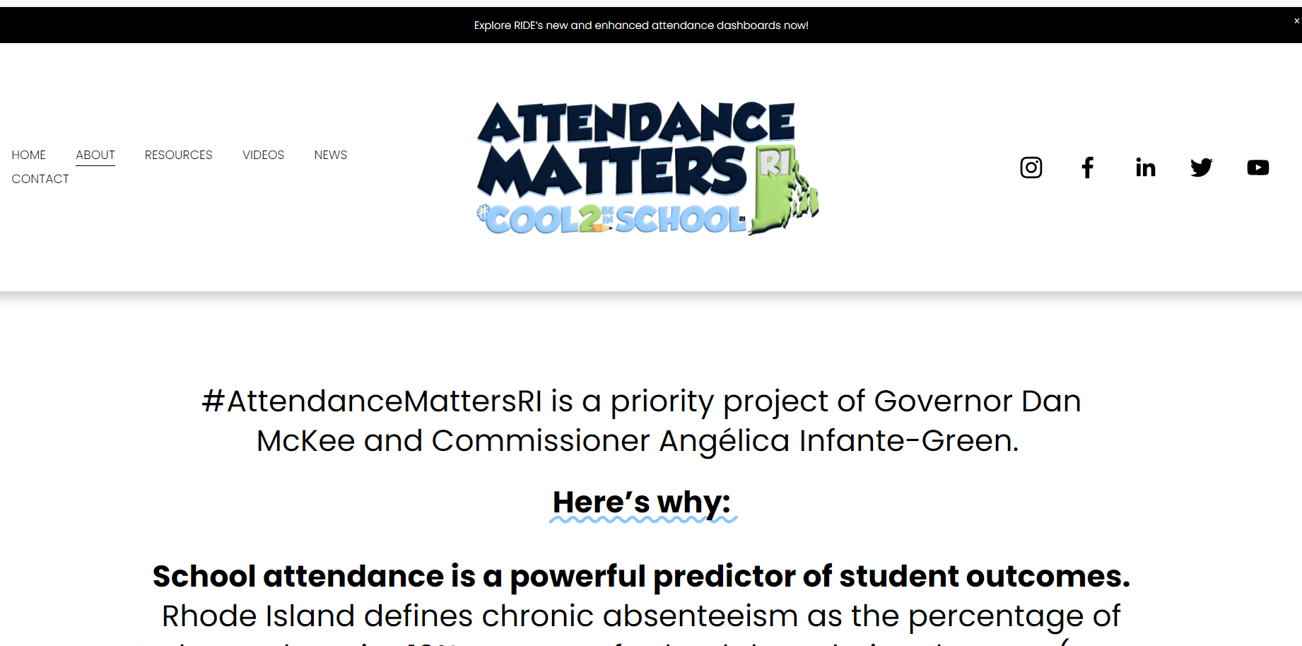
Attendance Tools
Real Time Attendance Dashboard(s) | Historical Absence Dashboard(s)
Various ways to analyze by time frames, subgroups, and trends | Explore information overtime by percent and number by school, LEA, and RI
The Nudge Tool | RIDE Attendance Matters website
Mobile app that allows school leaders to communicate with families | Learn about the latest tools, resources, and collective efforts
Link to Attendance Tools Deck
Link to Recorded Webinar

