Slide 1
Evidence Based Research Training Rhode Island Department of Education February, 2023
Notes:
Activity Option- Give scenario and they complete the chart.

Slide 2
Agenda
Today’s purpose:
Understand ESSA’s definition of evidence-based research
Understand the tiers of evidence-based research
Understand importance of evidence-based research and how it connects to the Title II Funding Application
Identify Title II, Part A allowable activities that require rigorous and relevant evidence

Slide 3
Meet the Title II Team

Slide 5
Clarifying the Why
The Title II Team’s goal is to get you to YES!
Why does this matter?
Evidence Based Research
Why should they care?
Where does the information? – Recommend it is going in the document library
Monitor-
Succession Planning/ Knowledge Management

Slide 6
Federal Funding Programs in the CRP
IDEA Programs
IDEA, Part B
IDEA, Preschool
ESEA Programs
Title I, Part A
Title II, Part A
Title III
Title IV, Part A
6
Notes:
We are specifically referencing the Title II Part A portion of the Consolidated Resource Program today, but it’s good practice to go back to the research any time you are implementing activities in your school as part of your strategic planning process to ensure that there is a statistically significant outcome for the proposed activity/ intervention.
Can anyone tell me what ESEA or IDEA means? – ESEA- Elementary and Secondary Education Act and Individuals w/ Disabilities Education Act.

Slide 7
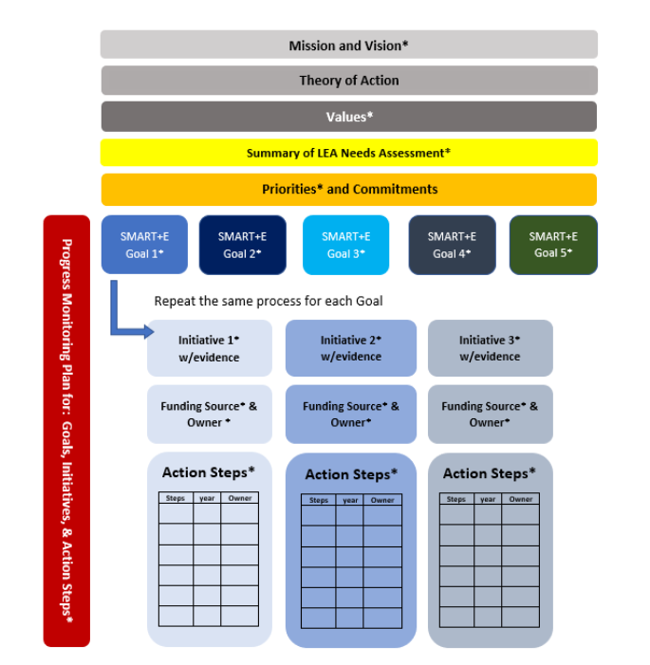
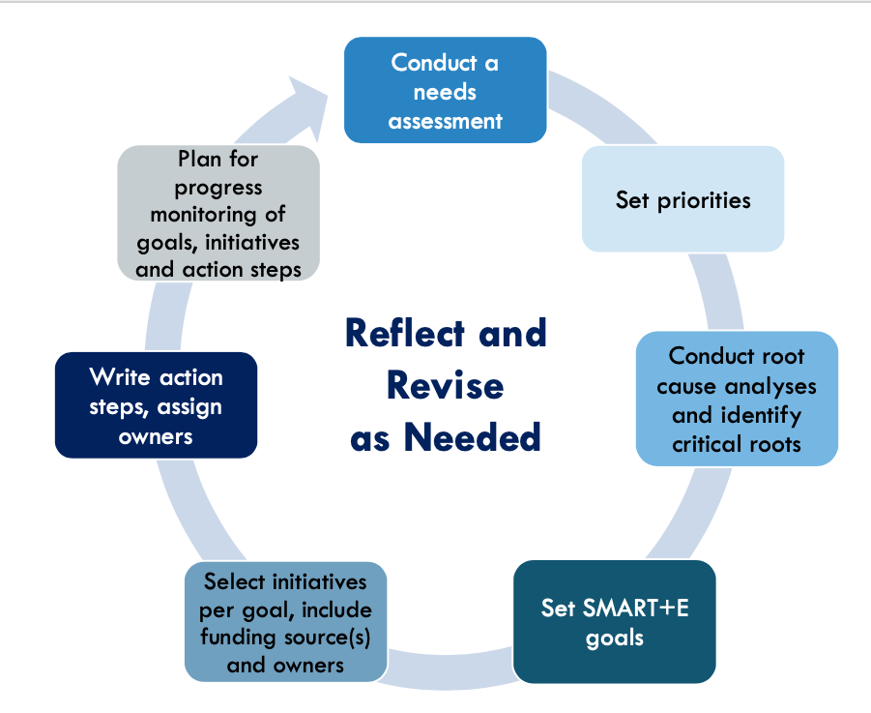
Anatomy of a Strategic Plan
Notes:
The Strategic Planning Process is meant to guide your school community with taking a step back, zooming out big picture to understand all of the activities related to teaching and learning taking place within your school, and then make revisions to change activities and initiatives as needed based on what you see in the data.
Within the Strategic Planning Process, evidence-based practices are selected at the Initiatives/Goals stage. As your team works to set SMART goals based on priorities and commitments, you must have evidence to justify the need as well as researched evidence-based practices that, can ensure a high likelihood of success during implementation. Big Picture: The goal here is to strengthen the effectiveness of the initiatives by going back to the research, and particularly finding activities that have been investigated in well designed studies of over 500 participants that have shown a statistically significant positive effect on student achievement.
Where are we? Where do we want to go?
Evaluate current practices:
What is working and needs to be continued?
What is NOT working and needs to be changed/eliminated?
Identify NEEDS before determining strategies
Identify available data sources to determine needs: division, school, and classroom level
What evidence is available to support implementation of strategies?

Slide 8
Required Uses of Funds: Equitable Access
The Title II, Part A program is designed, among other things, to provide students from low-income families and minority students with greater access to effective teachers, principals, and other school leaders.
LEAs MUST:
Describe the LEA plan to identifying equity gaps
Describe how disparities will be addressed (induction for teachers, principals, or other school leaders, systematic coaching on academic instruction or leadership development)
Submit annually within the CRP (LEA Part I section)
SEA may deny Title II funding, if description is not submitted
Notes:
Provide a description of the local educational agency’s systems of professional growth and improvement that describes how educators receive access to learning that is sustained over time, relevant to their context, and clearly linked to improved student outcomes and building leadership capacity.
Examples include induction for teachers, principals, or other school leaders, systematic coaching on academic instruction or leadership development, and well-structured team-based learning opportunities.
Describe the plan established by the district to gather and review data that will identify any disparities that result in low income students and minority students being taught at higher rates than other students by ineffective, inexperienced , or out area teachers, and how those disparities will be addressed.
Describe the district or school priorities areas that were identified through your comprehensive needs assessment and can
equity gaps disparities that result in low income students and minority students being taught at higher rates than other students by ineffective, inexperienced , or out area teachers
minority and low-income students are provided access to effective teachers, administrators and other school leaders
Ineffective
Any teacher who is not performing at a consistently high level as evidenced by Final Effective Ratings or has received an Ineffective Rating within the last 3 years.
Out of Field
Any teacher who does not hold the appropriate Initial, Professional, or Advanced Certificate for an assignment.
Inexperienced
Any teacher who has 0-3 years of prior working experience in a public school.

Slide 9
Determining the Allowability of a Title II-A
Step 1
Step 2
Step 4
The cost of an activity allowable under the Title II, Part A-Program;
It is reasonable and necessary for performance of the grant, and
It is allocable to the grant.
The activity aligned to one or more of the 4 pillars (purpose) of Title II, Part A-Program.
The activity allowable under Title II, Part A-Program,
there is evidence-based research that indicates effectiveness.
is based on data and data sources, and
Step 5
The activity:
is not prohibited in ESEA;
is not required for federal, State or local laws; and
was not paid for with State, Local, or other Federal funds in the previous year.

Slide 10
LEA Grant Eligibility: Title II-A
Who is eligible?
Teachers, paraprofessionals, principals, and other school leaders
How are funds awarded?
Grants are awarded to local school districts through a state grant application (CRP) process
The amount of funding varies based on
Total number of qualifying students statewide and
Federal funds available for each fiscal year
Funds are awarded by formula to each local school system.
ESEA section 2102(a)
Notes:
. The term “other school leaders” is defined in Section 8101(44) as a principal, assistant principal, or other individual who is:
An employee or officer of an elementary school or secondary school, local educational agency, or other entity operating an elementary school or secondary school; AND
Responsible for the daily instructional leadership and managerial operations in the elementary school or secondary school building.

Slide 11
Defining Evidence Based Practices

Slide 12
Every Student Succeeds Act Evidence Based Practices
The federal Elementary and Secondary Education Act (ESEA) requires LEAs to have an approved LEA Plan on file with the State to access their federal funds. It also emphasizes identification of evidence-based practices to support a high likelihood of success for implemented interventions.
The Every Student Succeeds Act (ESSA) emphasizes the use of evidence-based activities, strategies, and interventions (collectively referred to as "interventions"). The term 'evidence-based,' (from section 8101(21)(A) of the ESEA) when used with respect to a State, local educational agency, or school activity, means an intervention that demonstrates a statistically significant effect on improving student outcomes or other relevant outcomes.
12
Notes:
KD

Slide 13
Evidence-Based Research Tiers
Tier 1
Tier 2
Tier 3
Tier 4
At least 1 well designed/well implemented correlational study with statistical controls for selection bias
Demonstrates rationale (Logic Model + Research + Effort to Study (i.e., logic model)
At least one well designed/well implemented experimental study (i.e., randomized)
At least 1 well designed/well implemented quasi-experimental study
(i.e., matched)
13
Notes:
There are Evidence Based research tiers that correspond with the kind of research that you can reference when planning your strategic initiatives. Tiers 1-4 are shown here and I will spend some time unpacking each of these.

Slide 14
Evidence-Based Research Tiers
Notes:
Here is another visual of the evidence-based research tiers. The pyramid represents the fact that Tier 4 research is most commonly referenced, but we should all be striving towards the Tier 1 research.

Slide 15
Activity: Title II-A Evidence-Based Research Search How might our LEA use Title II-A funds to support an LEA initiative?
You will be provided with a list of common Title II interventions.
As a team, take 10 minutes to find an evidence-based research article that aligns with the intervention.
Identify which research tier your article would align to.
Complete the template to answer the following for your article (10 min):
What is being implemented? Who is implementing?
In what setting(s)? At what time(s)?
To which students? And for what cost?
Are the results statistically significant?
Does the study attend to any groups of students that might be underserved or require additional supports?
Notes:
Title II: Yellow marker
Title III: Orange marker
Title VI: Pink marker

Slide 16
Title II, Part A
Theory to Practice
Monitoring and Evaluation

Slide 17
Purpose: Title II-A
Title II-A funds can be used to support:
Increase student
achievement
Improve effectiveness
of teachers,
principals and
other school leaders
Increase the number of effective
teachers,
principals and other school leaders
Provide low-income & minority students greater access to effective teachers,
principals and
other school leaders
.
Services must be supplemental and based on a needs assessment, with input from stakeholders.
ESSA, Section 4101

Slide 18
Purpose: Title II-A
Title II-A activities must always be:
Consistent with Title II purpose
Reasonable, Necessary and Allocable
Sustainable
Address the Learning Needs of all Students
Services must be supplemental and based on a needs assessment, with input from stakeholders.
ESSA, Section 4101

Slide 19
Allowable Uses of Funds: Title II-A
Coaching
Learning Communities
Principal Leadership
Teacher Leadership
Induction
Mentoring
Academic Content
Recruit & Retain
Evaluation Systems
Teaching of MLL, students with disabilities, and Early Childhood students
STEM
Formative assessment
Trauma/mental illness
Gifted students
Library programs
Recognize/prevent sexual abuse
CTE and work-based learning
Class Size Reduction
Early Grades
ELL
Students with Disabilities
Notes:
Are an integral part of school and LEA strategies for providing education … with the knowledge and skills necessary to enable students to success in a well-rounded education and to meet challenging State standards
AND
Are sustained (not stand alone, 2-day, or short-term workshops) intensive, collaborative, job embedded, data driven and classroom focused
S. 1177, Section 8002, page 295, paragraph 42

Slide 20
Title III
English Language Acquisition

Slide 21
Supplement Not Supplant: Title II, Part A
Instances when it is presumed that supplanting has occurred:
If the LEA uses Title II-A funds to provide services that it was required to make available under other federal, state or local laws
or
If the LEA uses Title II-A funds to provide services that it provided with non-federal funds in the prior fiscal year.
Ask Yourself?
Is the activity required by Federal, State, or Local law?
Was the activity paid for with State, Local, or other Federal funds in the previous year?
If the answer to both is no, then funds are most likely supplemental.

Slide 22
Purpose: Title III
Title III funds are:
Supplemental funds available to local school districts
Based on the number of MLL students enrolled in the district and in Private Schools located in the district
To ensure that these students are prepared to meet the English language proficiency standards
and the same challenging state academic content and grade level performance standards expected of all other students

Slide 23
Cross Cutting Grant Requirements

Slide 24
Assurances
The CRP provides LEAs with an opportunity to maximize and coordinate federal resources to improve student achievement.
​The CRP contains unique assurances for each program.
LEAs must review, sign and commit to implementing these requirements every year.

Slide 25
Common LEA Plan Elements
Data
Comprehensive Needs Assessment
Stakeholder Input
25
Notes:
Talking points
These 3 components are requirements between Fed Programs & EAA requirements
Data comes from two sources, depending on the federal program:
Some is provided by RIDE including through the SPS, SurveyWorks and IDEA data
Other programs are also informed by local data sources two fold – RIDE provided and LEA

Slide 26
Transferability
Transfer from:
Transfer to:
Title II-A
Title I-A
Title III
Title IV-A
Keep in mind, LEAs:
Must conduct their needs assessment and begin equitable services consultation before making any decisions about transferring funds.
May then choose to transfer some, or all, of their funds from eligible programs, based on needs identified for improving student achievement.
Transferred funds must then meet the requirements of the program which they are transferred into, including equitable services requirements.
Title IV-A
Title I-A
Title II-A
Title III
Title I-A and Title III funds may not be transferred to other programs.
26
Notes:
LEAs must conduct their needs assessment and begin equitable services (in order to consider the needs of eligible private school students) before making any decisions about transferring funds.
LEAs may then choose to transfer some, or all, of their funds from eligible programs, based on needs identified for improving student achievement.
Transferred funds must then meet the requirements of the program which they are transferred into, including equitable services requirements.
Several districts chose this option last year –
Another thing to keep in mind is that funds need to be spent if you are transferring them to another Title.
Goal is to budget and expend all the funds each year.
Within the consolidated application, LEAs may transfer up to 100% their Title IV, Part A allocation to the following programs:​
Title I, Part A – Disadvantaged Youth
Title II, Part A – Supporting Effective Instruction​
Title III, Part A – English Language Acquisition​
Title IV, Part A – Student Support and Academic Enrichment​
Funds cannot be transferred out of TIPA or TIII​
An LEA, after consulting with appropriate private schools officials, must provide equitable services to private school students and teachers based on the rules of each program and the total amount of funds available to each program after a transfer.​
Note: Funds must be billed to TIVA

Slide 27
Well-Rounded Education in ESEA
ESEA shifted program focus from “core academic subjects” to providing a “well-rounded education.”
ESEA defines well-rounded education as courses, activities, and programming in subjects such as:
English,
reading or language arts,
writing,
science,
technology,
engineering,
mathematics,
foreign languages,
civics and government,
economics,
arts,
history,
geography,
computer science,
music,
career and technical education,
health, physical education, and
any other subject, as determined by the state or local educational agency, with the purpose of providing all students access to an enriched curriculum and educational experience.
ESEA Sec. 1114(b)(7)(ii); 1115(b)(2)(a)
27

Slide 28
Evidence Based Practices
Title I-A
Title II-A
LEAs must conduct, with the meaningful involvement of parents and family members of participating Title I-A students, an annual evaluation of the content and effectiveness of the parent and family engagement policy in improving the academic quality of all Title I-A schools.
LEAs must use the findings from this to design evidence-based strategies for more effective parental involvement.
Allowable Evidence Tiers: 1, 2, 3 and 4.

Slide 29
Professional Development
Title III
Title II
ESSA defines professional development as activities that are sustained, intensive, collaborative, job embedded, data-driven, personalized or based on information from an evaluation and support system, and classroom-focused.
Title II, Part A funds cannot be used to support stand alone, discreet professional development that does not connect to a larger school-wide or individualized plan.
Improves instruction and assessment of MLLs
Enhances ability of teachers and principals to implement curricula, assessment measures and practices, and instructional strategies for MLLs
Increases English proficiency or subject matter knowledge, teaching knowledge, and teaching skills of teachers of MLLs
Is of sufficient intensity and duration to have a positive and lasting impact on the teachers’ performance in the classroom.
LEAs may also use Title I-A, Title IV-A and IDEA funds to support professional development activities.
Notes:
Great place to provide an example for braiding funds – give an example here.
Grab from – as long as aligned with an identified need in LEA and / or swp
Build a sample – Title III what: if district is training on new required HQ math curriculum with Title II and I, Title III could support additional math needs such as training on an MLL Math intervention on the language of math, afterschool supplemental co-planning time between teachers of MLLs and math teachers, etc. Title III cannot pay for a prorated portion of the required math currico-rate the initiative. Support LIEPs – language instruction education programs
ulum PD.

Slide 30
Parent and Family Engagement
Title III
Title I, Part A
LEAs with allocations of $500,000 or more must spend at least 1% of their Title I-A funds on activities to assist families in improving student academic achievement.
Parent, family, and community engagement activities that enhance or supplement LIEPs for MLLs are required.
Community may include the local and extended network of organizations that exist to support the student and family and can include private, non-profit, for-profit, or faith-based organizations.
Families may include relatives involved in the social, emotional, and academic support of the student; it expands beyond parents and guardians to include siblings, grandparents, aunts, uncles, cousins and others.
LEAs may also spend funds to support parent and family engagement under Title IV-A and IDEA.
ESEA encourages LEAs to coordinate their
parent and family engagement efforts.
Notes:
Not duplicating – coordination of funds
Just be careful with Title III - a series of parent sessions in the home language on supporting students in math concepts or other initiative. Layer on top for parents of MLLs, don't pr
The LEA must then use the findings from the annual evaluation to design evidence-based strategies for more effective parental involvement, and revise, if necessary, the LEA parent and family engagement policy.
o-rate the initiative. Support LIEPs – language instruction education programs

Slide 31
Equitable Services for Private Schools
LEAs must follow the individual program rules and use funds to provide equitable services to eligible students, teachers and families for all of programs in the CRP.
For Titles II, III, IV-A, IDEA, Part B and Preschool - LEAs must consult with all private schools within district boundaries regardless of student’s district of residence.
For Title I-A - Funds and services follow resident students, including those attending private schools outside of the district boundaries.
Note: These requirements are not applicable to State run charter schools.
Notes:
Talking Point
Upcoming training for Equitable Services
Talking point – this does not apply to charter schools or LEAs that do not have private schools within LEAs.

Slide 32
Equitable Services Ombud
The State-designated Ombud monitors and enforces private school consultation and equitable service requirements to help ensure equitable services are provided to private school children, teachers and other educational personnel. Rhode Island’s designated Ombud is:
Anthony Cottone Rhode Island Department of Education 255 Westminster Street Providence, RI 02903
(401) 222-8933 ombudsman@ride.ri.gov
Please note: If private school officials believe the district did not meet consultation or other requirements, they may file a complaint with RIDE.

Slide 33
Allowable Costs
For all grant programs, funding requests must be:
Allowable under individual program rules.
Necessary for the proper and efficient performance of the program.
Reasonable in that it would be a cost that a prudent person would incur under similar circumstances.
Allocable to the program, such that the program must benefit in proportion to the amount charged to the federal program.
Authorized, or otherwise not prohibited, by federal, state or local rules.
Documented to justify all fiscal and program requirements.
2 CFP Part 200, Subpart E

Slide 34
ESEA Prohibitions
ESEA funds may not be used:
for construction, renovation, or repair of any school facility, except as authorized under this Act;
for transportation unless otherwise authorized under this Act;
to develop or distribute materials, or operate programs or courses of instruction directed at youth, that are designed to promote or encourage sexual activity, whether homosexual or heterosexual;
to distribute or to aid in the distribution by any organization of legally obscene materials to minors on school grounds; to provide sex education or HIV-prevention education in schools unless that instruction is age appropriate and includes the health benefits of abstinence;
to operate a program of contraceptive distribution in schools; or
for the provision to any person of a dangerous weapon or training in the use of a dangerous weapon.
Notes:
Talking Point
IDEA does not contain a list of specific prohibitions.

Slide 35
Activity: Braiding Funds to Support Students
Using a new LEA initiative and action steps, consider how the LEA might use funds from Titles I, II, III, IV-A and IDEA funds to support their initiatives and/or action steps?
Review the provided LEA Plan with you table partner(s).
Discuss how funds could be used or “braided”.
Use the following marker colors to highlight potentially fundable activities:
BLUE for Title I-A
YELLOW for Title II
ORANGE for Title III
PINK for Title IV-A
GREEN marker for IDEA
Notes:
Title II: Yellow marker
Title III: Orange marker
Title VI: Pink marker

Slide 36
Questions?

Slide 37
Additional Resources

Slide 38
Grants Team Contact Information: Title II, Part A
Mary Keenan 222-8497 Mary.keenan@ride.ri.gov | Barrington, Beacon, Blackstone Academy, Bristol-Warren, Burrillville, Chariho, Compass, Coventry, EWG, Foster, Foster-Glocester, Glocester, Greene, Highlander, International, Jamestown, Learning Community, Lincoln, Little Compton, Middletown, Narragansett, New Shoreham, North Providence, Nowell, Providence , Providence Prep, Segue, Smithfield, Warwick, West Bay, Westerly
Katie Jones 222-8174 Katie.jones@ride.ri.gov | Blackstone Valley Prep, Central Falls, Charette, Cranston, DCYF, East Greenwich, East Providence, Hppe, Johnston, Kingston Hill, MET, Newport, North Kingstown, Paul Cuffee, Portsmouth, RINI, RISE, Scituate, South Kingstown, Southside, TAPA, UCAP, Village Green, West Warwick, Barrington, Bristol-Warren, Burrillville, East Greenwich, and North Smithfield
Hilda Portzeba 222-8891 Hilda.Potrzeba@ride.ri.gov | Achievement First, Cumberland, Davies, North Smithfield, Pawtucket, Portsmouth, RI School for the Deaf, South Kingstown, Tiverton, and Woonsocket
Notes:
Appropriate EBR
Understand the Tiers
Why does it matter?
Why should they care?
Where does the information? – Recommend it is going in the document library
Monitor- and no research articles we will do a 1:1
Local – Google Drive/ Document Library
Succession Planning/ Knowledge Management
Title II Session Draft Feb2023

Slide 39
Grants Team Contact Information: Fiscal
Grant Officers
Lisa Ellis
Phone: 222-8954
e-mail: lisa.ellis@ride.ri.gov
Crystal Martin
Phone: 222-8482
e-mail: crystal.martin@ride.ri.gov
Dalila Townes
Phone: 222-8171
e-mail: dalila.townes@ride.ri.gov
Anthony Vescera
Phone: 222-4653
e-mail: anthony.vescera@ride.ri.gov
Finance Director
Mark Dunham
Phone: 222-4647
e-mail: mark.dunham@ride.ri.gov
Federal Grants Administrator
David Luther
Phone: 222-4652
e-mail: david.luther@ride.ri.gov

