Slide 1
School Improvement Plan Review & Feedback
Important Note for the Deck Use:
Please use in PRESENTATION VIEW as the animations are an essential part of the overview.
Using the Review Tool
April 2024

Slide 2
Using the Review & Feedback Tool
School Improvement Planning

Slide 3
Table of Contents
4
Background
A description that explains why the tool is needed & how it will be used.
15
High-Impact Components
The critical components used so the plan can support the purpose.
6
Tool Design
The layout and design of the tool.
16
Providing Actionable Feedback
Guidance to provide feedback through actionable responses.
7
Quality Indicators
The rating criteria that will be used to score each component.
40
Stepping Through a Review
The suggested process to review a plan.
8
Components
The elements of the tool.
41
Resources & References
The RIDE resources and research used to develop the tool

Slide 4
The Education Accountability Act (EAA) was passed in 2019. This requires all schools to have a School Improvement Plan (SIP) that is specific to the school’s needs and context. Schools must have their SIP entered within the Strategic Planning System (SPS) so that it can be approved by their superintendent no later than July 1 each year. Each LEA and school have been provided with clear guidance, resources, and supporting documentation to meet this requirement. In addition, workshops, technical assistance, tools, and templates have been provided. This tool will assist in the review of a school’s improvement plan and inform this continual cycle of reflection and growth.
Background

Slide 5
About this Tool
The tool can be used for several purposes:
This tool will be used to assist in the Superintendent's review of the submitted school improvement plans and to provide feedback to help inform a continual cycle of reflection and growth.
The tool may also be used as a self-assessment tool for Principals and School Improvement Teams.​
This tool will also be used by RIDE Office of School and District Improvement to review and provide feedback to the Comprehensive Support and Improvement (CSI) School Plans.
The tool is built using the following requirements:
* indicates a required component for School Improvement Plans.
^ indicates a requirement per RI Regulation and General Law, including the Education Accountability Act (EAA)
^^ indicates a requirement per Federal law, including the Every Student Succeeds Act (ESSA) and Titles I, Part A; II, Part A; and IV, Part A (when the plan is being used to fulfill the grant requirements)

Slide 6
Review and Feedback Tool Design
The review and feedback tool has 17 components and descriptions. Each component will be independently reviewed as meets, does not meet, or is not applicable (N/A). Feedback should be provided in the form of positive notes, required actions, and/or recommendation notes. Feedback could be used for plan revision, action planning, and/or future plan development.
Recommendation Notes will be provided for consideration of evidence-based best practice or future plan considerations.
Required Actions will be based on elements outlined in EAA (^) and previously shared with schools as requirements. In addition, they are requirements (*) in SPS.

Slide 7
Review and Feedback Tool Quality Indicators
The components of the plans will be reviewed using clear indicators:
Does Not Meet
Meets
N/A
Required Action(s) should be provided for any component that receives a Does Not Meet Criteria
A positive note(s) or recommendation note(s) should be provided for each component that receives a Meets Criteria
No comments are provided when N/A is identified

Slide 8
Review and Feedback Tool Components
The seventeen components of the plans that will be reviewed are listed below:
1) General Guidance
8) Summary of Needs Assessment
9) Priorities
10) Measurable Goals
11) Progress Monitoring/Target & Annual Action Plan Requirements
2) Length of Implementation
6) Theory of Action
3) Stakeholders
4) Mission
5) Vision
15) Report Card Low Performing Student Group(s) & Reason(s)
7) Values
16) Professional Development
13) Action Steps
12) Initiatives
14) Report Card Focus Area(s)
17) Providing Students with Assistance Needed

Slide 9
Review and Feedback Tool Components
The first seven components are the Informative Inputs. They provide the plan’s foundation and should be strongly aligned with each other.
General Guidance
Length of Implementation
Theory of Action
Stakeholders
Mission
Vision
Values

Slide 10
Review and Feedback Tool Components & Brief Descriptions
Informative Inputs provide the foundation and should be strongly aligned
General Guidance
Length of Implementation
Stakeholders
Mission
Vision
Values
An LEA Strategic Plan should be grounded in data, be focused on closing achievement gaps, and be created by using an equity lens
A school must develop an annual school improvement plan. The superintendent should review and approve the plan each year, no later than July 1
SIPs must be developed with timely and meaningful consultation with educational partners, i.e., principals, teachers, and education support employees, students and families, department heads), and business and community members
A mission statement describes the LEA's purpose and direction, supporting the vision of the LEA
A vision statement looks forward and creates a mental image of the ideal state that the LEA wishes to achieve. It is inspirational and aspirational. LEAs may include the Vision of a Graduate
Theory of action is a connected set of propositions, a logical chain of reasoning that explains how change will lead to improved practices
Values are the core principles that guide and direct the LEA and its culture. Values create a moral compass for the LEA
Theory of Action

Slide 11
Review and Feedback Tool Components
The next six components are the Strategic Actions. They connect the informative inputs with the strategic direction.
Summary of Needs Assessment
Priorities
Measurable Goals
Progress Monitoring/Target & Annual Action Plan Requirements
Action Steps
Initiatives
Indicates high-impact components (see slide 15)

Slide 12
Review and Feedback Tool Components & Brief Descriptions
Strategic actions connect the informative inputs with the strategic direction
Summary of Needs Assessment
Priorities
Measurable Goals
Progress Monitoring/Target & Annual Action Plan Requirements
Action Steps
Initiatives
The process of identifying and determining how to bridge the gap between a school’s current and desired state through a thorough examination of school data. Includes focus groups, subgroup gaps, academic and non-academic needs
The objectives the school hopes to achieve over a designated time. Priorities are part of the school’s core culture and help to guide the school to future success
SMART+E stands for Strategic, Measurable, Achievable, Rigorous, Timebound, and Equitable
Includes annual targets, the financial resources, and annual action steps. Schools will be required to document progress toward goals and complete their initiatives and action steps each year
A program, intervention, or strategy that the school will implement to reach a particular measurable goal
The set of actions that the school will take to implement each initiative

Slide 13
Review and Feedback Tool Components
The final four components are the Strategic Direction. They should be woven throughout the entire plan.
Report Card Low Performing Student Group(s) & Reason(s)
Professional Development
Report Card Focus Area(s)
Providing Students with Assistance Needed
Indicates high-impact components (see slide 15)

Slide 14
Review and Feedback Tool Components & Brief Descriptions
Strategic direction should be woven throughout the entire plan
Report Card Low Performing Student Group(s) & Reason(s)
Professional Development
Report Card Focus Area(s)
Identified as focus areas on the school report card should be addressed in the SIP and in the budget
The low-performing subgroups that have been identified on the school report card should be addressed in the SIP and in the budget
Activities that will support the school's improvement & teacher induction and mentoring activities that will be undertaken to support the implementation of the school's improvement efforts (as applicable)
Providing Students with Assistance Needed
Plan used for summer school, after school, and other support to provide each child with the assistance needed (when appropriate)

Slide 15
High-Impact Components
Summary of Needs Assessment
Priorities
Measurable Goals
Report Card Focus Areas
Report Card Low Performing Subgroups & Reasons
Purpose of the School Improvement Plan
Drive impact and change for school to improve student outcomes
Aid the school in distilling the most important priorities and goals
Hold the school accountable to its mission and goals
The high-impact components are the most critical when ensuring the strategic plan meets its purpose
‘Power Standards’
The components of the strategic plan that are most critical to ensuring this purpose is realized

Slide 16
The next section reviews the important aspects of each component through common responses and actionable feedback. It also includes key questions and answers to assess participant understanding.
Providing Actionable Feedback

Slide 17
Providing Feedback for Each Component
Each component will be independently reviewed and marked as meets, does not meet, or not applicable (N/A).
If does not meet is checked then a required action should be included.
In most cases, there should be at least one comment per component. No comments are given for N/A.
Note that there is a common response list for reviewers to reference.

Slide 18
Using the Common Response List for Feedback
A bank of common responses is available in the Review & Feedback Tool (as a tab).
The common response list is organized by component, type, and area.

Slide 19
Providing Actionable Feedback
Submission status is confirmed in SPS. Other information will be checked during the review of each component.
General Guidance & Stakeholders
Required Action: SIPs must be developed with timely and meaningful consultation with educational partners, i.e., principals, teachers, and education support employees, students and families, department heads, and business and community members.
Positive Note: Stakeholders were engaged in development and review of the plan.

Slide 20
Providing Actionable Feedback
Mission, Vision, Theory of Action & Values
Required Action: Mission, Vision and Values must align.

Slide 21
Providing Actionable Feedback
Required Action: The needs assessment should describe the data analysis and the school’s current reality.
Summary of Needs Assessment & Priorities
Required Action: The needs assessment should reference focus area(s), subgroup(s) and the reason(s) from the school report card.

Slide 22
PRACTICE 1 Providing Actionable Feedback
Directions:
Read the needs assessment component description.
Read the practice needs assessment located on the next slide.
Determine how you would rate the needs assessment component.
Determine what type of feedback you would provide.
Needs Assessment

Slide 23
PRACTICE 1 Providing Actionable Feedback – Needs Assessment
The SIT used the school report card accountability results which includes state assessment results. The review of the school report card identified the following:
The state assessment results are as follows: ELA 32.7% proficient, math 37.3% proficient, and science 39.4% proficient. Note that the proficiency of the currently enrolled students is as follows: ELA 31.6% proficient and math 29.8% proficient.
The review of survey works results found the following:
Social-emotional learning has a rating of 72%. An area of strength is that 95% of students identified that there is an adult outside of school that they can talk with when they have a problem. Stress in school (59%) and outside of school (55%) are areas of significant concern.
A review of chronic absenteeism impacts 13.8% of students. Over a quarter of these students are Hispanic.
School Improvement Plan Review & Feedback Tool

Slide 24
PRACTICE 1 Providing Actionable Feedback
Needs Assessment
X
The needs assessment must include analysis and subgroup achievement gaps in core subject areas as noted on your school report card.

Slide 25
PRACTICE 2 Providing Actionable Feedback
Directions:
Read the needs assessment component description.
Read the practice needs assessment located on the next three slides.
Determine how you would rate the needs assessment component.
Determine what type of feedback you would provide.
Needs Assessment

Slide 26
1 of 3
PRACTICE 2 Providing Actionable Feedback – Needs Assessment
The SIT used the school report card accountability results which includes state assessment results. In addition, the team used the state assessment data portal, state assessment data portal item analysis, local assessment (screening) results, and survey works to analyze school needs. (Please see the stakeholder section for our SIT participants. Note that the school is Title I-A school so in addition to including family and community voice, the Title I-A stakeholder requirements were also addressed.)
The review of the school report card identified the following:
The focus area is identified as those students that exceed expectations in ELA. There are also two low-performing subgroups (Targeted Support and Improvement / TSI) identified: 1) students with disabilities in achievement and 2) students that are two or more races in achievement. It should be noted that the students with disabilities subgroup is also identified for two other schools in the district.
The state assessment results are as follows: ELA 32.7% proficient, math 37.3% proficient, and science 39.4% proficient. Note that the proficiency of the currently enrolled students is as follows: ELA 31.6% proficient and math 29.8% proficient.
Further analysis of our ELA results found that the following subgroups scored below their peers: two or more races (22% proficient), economically disadvantaged (22% proficient), and students with disabilities (14%) proficient.
School Improvement Plan Review & Feedback Tool

Slide 27
PRACTICE 2 Providing Actionable Feedback – Needs Assessment
2 of 3
The team examined the subscore performance and found the following:
• Reading 51% overall averages of points earned
• Language 44% overall averages of points earned (includes 17% earned from conventions)
• Writing 15% overall averages of points earned (includes 15% earned from idea development)
Further analysis of our math results found that the following subgroups scored below their peers: two or more races (17% proficient), economically disadvantaged (27% proficient), and students with disabilities (14%) proficient.
The team examined the subscore performance and found the following:
• Operations and algebraic thinking 51% overall averages of points earned
• Number and operations in base ten 45% overall averages of points earned
• Number and operations – fractions 44% of overall averages of points earned
• Measurement and Data 47% overall averages of points earned
• Geometry 47% overall averages of points earned
The subscore performance in science showed an even distribution across life, earth and physical science.
The English Language Proficiency results show areas where we have seen strengths and continuous improvements. Approximately 50% of our students met their target for ACCESS (grades 1, 2, 3, and 4).
School Improvement Plan Review & Feedback Tool

Slide 28
3of 3
PRACTICE 2 Providing Actionable Feedback – Needs Assessment
Our SIT also used SurveyWorks and chronic absenteeism rates to analyze non-academic data: School Safety is currently at a rating of 48%. The area of strength is the 39% response rate for students who say if they are bullied at school an adult will help them. The area of concern is that 70% of students identified that someone from their school will bully them online.
Social-emotional learning has a rating of 72%. An area of strength is that 95% of students identified that there is an adult outside of school that they can talk with when they have a problem. Stress in school (59%) and outside of school (55%) are areas of significant concern.
Chronic absenteeism is impacting 13.8% of students. Over a quarter of these students are Hispanic.
The team found that the areas of weakness and prioritization are writing. They also find that idea development is an area in writing that they want to focus on (see item analysis). They want to better understand the science results since the assessment is administered at the middle school but encompasses grades 3, 4 and 5 science standards. For all state assessment areas they want to focus on the needs of the identified subgroups. For non-academic needs they have identified online bullying and social-emotional stress as an area. Chronic absenteeism, especially for students that miss the bus is also an issue.
The team will use the strong work that is being done in building relationships, math and MLL/ELP to help build the plans for these areas.
School Improvement Plan Review & Feedback Tool

Slide 29
PRACTICE 2 Providing Actionable Feedback
Needs Assessment
X
The needs assessment includes a clear analysis of student and subgroup achievement gaps in core subject areas, academic, and nonacademic needs.

Slide 30
Providing Actionable Feedback
Required Action: The goals must be SMART+E. Please take special care to ensure that they are measurable and timebound.
Measurable Goals
Required Action: For ELA, math, and science state assessment results: Did 80% of students meet proficiency? If no then the goal, initiative and/or action steps should reflect this. Note that while some schools do not administer NGSA they are still accountable for the results and should include a science goal.

Slide 31
PRACTICE 3 Providing Actionable Feedback – Measurable Goals
Measurable Goals
Directions:
Read the measurable goals component description.
Read the practice goal(s) located on the next slide. (Note that there are two goals for you to practice.)
Determine how you would rate the component.
Determine what type of feedback you would provide.

Slide 32
PRACTICE 3 Providing Actionable Feedback – Measurable Goals
#1
By the end of School Year 24-25, the percentage of students meeting or exceeding expectations on ELA State Assessments will increase.
The school goals should be written in a SMART+E format. Each goal must include elements that are strategic, measurable, achievable, rigorous, timebound, and equitable. The goal should be re-written to include the appropriate measure(s) and applicable time frame. [Note that this goal does not meet the measurable criteria because increase is not a measurable amount.]
X
#2
By the end of School Year 24-25, the percentage of students meeting or exceeding expectations on ELA State Assessments will increase from 29.8% to 33%.
The school goal(s) are written in a SMART+E format. The goal includes elements that are strategic, measurable, achievable, rigorous, timebound, and equitable. The goal(s) include the appropriate measure(s) and applicable time frame.
X
School Improvement Plan Review & Feedback Tool

Slide 33
Providing Actionable Feedback
Required Action: Targets for each goal must be set. (Note that progress monitoring does not need to be complete during this initial submission of the plan.)
Progress Monitoring Targets & Annual Action Planning
Positive Note: The plan includes how progress will be monitored throughout the year.

Slide 34
PRACTICE 4 Understanding Progress Monitoring Targets
Progress Monitoring Targets & Annual Action Planning
Directions:
Read the sample goal used earlier: By the end of School Year 24-25, the percentage of students meeting or exceeding expectations on ELA State Assessments will increase from 29.8% to 33%.
Identify what type of progress monitoring / performance benchmark targets could be used to monitor an ELA goal in your school.
If a school has set a goal using state assessment results, then the school can use local screening / benchmarking systems to progress monitor the goals.

Slide 35
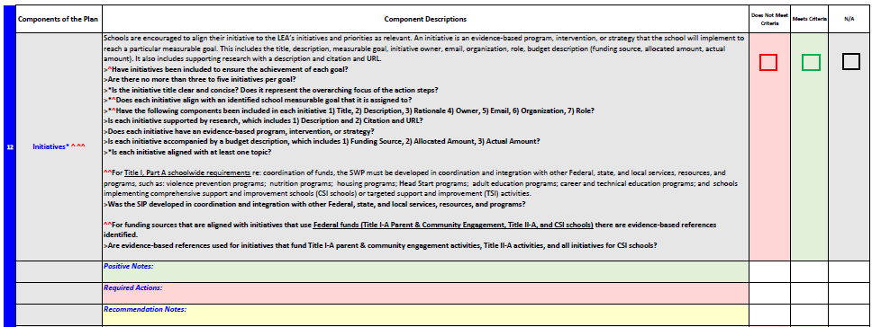
Providing Actionable Feedback
Positive Note: If evidence-based research is included for initiatives, then a positive note should be provided.
Required Action: Consider if the accomplishment of the initiative will directly impact achievement of the goal.
Initiatives
Recommendation: There should be no more than 3-4 initiatives.
Positive Note: If the budget is included as part of the initiative with the funding source and amount.
Required Action: A budget item must be included with the funding source identified.

Slide 36
Providing Actionable Feedback
Action Steps
Required Action: Action steps should support the initiative with high-level activities to accomplish the goal.

Slide 37
Providing Actionable Feedback
Report Card Focus Area(s)
Required Action: The school report card focus areas need to be identified in the plan.

Slide 38
Providing Actionable Feedback
Report Card Low Performing Subgroup(s) & Reason(s)
Required Action: The school report card low performing subgroups and reasons need to be identified in the plan.

Slide 39
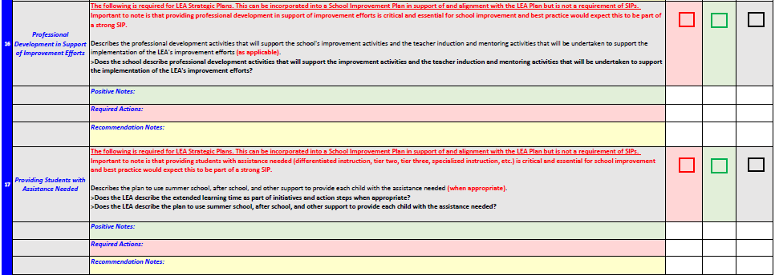
Providing Actionable Feedback
Required Action: Professional development activities that will support the school’s improvement efforts should be included (CPTs, PLCs, training, mentoring, book studies).
Professional Development in support of Improvement Efforts &
Providing Students with Assistance Needed
Positive Note: If the plan includes clearly identified professional learning to support the school improvement activities.
Required Action: The plan must show how the school is providing students with the assistance that they need (ex. through summer school, after school and other supports). It should be identified in goals, initiatives and/or action steps.

Slide 40
Suggested Steps to Review a SIP
Review the School Report Card (noting the identified areas of focus, subgroup(s), and reason(s)) & SurveyWorks results. Consider using the Report Card Organizer to unpack your results
Read over the Review & Feedback Tool
Read through the entire School Improvement Plan
Use the Review & Feedback Tool to review the foundational areas (informative inputs*) and needs assessment. Step through the plan's first priority area while referencing each component
Continue to step through the plan’s remaining priority areas while referencing
each component
(strategic actions**).
Use the Review & Feedback Tool to review the strategic directions***. Complete the review with a final check of your feedback in the Review & Feedback Tool.
* Informative Inputs are components 1 – 7 ** Strategic Actions are components 8-13 ***Strategic Directions are components 14-17

Slide 41
Resources & References for the Tool Development
Mandouit, L., & Hattie, J. (2023). Revisiting “The Power of Feedback” from the perspective of the learner. Learning and Instruction, 84. https://doi-org.umasslowell.idm.oclc.org/10.1016/j.learninstruc.2022.101718
Meyers, C. V., & VanGronigen, B. A. (2021). Planning for what? An analysis of root cause quality and content in school improvement plans. Journal of Educational Administration, 59(4), 437–453. https://doi-org.umasslowell.idm.oclc.org/10.1108/JEA-07-2020-0156
Smucker, A. D., & Grant, L. W. (2022). A Formative Tool and Approach to Assessing Strategic Plans in Higher Education. Educational Planning, 29(3), 7–21.
Van Gronigen, B. A., & Meyers, C. (2020). Short-Cycle School Improvement Planning as a Lever to Launch School Turnaround: A Descriptive Analysis of Plans. Teachers College Record, 122(5), 1–14. https://doi-org.umasslowell.idm.oclc.org/10.1177/016146812012200501
Gutierrez, Rochelle. (2008). A "Gap-Gazing" Fetish in Mathematics Education? Problematizing Research on the Achievement Gap. Journal for Research in Mathematics Education. 39. A "Gap-Gazing" Fetish in Mathematics Education? Problematizing Research on the Achievement Gap (ksu.edu)
Office of School and District Improvement website (click School Improvement Planning tab)
SIP FAQ March 2024
RIDE School Improvement Team Guidance
Education Accountability Act (EAA) 2019
School Report Card Organizer

