Slide 1
Rhode Island Department of Education Title II, Part A Overview Session
March 1, 2022
Notes:
Mary to introduce

Slide 2
Welcome and Introductions
Notes:
Mk will Introduce
Dalila Townes
Hilda Potrzeba
Mary Keenan
Joy Souza – Tentative
Add a poll to get a pulse of who is here today and content knowledge
A) I am new to the role
B) I am not new to the role, but am still learning the Title II regulations
C) I am not new to the role and I have a deep understanding of Title II regulations
5 mins

Slide 3
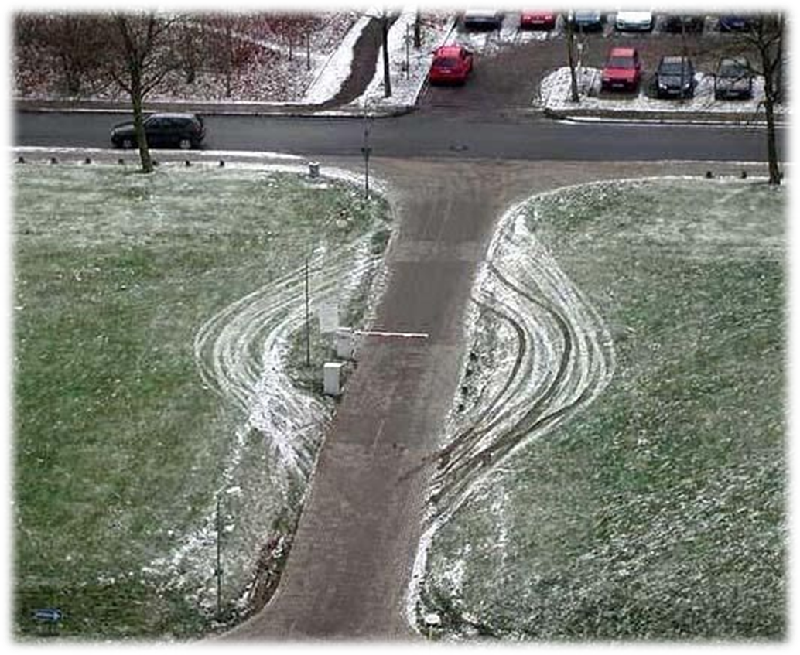
From a Title II coordinator lens, what comes to mind when you look at this picture?
Notes:
MK- 3 minutes
Waterfall
will ask participants to write responses in the chat and respond at the same time

Slide 4
Objectives for Today’s Session
Provide an overview of Title II, Part A-Program
Build understanding of the Comprehensive Needs Assessment
Strengthen Evaluation and Monitoring Responses
Provide an overview of Equitable Services: Private School
Meet new Fiscal Support: Dalila Townes
Provide an overview of Fiscal requirements
Notes:
MK 2 minutes

Slide 5
Agenda: 2:00 PM-4:00 PM
Welcome
Objectives and Norms
Purpose and Allowable Uses
Needs Assessment
Equitable Access
BREAK
IV. Evaluation and Monitoring of PL activities
V. Private Schools
VII. Fiscal Overview
CRP Fiscal Items
Supplement/Supplant
Private Schools
Transferability
Carry Over Funds
VIII. Closure
Notes:
Agenda Minutes:

Slide 6
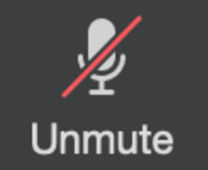
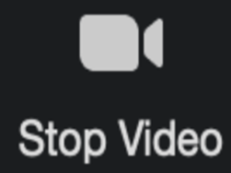
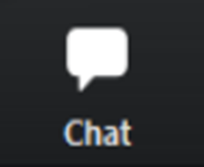
ZOOM Norms
Mute yourself to eliminate background sounds.
Unmute yourself in your breakout room.
Cameras on will help build human connection.
Turn camera off if you need to step away from Zoom.
Have a question or something to say?
Drop it in the chat.

Slide 7
RIDE Supports to Approval
Collective Goal: Get to “YES” and Award Funds
Approval of CRP Title II, Part A application in a timely manner
RIDE has:
Streamlined the CRP questions
Provided prompt technical assistance via phone/email
Included additional resources in the Document Library
Added additional staff (welcome Hilda Potrzeba)
Host additional Drop-In training sessions for:
Title II Monitoring Training
New Title II Coordinators
Expanded face-to-face technical assistance offerings
Notes:
MK 3 Mins
Data to support streamlines process

Slide 8
Spending Your Title II Funds
Notes:
Frame the days session
Purpose areas and priority/Focus areas

Slide 9
Title II, Part A Federal Program – Purpose
Increase student achievement consistent with the challenging state academic standards
Improve the quality and effectiveness of teachers, principals, and other school leaders;
Increase the number of teachers, principals, and other school leaders who are effective in improving student academic achievement in schools
Provide low-income and minority students greater access to effective teachers, principals, and other school leaders
Notes:
MK – 3 minutes
Ask the coordinators the purpose of Title II
Add responses to the chat
Then show image

Slide 10
Title II Activities Must Always Be…
Consistent with Title II purpose
Reasonable, necessary and allocable
3. Sustainable
4. Address the learning needs of all students
Notes:
MK 3 mins
Support the Purpose
R, N and A
Sustainable- cannot be one day workshops sustained over time
ALL Learners

Slide 11
Needs Assessment is your FOUNDATION:
LEA must provide a Plan:
Based on comprehensive needs assessment
Addresses academic achievement of students in relation to State academic standards
Particularly the needs of those children who are failing or at risk of failing,
How to meet those standards
How to meet any other factors as determined by the LEA
Plan must be reviewed annually and revised as needed (amendment period)
ESSA Sec. 1114(b)(6)
Notes:
MK 2mins
Title II, Part A’s Non-Regulatory Guidance for Title II, Part A: Building Systems of Support for Excellent Teaching and Leading, September 2016 states “(w)hile Title II, Part A of the ESEA ,as amended by ESSA, does not require a needs assessment…, such an assessment may help ensure that Title II, Part A funds are used strategically, to maximize educator effectiveness and student outcomes.” (p.31).
It is, however required that stakeholders are engaged yearly to “examine relevant data to understand students’ and educators’ most pressing needs, including the potential root causes of those needs given local context” (p.30).

Slide 12
Identification of Needs – Data Sources
Student Data
Demographics
Achievement and Growth
School Data
Resources
Graduation Rates
Salary
Climate
Survey Works
Curriculum Analysis
Student Surveys
Educator Data
Retention Rates
Experience
Areas of Expertise and Shortage
Job Satisfaction
Teacher Observations/Evaluations
Teacher Surveys
Notes:
MK 3 mins
When you are citing sources of data you must also include the specific data results

Slide 13
Identification of Needs: Data Sources (cont.)
Report Card
Data used in evaluating school performance for students and teachers
test scores graduation rates, and chronic absenteeism
Survey Works
Survey data from students, teachers, support professionals, administrators, and parents about their experiences in their schools
Data on formative feedback to impact classroom practice and school improvement in grade 3-12 students
Frontline
Data on evaluation system which seeks to develop, support, and grow educators through observation of practice and high-quality feedback.
Support students, educators, and families in understanding how their school community is performing
Teacher Evaluation Data
Heat Map based on data aggregated from Classroom Observations
Notes:
MK 2 min
RIDE provides the following Data sources that can be used by LEAs

Slide 14
Title II, Part A- Reports
Consolidated Resource Plan
Annual submission
Grounded in Needs Assessment
LEA budgeted breakdown of use of funds
PL Activities based on research(EBR)
All activities must align to the purpose (4 pillars)
Description of equitable services and supports
Federal Monitoring Audit
Five Year Desk Audit
Formative Process to monitor, provide feedback and continue growth
Evidence of meeting or working towards requirements in CRP
Verification that activities are grounded in research (EBR )
Opportunity to recalibrate and collaborate with SEA
Notification and application sent out in February
Notes:
MK 4 Mins
Where? Application at SEA and Federal level

Slide 15
How Can Title II Funds Be Spent?
Reserve Areas in CRP: Identifies area of allocation
ONLY 2 require PL Worksheet and EBR article
Professional Learning (15 allowable areas)
Private Schools
Class Size Reduction statement and EBR article
Class Size Reduction (RIDE encourages LEAs to phase out CSR)
Other Reserve Areas:
Certification
Equitable Access
Recruitment & Retain
Administration
Notes:
MK 4 Mins
Add link of allowable areas:
https://ridoe.sharepoint.com/:w:/r/OFFICES/TC/Internal/Shared%20Documents/Title%20IIa/11_2021-2022/Allowable%20Uses%20chart%202022.docx?d=w47066aec284d4b249657a27726cb7804&csf=1&web=1&e=FGccrv
The term 'professional development' means activities that are:
sustained (not stand-alone, 1-day, or short-term workshops)
intensive,
collaborative,
job-embedded,
data-driven, and
classroom focused.”
AND
Provide the knowledge and skills necessary to enable students to succeed in a well rounded education and to meet challenging state standards.

Slide 16
Evidence Based Research Requirements (EBR) for Title II
Under Every Student Succeeds Act (ESSA)
Evidence-based as a research study that meets the criteria for one of four possible tiers
Title II allocations must be grounded in evidence-based research
LEAs must provide EBR articles for PL activities (at the request of SEA)
A review of evidence is now a standard component of the RIDE Title II Federal Monitoring Desk Audit
Notes:
MK: 2 Mins
Mary will post a quick poll on the comfort level of find EBR articles with each PL activity
Dalila will share link :
file:///C:/Users/keenma/Downloads/Evidence-Based%20Tiers%20(1).pdf
ESSA includes a requirement that Title II dollars be spent in ways that are back by evidence. Effort to both increase the impact of federal dollars and move the field generally to a more evidence-backed approach.
Important given existing threats to Title II funding.
ESSA defines evidence-based as a research study that falls into one of four tiers.
You can use a study that falls into any of the four tiers for an activity funded with Title II dollars, but this is not the case for all Titles.
In order to comply with our requirements under ESSA, RIDE is requiring all LEAs to collect and document evidence, and make this evidence available upon request. Note that there is a document in the document library to help with the organization of evidence.
Review of evidence is included in our monitoring procedures moving forward.
Document Library- slide deck Evidence Based

Slide 17
Equitable Access CRP Application Question -Part I:LEA Plan
The Title II, Part A program is designed, among other things, to provide students from low-income families and minority students with greater access to effective teachers, principals, and other school leaders.
Districts MUST describe how they will use Title II funds to address equity gaps
Address how minority and low-income students are provided access to effective teachers, administrators and other school leaders
Submit annually within the CRP (LEA Part I)
SEA may deny Title II funding, if description is not submitted
Notes:
MK 2 mins
What does Equitable Access mean to you?
STATE:
Under ESSA Equity Gaps must be addressed to identify the root causes for the disproportionate rates at which low income and minority students are being served by ineffective, out of field and inexperienced T,P and OSL
2 options
% of funds
Description of how funds are used
Under ESEA sections 1111(g)(1)(B) and 1112(b)(2),
SEAs must :
describe
how low-income and minority children are not served at disproportionate rates by ineffective, out-of-field or inexperienced teachers
And
identify and address any disparities that exist in the rates at which these students are taught by teachers in these categories.
To eliminate any such disparities,
develop and implement strategies that are responsive to the root causes of those disproportionate rates;
Title II, Part A funds can be used
to provide students from low-income families and minority students with greater access to effective teachers, principals, and other school leaders
Ensuring all students have access to high quality learning. Doesn’t mean everyone gets the same thing.
Must address root causes of disproportionate rates of ineffective, out of field and inexperienced t, principals and other school leaders

Slide 18
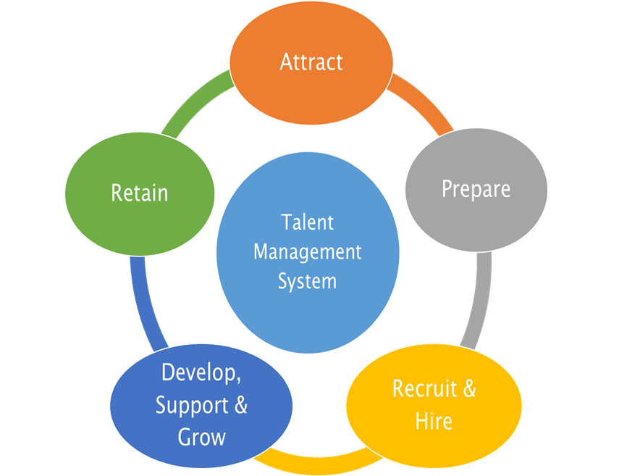
Equitable Access
Ineffective:
Any teacher who is not performing at a consistently high level as evidenced by Final Effectiveness Ratings or has received an Ineffective rating within the last 3 years
Out of Field:
Any teacher who does not hold the appropriate Initial, Professional, or Advanced Certificate for an assignment
Inexperienced:
Any teacher who has 0-3 years of prior working experience in a public school
Notes:
3 mins MK

Slide 19
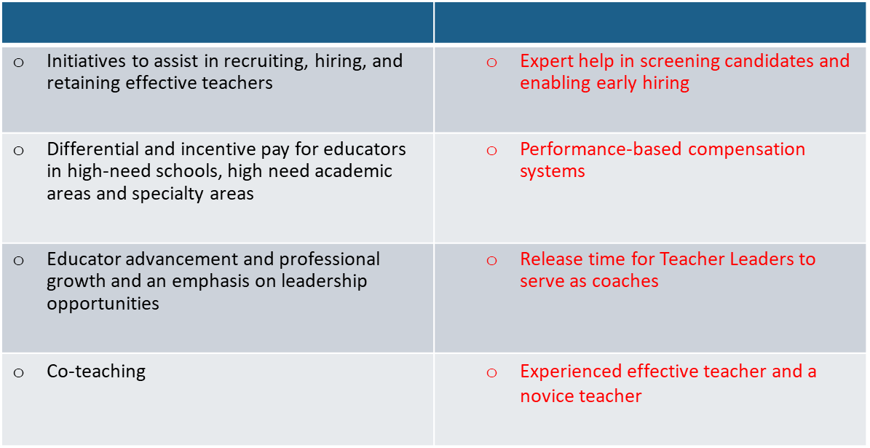
Equitable Access
The Title II, Part A program is designed, among other things, to provide students from low-income families and minority students with greater access to effective teachers, principals, and other school leaders.
Notes:
MK 2 mins

Slide 20
Questions
Notes:
2 min
Questions will be responded to as they appear in the chat:
DT will monitor chat and share questions

Slide 21
STRETCH Break
Notes:
Update and adjust as needed
Mary will say it’s a 3 min stretch break and give time to come back

Slide 22
Evaluation & Monitoring of Professional Learning
Notes:
MARY: provide overview 1 min

Slide 23
Evaluate and Monitor WHY?
Understanding: Is the PL activity accomplishing the goal?
Allows us to make changes when it’s not working
Allows us to make the case for effectiveness or ineffectiveness
Regulation: It is required under ESSA.
LEAs’ must submit an annual application that describe how funds will be used, data aligning to need, and monitoring and evaluation to continually update and improve activities
3. Effectiveness: Should we adjust, continue or discontinue?
Data provides understanding of impact
Notes:
MK: 2 mins
Generally, everyone wants to do PL for the right reasons. We want this to positively impact students and educators.
Have to be thoughtful about how to evaluate it so we know if what we are doing is working, and so we can change it if it’s not.
Important to make the case about what PL is doing effectively. Title II funding is constantly at risk, as well as PL in local budgets.
ESSA requires a description of how data will be used to improve PL activities
Hard to use data to improve PL activities if you don’t have any data on the effectiveness of those activities

Slide 24
Needs Assessment is Grounded in Data
IMPACT: Monitoring and Evaluation
Data Sources and Data Points
Outcome:
Discontinue
Outcome:
Continue
Outcome:
Adjust
Notes:
MK: 2 mins
Budgeted activity in person started virtual minimum screen time low impact
Feedback by participants was that no useful
Amendment- adjust and add new activity

Slide 25
Monitoring and Evaluation of an Activity How to determine if you should continue, adjust, or discontinue
Q4. Describe the activity/series, explain how this activity is aligned with content standards (e.g., Common Core) and district or school priorities.
Q5. Complete the chart to explain how the LEA will identify and track progress and performance.
Include data sources and data points, how each will be monitored and evaluated, including specific expected outcome metrics, to determine the impact of the PL activity/strategy.
Data Source | Aligning Data Points | Impact: Monitoring and Evaluation
Notes:
MARY 2 mins

Slide 26
CRP: Professional Learning Activity Worksheet Response Example
Q 5. Complete the chart to explain how the LEA will identify and track progress and performance. Include data sources and data points, how each will be monitored and evaluated, including specific expected outcome metrics, to determine the impact of the PL activity/strategy.
Data | Aligning Data Points | Impact: Monitoring and Evaluation
Notes:
MK 1 min

Slide 27
PL Activity Worksheet (Question 5)
RICAS ELA Students without Disabilities: 1.8% Not meeting expectations, 27.5% Partially meeting, 54.6% Meeting and 10.8% Exceeding
RICAS ELA Students with Disabilities: 34.6% Not meeting expectations, 54.6% Partially meeting, 10.8% Meeting and 0% Exceeding
While results for the 2020-21 school year need to be analyzed, accounted for and compared with the 2018-19 data once they are released.
If we assume similar results between 18-19 & 20-21 school years, we will want to see at least 2-5% movement to the next level of proficiency in year 1 (SY 21-22) for all students.
In addition to State achievement results, administrators and teacher leaders will continue to monitor student achievement data on local Classroom assessments & STAR assessments to see if direct correlation exists between the instructional model, curricular implementation and student achievement in ELA. Leadership will also gather feedback through teacher surveys.
Notes:
MK – total allotted time 5 mins
https://ridegms.blob.core.windows.net/documentlibrary/3B2429F6-FD53-4901-B5AD-5D1246EAA446.pdf
While reading the responses think about:
What data sources are included?
Does each data source include aligning data points?
How will impact of the activity be monitored and evaluated?
Is there an expected outcome metric that will gauge impact?
MK will ask the group to share In the chat share – this will be done one area at a time
data sources...
Data points
Measures
Impact statement

Slide 28
CRP: Professional Learning Activity Worksheet Response Examples
Q 5. Complete the chart to explain how the LEA will identify and track progress and performance. Include data sources and data points, how each will be monitored and evaluated, including specific expected outcome metrics, to determine the impact of the PL activity/strategy.
Data | Aligning Data Points | Impact: Monitoring and Evaluation
RICAS ELA Students without Disabilities
RICAS ELA Students with Disabilities
Classroom assessments
STAR assessments
1.8% Not meeting expectations, 27.5% Partially meeting, 54.6% Meeting and 10.8% Exceeding
RICAS ELA Students with Disabilities: 34.6% Not meeting expectations, 54.6% Partially meeting, 10.8% Meeting and 0% Exceeding
*While results for the 2020-21 school year need to be analyzed, accounted for and compared with the 2018-19 data once they are released- if we assume similar results between 18-19 & 20-21 school years
While results for the 2020-21 school year need to be analyzed, accounted for and compared with the 2018-19 data once they are released- if we assume similar results between 18-19 & 20-21 school years
Provide surveys to ELA teachers for feedback on observation tool
Provide surveys to ELA teachers on walk-through protocol
See at least 2-5% movement to the next level of proficiency in year 1 (SY 21-22) for all students.
Notes:
Waterfall – MK to ask for responses
Share data and data points from the response

Slide 29
Exemplars: Monitoring & Evaluation
Data Source | Aligning Data Points | Impact: Monitoring and Evaluation
RICAS
STAR
Reading Proficiency 35%
Reading Proficiency 45%
Bi-weekly data meetings will be held with PL Coordinator and Lead Teachers to determine effectiveness. Reading proficiency expected to show a 10-15% growth in both RICAS and STAR because of the activity.
Teacher Evaluations
Classroom Observations
Teacher Surveys
MTSS
Classroom management metrics (30%-criteria 2 b, c)
Office/discipline referrals (115 submitted )
Teacher Feedback (86%)
End of year review of teacher evaluations and classroom observation metrics related to the activity will be used to determine if teachers and staff have implemented with fidelity Teacher surveys will be used to determine comfortability/confidence in using Conscious Discipline;
As a result, office/discipline referrals will show an expected decrease of 15-20%, and classroom management metrics on teacher evaluations/observations will increase by 10-15%.
Teacher Surveys
Teacher Evaluations and Observations
Staffing Data
Job Satisfaction and confidence levels (47%)
Retention Data (70%)
Behavior Mgt (75/115 referrals from beg teachers)
End of year data collected from participating teachers and mentors will be evaluated to determine novice teacher growth, level of confidence, job satisfaction to increase by 15-20%; Teacher evaluations/observations will show increases in classroom management effectiveness throughout the year with a decrease in referrals by 10-15%; Teacher retention numbers will increase by 5-10%.
Notes:
Skip
Adding to resource guide- will not share

Slide 30
Questions
Notes:
Minute 65 or 120

Slide 31
Private Schools
Notes:
2 min Poll:
Quick poll to gauge relationship and communication with private schools

Slide 32
Private Schools Consultation Timeline
Consultations
WINTER
Dec-Feb
SPRING
Mar-May
SUMMER
June-Aug
FALL
Sept-Nov
Verify private school contacts
Send out Letter of Intent
Collect Letter of Intent
Schedule initial /ongoing consultation & send out consultation template
Conduct ongoing consultation
Review current programs and amend as needed
Prepare Letter of Intent
Meet with private school officials
Provide funding amounts
Discuss consultation topics
Discuss needs assessment
Review Planning template and provide guidance on allowable use of funds
Finalize programs and services
Inform readiness of services and programs for SY 2019-20
Notes:
MK 3 mins
HP add link to chat when prompted
Link: https://ridoe.sharepoint.com/OFFICES/TC/Internal/Shared%20Documents/Title%20IIa/10_2020-2021/Detailed%20Consultation%20Timeline.docx?web=1
Consultation:
Involves communication and discussions on key issues relevant to the equitable participation of private school students, teachers, and other educational personnel in Federal education programs.
LEA must engage in timely and meaningful consultation with private school officials
BEFORE making a decision (such as on ordering materials or hiring staff) that affects the opportunities of private school participate in programs requiring their equitable participation
DURING the design and development of programs (including the process of developing a competitive grant application) and
THROUGHOUT the implementation and assessment of programs

Slide 33
Private School Consultation Records
1. LEA must provide written affirmation to SEA
2. Private school official signature required
3. If private school officials do not provide an
affirmation LEA should provide evidence of documentation
attempts (Letter of Intent, emails, phone logs)
4. LEA must have Needs Assessment consultation template signed by private
schools and submit to SEA
ESSA section 8501
Notes:
MK 2 min
1. Provide written affirmation to SEA Each district must provide to the SEA written affirmation signed by private school officials of each participating private school during meaningful consultation.
2. must provide the options for private
school officials to indicate if
timely and meaningful consultation has not occurred AND/OR
that the program design is not equitable with respect to eligible private school children
3. If private school officials do not provide such affirmation within a reasonable period of time, the LEA shall forward the documentation that such consultation has, or attempts at such consultation have, taken place to the SEA in lieu a signed letter.

Slide 34
Private School Consultation Resources for Titles II-A and IV-A
Goal:
Provide comprehensive guidance document with structured guidance to support private schools on using grant funds that are aligned to school priorities that are based on comprehensive needs assessment and stakeholder feedback.
Comprehensive Resource Document that provides details on:
Consultation requirements
Ongoing consultation
Funding
Complaint protocol
Documentation templates
Located in Titles Document Library
Notes:
MK 2 min

Slide 35
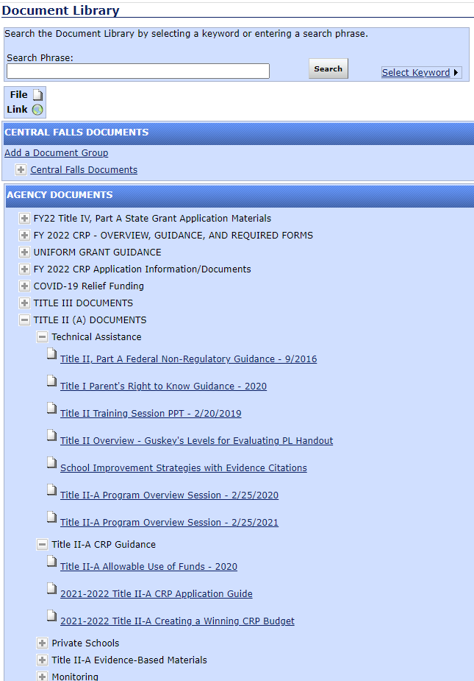
Resources and Supports
Notes:
MK 1min

Slide 36
The State-designated Ombudsman will monitor and enforce private consultation and equitable service requirements to help ensure equitable services are provided to private children, teachers, and other educational personnel.
Rhode Island’s designated Ombudsman is:
Anthony Cottone Chief Legal Rhode Island Department of Education 255 Westminster Street Providence, RI 02903
(401) 222-8933 ombudsman@ride.ri.gov
ESSA sections 1117(a)(3)(B) and 8501(a)(3)(B)
Notes:
MK 1 min
If private school officials believe the district did not meet consultation or other requirements, they may file a complaint with RIDE if:
consultation was not meaningful or timely;
the district did not give due consideration to the views of the private school official; or
the district failed to make decisions that treat the private school or its students equitably.
A formal written complaint must include:
a statement that the SEA (RIDE), the LEA, or other entity receiving federal financial assistance has violated a requirement of a federal statute or regulation that applies to a program requiring equitable participation;
the facts on which the statement is based and the specific statutory or regulatory requirement allegedly violated; and
the signature of the complainant.
ESSA sections 1117(a)(3)(B) and 8501(a)(3)(B)

Slide 37
Questions
Notes:
2 min
76 of 120 minutes
Transfer cohost to DT

Slide 38
Fiscal Overview
Dalila Townes
Grants and Finance Officer
Dalila.townes@ride.ri.gov
Notes:
DT 1 min
I'll start the fiscal overview with some high level discussion on key items that impact your CRP and then I'll go over some fiscal items that are specific to Title II. I start with going over the items that impact your overall CRP because even if the Title II portion of your application is programmatically and fiscally approvable, it is still just a piece of your overall CRP application - there are general items that would impact all programs and that need to be addressed in order for final approval of the entire application.

Slide 39
When may an LEA begin to obligate funds?
The State (SEA) may not authorize an applicant for a sub-grant to obligate funds until the later of the following to dates:
The date that the funds become available; or
The date that the applicant (LEA) submits an application to the SEA in substantially approvable form.
Status of: District Superintendent Approved = Submitted
Reimbursement for obligations is subject to RIDE final approval of the application.
Notes:
DT 2 mins
On this slide I will talk about the submission of the CRP application - the items on this slide are applicable to all CRP programs and not just Title II.
An LEA cannot obligate funds until the later of the date the funds become available or the date that LEA submits application to RIDE in substantially approvable form
Typically applications are due no later than June 30th or if you have summer activities the due date is mid May
The project period doesn’t start until you submit your application so its very very important to get your application in on time. For example, lets say funds become available on 7/1 but you don’t submit your application until 10/1, those expenditures between 7/1 and 10/1 would not be allowable and you would have to fund them with local dollars. Again, the takeway here is ensure you are submitting a timely application.
A key item to remember is that an application is not considered submitted until its in District Superintendent Approved status which means its gone through all of the LEA levels of approval. Simply having an application in Draft Started or any approval level below Superintendent Approved does not mean the application has been submitted.
Also remember that when the application is opened its in "Not started" status, in order to begin making changes you need to move it to "Draft started" to make changes
While you may obligate funds before the application is in final approved status, you cannot submit for reimbursement until the application is final approved by RIDE.

Slide 40
Don't forget the required documents!
Signed Assurance Affirmations
Request to Obligate Federal Funds
Process for the Development of the CRP Application
All can be found in the document library. Submit to RIDE when submitting the consolidated application.
Notes:
DT 2 mins
In order to prevent delays in the RIDE approval process, don't forget to submit all the required documents. These required documents aren't specific to Title II and apply to your overall CRP application.
Within the document library (which Mary showed you how to get to a few slides back), there is a section called FY22 CRP- Overview, Guidance and Required Forms. Within this section there is a Instructions for CRP submission document which mentions the three documents on this slide and where to send the documents
The Assurances Affirmations – In this document you are making various assurances that apply to your overall CRP and each individual program in order to ensure compliance with the applicable Federal statutes, regulations etc
The Request to Obligate Federal Funds - on this form you indicate whether you have summer activities and for which programs. Its really important to submit this timely so that RIDE knows when you are beginning your activities so that we can plan and focus on the review of your summer activities and getting those approved timely
The Process for the development of the CRP application fulfills the Federal requirement to document who participated in the application development such as community members, parents, teachers, students etc

Slide 41
Why is my CRP application not final approved?
All Required Documents are not submitted to RIDE
Application has not been resubmitted
(Superintendent Approved status)
Prior Year Final Expenditure Report (FER) issue(s)
Late Reporting (due by August 15th)
Refund(s) Due back to RIDE
E.I.S. Reporting discrepancies (vs. UCOA file)
Overdue IDEA MOE Compliance Test Reporting
Issue(s) with private school component
Equitable Share Calculator (Update when Amending!!!)
Notes:
DT 4 mins
On this slide I'll go over what factors might be holding up your CRP application:
The first bullet, make sure you submit all of the required documents I discussed on the previous slide
Confirm the status of the application and ensure any resubmitted applications are in Superintendent Approved status. RIDE may have returned the application to you for edits and even if you've made the required changes unless its in Superintendent Approved status it will not trigger another RIDE review and ultimately RIDE final approval
Even if we are able to get through the programmatic and fiscal reviews the application won't be final approved if your FER hasn’t been submitted or if there are certain issues related to FER
During the initial application process RIDE fiscal inputs preliminary allocations which include an amount for carryover – carryover is comprised of two components 1) unapplied amount from PY and 2)unspent from PY. Without the FER RIDE does not know the unspent amount/final carryover amount.
Additionally, even if the FER is submitted you cannot have any refunds due to RIDE, this will hold up final approval
If there are discrepancies on between reporting on the FER for IDEA Early Intervening Services and the UCOA file, this will hold up the process
If you are behind on other reporting like the IDEA MOE compliance report
And lastly if there is an issue with the private school proportionate share calculator
A common issue we see is that the equitable share calculator is not updated at amendment time. At the time of the initial application, the allocation and funds available are preliminary, by amendment time allocations are finalized and the calculator needs to be updated for the final allocation amounts

Slide 42
Supplement not Supplant (SNS)
Instances when it is presumed that supplanting has occurred:
If the LEA uses Title II(A) funds to provide services that it was required to make available under other federal, state or local laws
or
If the LEA uses Title II(A) funds to provide services that it provided with non-federal funds in the prior fiscal year
Ask Yourself??
Is the activity required by Federal, State, or Local law?
Was the activity paid for with State, Local, or other Federal funds in the previous year?
If the answer to both is no, then funds are most likely supplemental.
Notes:
2 min
Title II funds are supplementary and as such you need to ensure you are not supplanting. It is presumed that supplanting has occurred if Title II funds are used to provide services the LEA was required to make available under other federal, state or local laws or if the LEA uses title II funds to provide services it provided with non federal funds in the prior fiscal year.
This leads to the two questions to ask yourself to determine if funds are supplemental or if supplanting has occurred.
Is it required under other Federal, State or Local law? If you are required to do the activity anyways then the reasoning behind it is why should the Federal government be paying for it.
Was the activity paid for with State, Local or other Federal funds in the previous year?
If answer to both questions are no then the funds are most likely supplemental.

Slide 43
Private School Proportionate Share Calculator
Calculator assists LEAs determine proportionate share of each eligible participating private school.
To be eligible, each private school must be RIDE approved (annual process).
Use of private school student counts from October 1st of the previous school year.
Counts include all students (K to 12) regardless of district of residency.
Private School Proportionate Share based upon LEAs Title II allocation
Transfer of funds in or out of Title II will need to be accounted for within calculator.
A change in the amount allocated will require an update to the private school share calculation - such as at amendment time.
Must obligate all (private school) funds in the year made available
LEA may take administrative costs off the top.
Such as Indirect Cost Recovery
Notes:
DT 4 min
The private school proportionate share calculator determines the districts minimum required reserve of Title II funds for equitable services for participating private schools located within the districts boundaries. In order to be an eligible participating private school the private school must be RIDE approved which is an annual process.
There is an Enrollment Counts tab of the calculator that has the enrollment counts for the district and the eligible private schools within the district. This is based on October 1 data of the previous school year and includes all students (K to 12).
There are a couple items I'd like to point out here, you may see more schools listed in the private school section of your Accelegrants application than you do not see on the enrollment counts tab of your proportionate calculator. That’s because the proportionate share calculator includes only those private schools that have been RIDE approved for the current year.
Additionally, if there is a school in the private school section of the accelegrants application that has been closed let David Luther know and he can remove that school from Accelegrants.
The calculation is based on the Title II allocation, and you adjust for carryover and transfers in and out of title II. Any change in the overall allocation/carryover/transfers will also impact the private school share! This is of particular note at amendment time when the allocations have changed. Again, this is an issue we often see overlooked by LEAs. I talked about it a couple slides back and it is worth another mention here as well.
As the district you are trying to get the private schools to utilize all of the funds they have in the year its made available. You want to ensure that you are appropriately and timely consulting with them and seeing what their needs are. Private school consultation is an ongoing process, you want to be sure you capture any changes in their needs – for example at amendment time you want to confirm if there any adjustments that need to be made to the budgeted private school line items.
LEAs can assess necessary and administrative costs to address the fact that there is an administrative cost associated with managing the private school funds. The simplest way to do this is through the indirect cost rate - the proportionate share calculator has a section where you would input the total administrative cost for Title II program. This essentially takes the administrative costs off the top or in other words the beginning of the equation – before the amount required to be reserved for private schools is calculated.

Slide 44
Proportionate Share Calculator
Notes:
DT 1 min
On this slide is a picture of where you can find the proportionate share calculator within the document library. Since we are in the amendment period I am specifically referencing the FY 2022 CRP Amendment Materials – its called Title II equitable share calculator – you will sometimes hear it referenced to as proportionate share and sometimes equitable share. If it was the initial application time it would be in the FY 2022 CRP Application/Documents section.

Slide 45
Transferability
Within the consolidated application, LEAs may transfer up to 100% of their Title II, Part A allocation and up to 100% of their Title IV, Part A allocation to the following programs:
O Title I, Part A – Disadvantaged Youth*
O Title I, Part D – Neglected and Delinquent*
O Title II, Part A – Supporting Effective Instruction
O Title III, Part A – English Language Acquisition*
O Title IV, Part A – Student Support and Academic Enrichment
* Funds cannot be transferred out of these programs including any funds transferred in.
Notes:
3 minutes
Transferability allows you to move funds between programs – however there are restrictions.
You can transfer 100% of your Title II & Title IV funds into the programs on this slide – Title I Part A, Title I, Part D, Title II (If you are transferring in from Title IV) Title III, Part A, Title IV.
One of the biggest restrictions is that once you transfer funds into Title I or Title III, you cannot transfer these funds out. Even during amendment time, you can increase the transfer amount to these programs but you cannot decrease the transfer amount.
LEAs should only be transferring the amount up to what is needed in the program. RIDE doesn’t recommend blanket transferring funds if you do you have a need for it in the other program.
You would make the election to transfer in the allocation transfers section of the application

Slide 46
Transferability (cont.)
Private Schools
Transferring funds between programs impacts your private schools.
The LEA must update the Proportionate Share Calculator to reflect transfer of funds; either going out of Title II or going into Title II.
Notes:
1 minutes
Additionally, transfers between programs also impact the equitable share for private schools. For example, lets say you are transferring money into Title II from Title IV, there is now a larger pot of Title II funds available and as such the required reserve for private schools is larger. Alternatively, if you are transferring money out of Title II and into one of the other programs, there are less Title II funds available in the overall pot and therefore less funding available to private schools. There are lines within the calculator to reflect transfers in/transfers out. This further expands upon a point I made a couple slides back where any change in allocation, transfers carryover etc. triggers an update to the proportionate share calculator.

Slide 47
Period of Availability & Carryover
Title II(A) funds are available for 27 months
First In First Out (FIFO) Approach
LEAs are encouraged to apply for all available funds
Unlike Title I (A) funds - no restriction on the percentage that can be carried over within the 27-month period of availability
Account for Private School funds separately and allow for similar carryover, if necessary
Fiscal Year | Period of Availability
FY 2020* | 7/1/2019 - 9/30/2022* *Covid related one year waiver granted by US ED
FY 2021 | 7/1/2020 - 9/30/2022
FY 2022 | 7/1/2021 - 9/30/2023
FY 2023 | 7/1/2022 - 9/30/2024
Notes:
3 min
Title II (A) funds are available for 27 months – we currently have 3 years open and another year will soon open.
We were granted a 1 year waiver on 2020 funds, these funds were originally set to expire 9/30/21 but this waiver allowed for a bit of reprieve. We arent counting on any additional waivers so for all other years you want to ensure you are utilizing your funds within the set period of availability.
The 2021 funds are available until 9/20/22 the 2022 funds until 9/30/23 and the next year's application will be for funds that are good until 9/30/24
Funds are used on a first in first out basis, so you are using up your old funds first
RIDE encourages LEAs to apply for all available funds
You can carry over all of your title II funds within the 27 month period of availability – this is pointed out in the slide because this is unlike Title I where you have to obligate or spend 85% of funds within the first 15 mos.
Lastly business officers should be accounting for private school funds separately

Slide 48
2022 Amendment
2022 Amendment Period: February 25- March 28
When to submit a CRP Amendment:
Decrease in available funds
If LEA cumulative anticipated change(s) within or among objects of expenditure (Budget Series) exceeds 10% of the total approved budget
If LEA cumulative anticipated change(s) within or among objects of expenditure (Budget Series) exceeds Over $100,000.00, whichever amount is less
10% Flexibility Rule
Prior approved line items/activities.
The flexibility is not meant for new or unapproved activities
Don't forget to update Private School proportionate share calculator & budgets!
See FY22 Amendment Guidance Document within Document Library
Notes:
DT 2 Mins
The 2022 amendment period has been opened and LEAs can submit an amendment until March 28th:
So when/why might you need an amendment?
As a general rule, any proposed change in the total approved budget amount and/or significant change in the scope, goals, or intent of an approved program will require an amendment request.
Final allocations and prior year unspent has been loaded into the applications. Many times (but not always) this might result in an increase in funds (remember the original application is based on a preliminary allocation) but sometimes it results in a decrease in funds. If the change in the total amount of available funds has caused the currently approved budget to exceed the total amount of available funds – in other words you're over budgeted, you will need to submit an amendment. So for example, if you previously budgeted for $50,000 and your available funds is updated to $49,000, you will need to submit an amendment. You are not required to amend for an increase in funds – however just keep in mind that you cannot spend on the increase until it is budgeted. So for example if your previously approved budget was $50K and you now have available funds of $55K, you can only request for reimbursement up to the $50K approved budgeted amount. The remaining $5K unbudgeted will be carried over into your next year's application and you can budget for it at that time.
An amendment is required If the LEA has changes within or among objects of expenditure (ex: 51000 series for compensation, 52000 series for benefits, 53000 for purchased services) that exceed 10% of the total approved budget or if that change exceeds $100,000 within the budget series, whichever is lower. To clarify – within the object series means the individual line items that make up each budget series, for example the individual line items budgeted in 53000 purchased services. Among/between the line items means from one budget series to another, for example 53000 purchased services to one of the other budget series such as 51000 compensation and 52000 fridge
Otherwise, if your total changes within and among the budget series is less than $100,000 and does not exceed 10% of the total approved budget you can apply the flexibility rule rather than submit an amendment. When you request for reimbursement within accelegrants you would reflect the change there.
The caveat with the flexibility rule is that this can only be used for changes with prior approved line items/activities. This is not meant for new or unapproved activities.
I've mentioned this on multiple slides but don’t forget to update the private school proportionate share calculator for changes in allocation/carryover etc at amendment time. Additionally, any amendment required to private school budgets should also be made at this time, as a reminder private school consultation is an ongoing process and you should be meeting with the private schools to ensure needs are being met, which includes review and assessment of budget and spending and amending as necessary.
The guidance I've given here is high level and not exhaustive – there is a detailed amendment guidance document for your reference that goes over in detail the amendment requirements.

Slide 49
Questions
Notes:
100 of 120 minutes

Slide 50
Final Thought..
Notes:
2 min
Began the session reflection on a picture of a road that made us think about difficulties, barriers … in the Title II process
I want to end with this final thought by Henry Ford
We are making an impact in supporting teachers and administrators in providing meaningful PL
As we continue to work together, we will grow together and impact even greater impact together….

Slide 51
Thank You for Your Participation!
RIDE Title II, Part A Program and Fiscal Contacts
Title II, Part A Program
mary.keenan@ride.ri.gov 401-222-8497
hilda.potrzeba@ride.ri.gov 401-222-8891
Title II, Part A Fiscal Support
dalila.townes@ride.ri.gov 401-222-8171
Notes:
2 min

