Slide 1
Part II: Using Research & Tools to Build a Plan for Attendance Success
Originally presented on
May 23, 2024

Slide 2
PART II: Using Research and Tools to
Build a Plan for Attendance Success
Welcome
Continuous Growth & Improvement
An Effective School Team to Improve Attendance
Attendance Teams at Work
Attendance for Success Act: Shifting to Prevention & Intervention
Wrap Up
2

Slide 3
How is RIDE supporting schools with chronic absenteeism?
Establish partnerships with municipal leaders, LEAs, and community organizations that prioritize addressing student chronic absenteeism. The Chronic Absenteeism Working Group will share best practices, raise awareness, and develop strategies to improve student attendance.
Develop several interactive data tools including a real-time attendance leaderboard and a community dashboard detailing chronic absenteeism data and trends.
Advocate and assist with legislation that creates common definitions, focuses on prevention and intervention, establishes an early warning system, ensures LEA and school attendance success plans, ensures the use of data to guide decision-making, and requires school-based attendance teams
3

Slide 4
PART II: Using Research and Tools to
Build a Plan for Attendance Success
Welcome
Continuous Growth & Improvement
An Effective School Team to Improve Attendance
Attendance Teams at Work
Attendance for Success Act: Shifting to Prevention & Intervention
Wrap Up
4

Slide 5
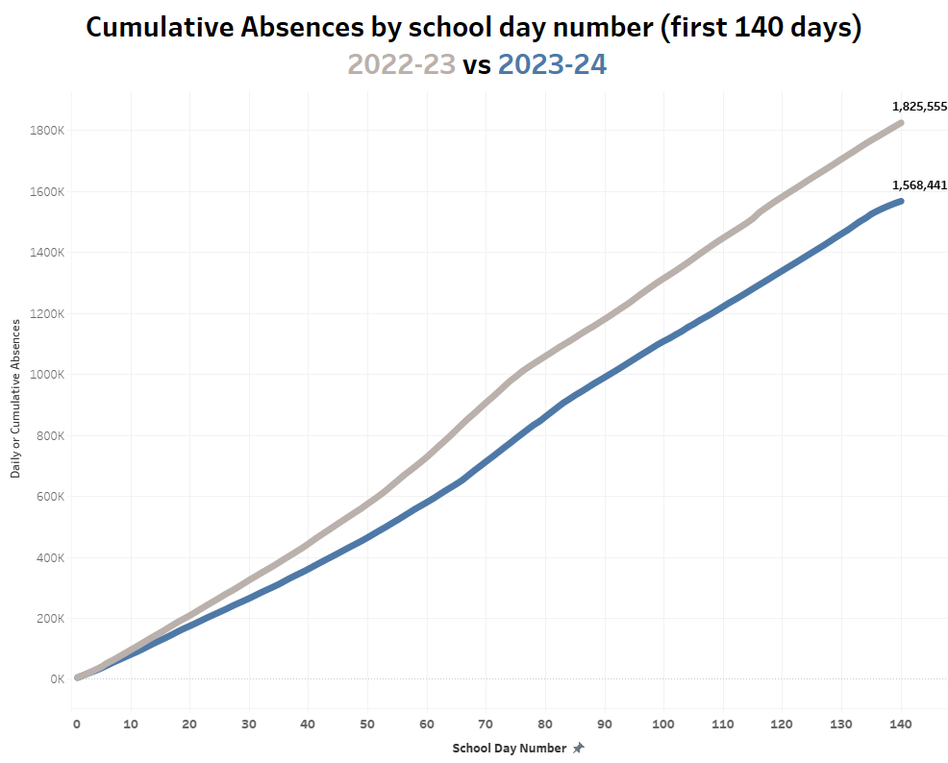
Update: Rhode Island
257,114 fewer absences this year
Notes:
This cumulative absence analysis compares last year to this year. This is based on the first 140 days of school (April).
Last year at this time the cumulative days absent were 1,825,555.
This year the cumulative days absent are 1,568,441.
This is 257,114 fewer absences.

Slide 6
Reminder: The Root Causes
Aversion to school climate, academics, relationships, disciplinary practices, and other factors that psychologically discourage attendance.
Barriers
Aversion
Disengagement
Misconceptions
Barriers like illness, family or home challenges, trauma, lack of transportation, housing issues, inequitable access to services, and more.
Motivationally-based absences often happen when there are poor relationships with other students, academic failure, or when a student is not engaged in instruction.
A view or opinion that is incorrect because it is based on faulty thinking or understanding.
Root Causes - Attendance Works
Notes:
Understanding the four root causes were critical for our schools to determine the needs of their students and families.

Slide 7
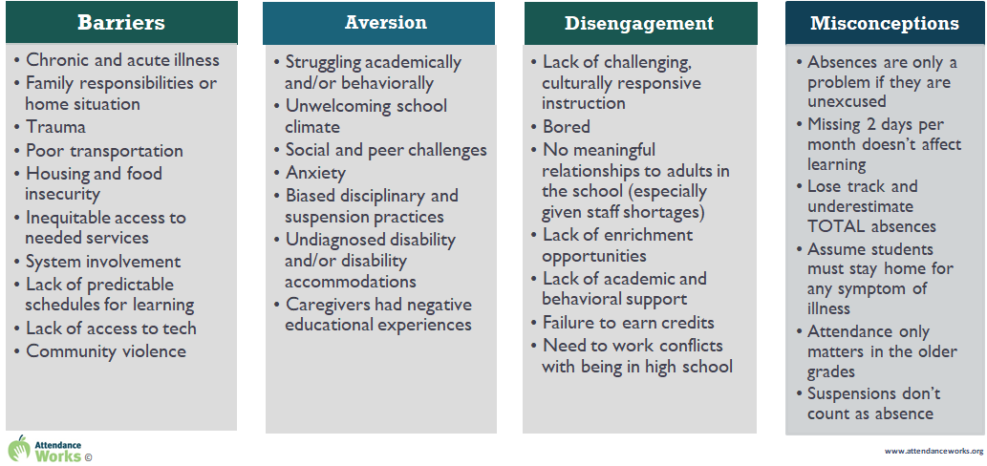
Reminder: The Root Cause

Slide 8
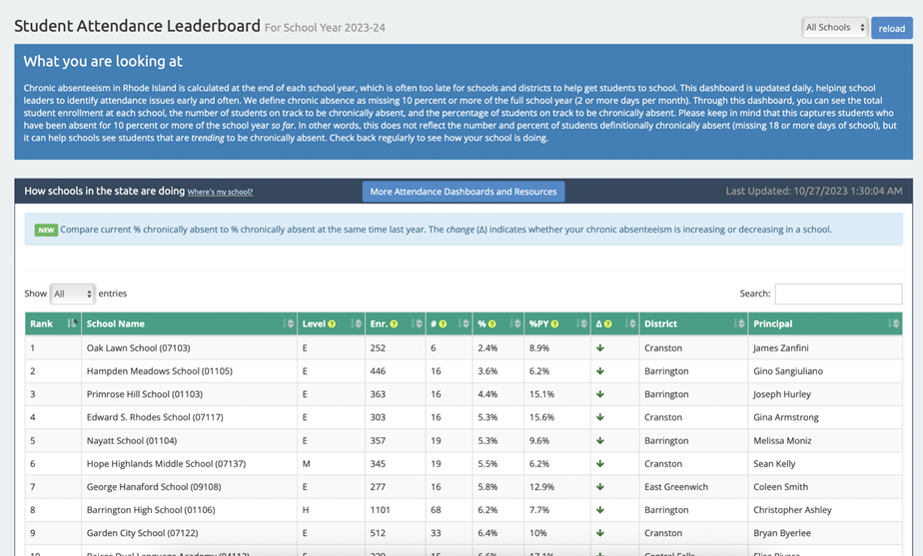
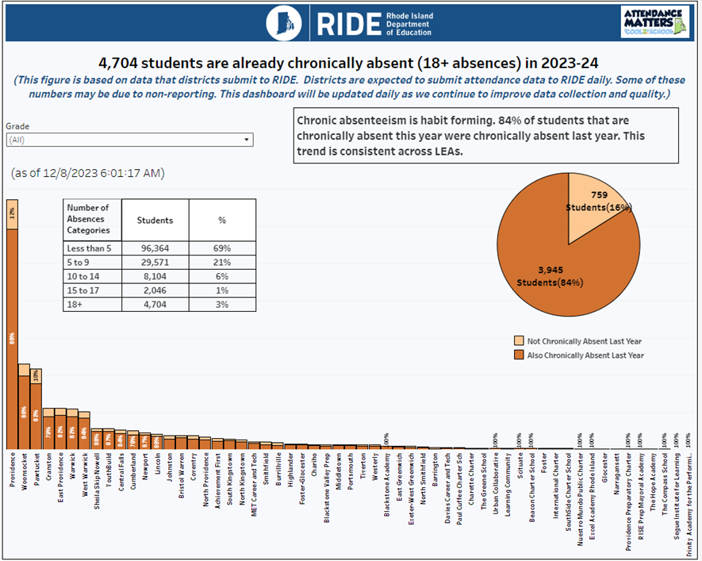
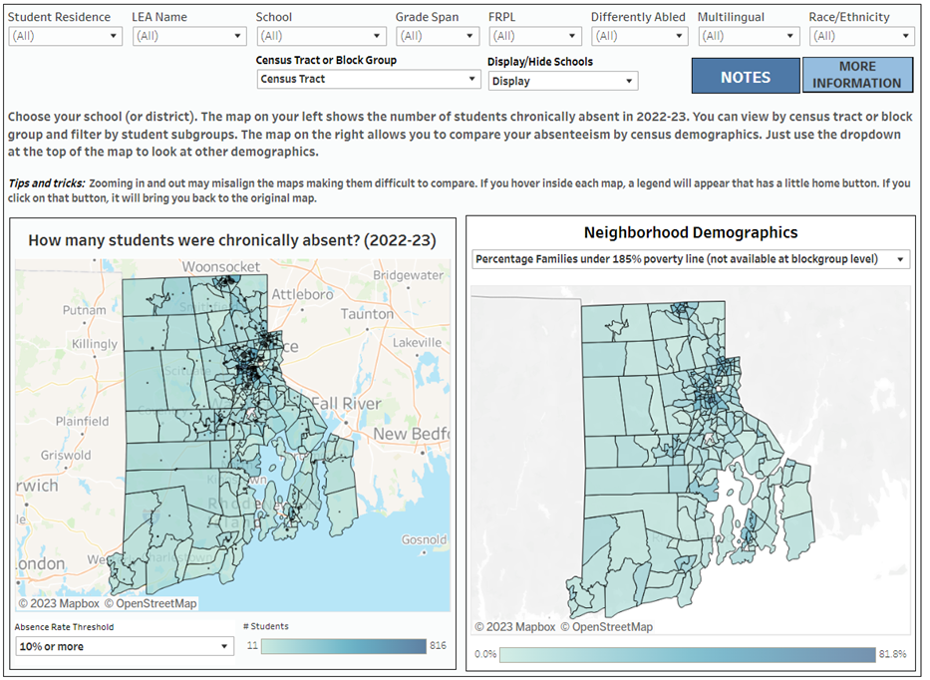
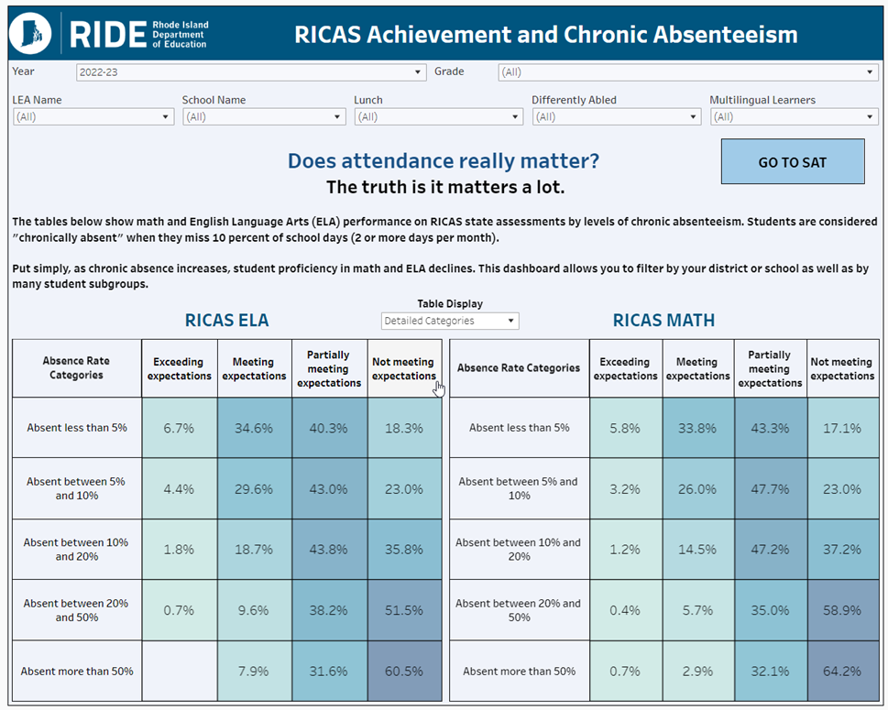
Reminder: Attendance Tools
RIDE has developed multiple dashboards to help the Rhode Island school community understand, explore, and address chronic absenteeism.
Attendance Leaderboard | Daily Chronic Absenteeism Update
Updated daily to help address chronic absenteeism early and often | Students that are already chronically absent this year AND were last year
Attendance Community Dashboard | Chronic Absenteeism and Achievement
Examine chronic absenteeism by census tract or block group while filtering by various demographics | View the impact of chronic absenteeism on state assessments

Slide 9
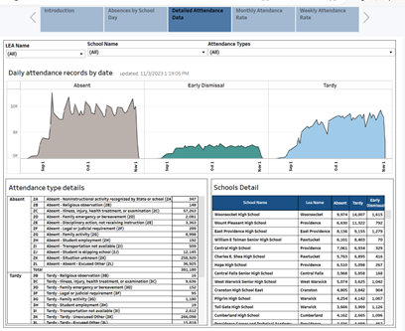
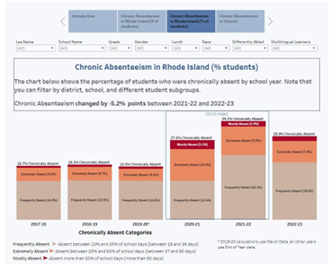
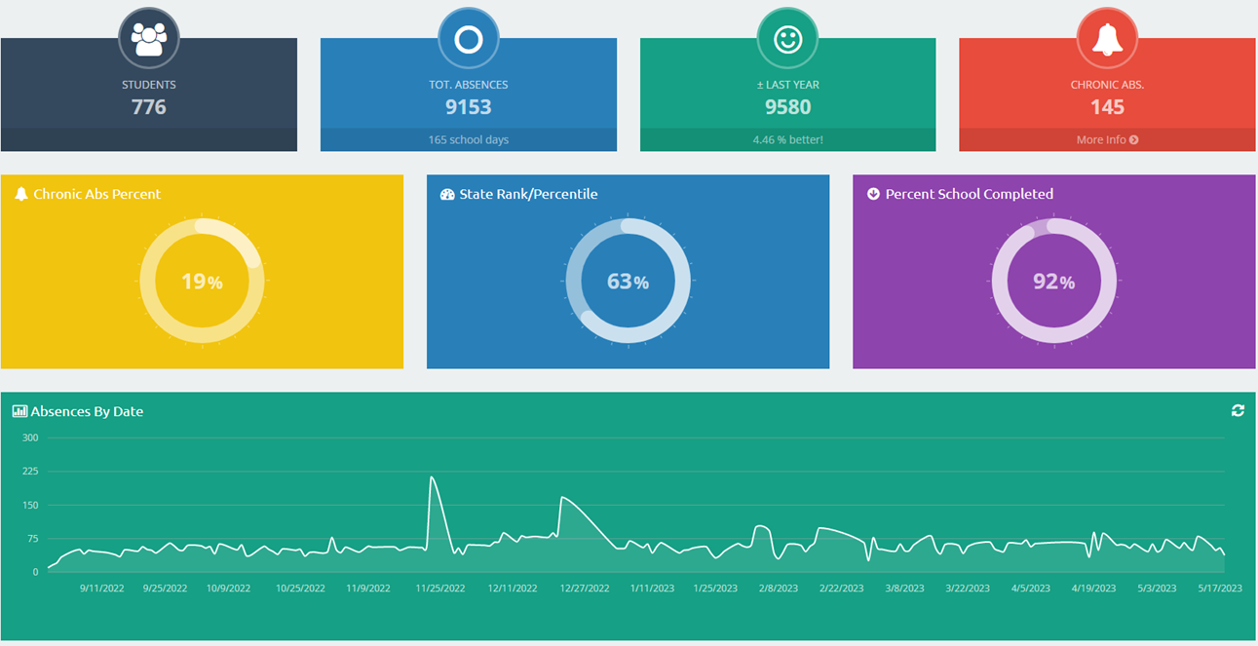
Reminder: Attendance Tools
Real Time Attendance Dashboard(s) | Historical Absence Dashboard(s)
Various ways to analyze by time frames, subgroups, and trends | Explore information overtime by percent and number by school, LEA, and RI
The Nudge Tool | RIDE Attendance Matters website
Mobile app that allows school leaders to communicate with families | Learn about the latest tools, resources, and collective efforts
Link to Attendance Tools Deck
Link to Recorded Webinar

Slide 10
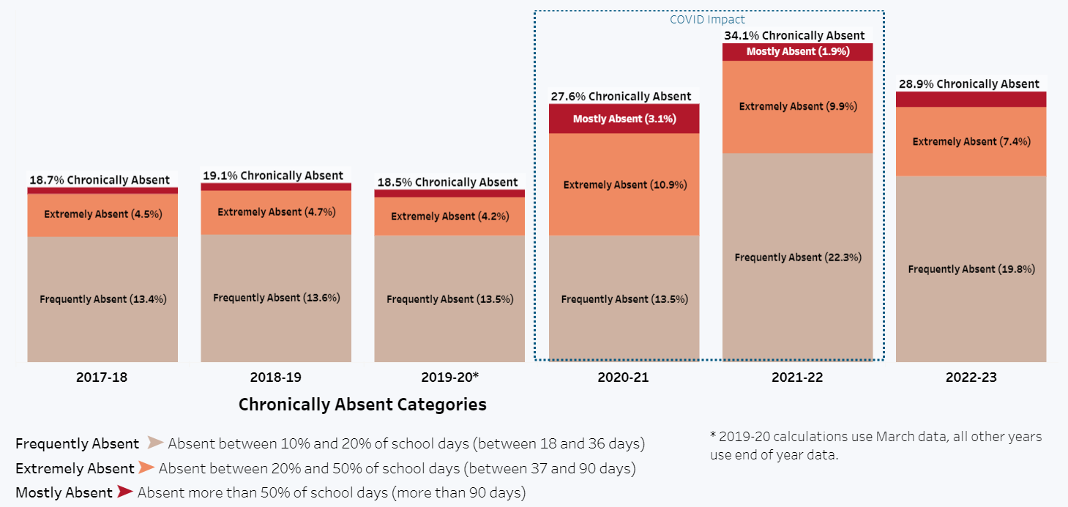
Aversion: Academic, Behavioral, and Social Climate
Using a Data Tool to Determine a Root Cause
Statewide Chronic Absenteeism Rates
RIDE Data Tool
2,190 students (1.6%) were absent more than 50% of school days in 2022-23.
10
Notes:
For the 1st time RI broke CA into more extreme category. During the height of the pandemic, more than 34% of our students were CA. 1.6% were absent more than 50% of the school year.
We improved. And we continue to improve. And you will see how much shortly.

Slide 11
PART II: Using Research and Tools to
Build a Plan for Attendance Success
Welcome
Continuous Growth & Improvement
An Effective School Team to Improve Attendance
Attendance Teams at Work
Attendance for Success Act: Shifting to Prevention & Intervention
Wrap Up
11

Slide 12
Attendance for Success Act
Collective Impact
Attendance Teams
Attendance Success Plans
Prevention & Intervention
Strong, Consistent Definitions
School Attendance Policy Requirements
Notes:
The Act is built on two main elements.
The first is that we need to collectively work on improving attendance. This is internal and external to the education system.
The second is that we need to focus on prevention and intervention – not a punitive system.
The focus on the act is to ensure that we
use strong, consistent definitions,
school attendance policies,
each school has an attendance team
and each school incorporates an attendance success plan in their school improvement plan.

Slide 13
Attendance Act: Strong, Consistent Definitions
Absent
means not in attendance for a school day for any reason, whether excused or not, or at least one-half of the school day (not less than 50% of the school day)
Excessively Absent
a student who is identified as needing intensive support and has not responded to intervention efforts implemented by the school
means that a student who has been enrolled for more than ten days and has been absent, for any reason, whether excused or not, for ten percent or more of the school days during any given school year
Chronically Absent
How does your school define absence? Is this the definition that is used when you report your data to RIDE?
Notes:
Today we define chronically absent as 10% or more of school days.
The act provides a common definition for absent so that we can norm our expectations for what it means to be present for a school day.
Today there are variations in this definition so one school could mark a student present for being in school for 10% of the day while another could mark a student absent if they were not there for at least 50% of the school day.
It is also important to note that excessively absent is not clearly defined today. This would help to create a culture of support for those students that were not responded to the intervention efforts.

Slide 14
Attendance Act: Attendance Teams
Responsible for school attendance strategy and improving overall attendance
Meets regularly to coordinate efforts to reduce chronic absence
Group of school-based administrators, teachers, staff and other school personnel and community members who collaborate to implement an attendance improvement plan
Principal leadership is important for establishing attendance as an important priority
May be formed in whole or in part from preexisting groups or teams within the school (for example MTSS team or SIT) or for the sole purpose of improving school attendance
Monitors overall attendance and chronic absence for individual students to ensure that there are adequate resources
Do you have an attendance team?
Notes:
The attendance success plan would be authored by the LEA and/or school attendance teams.
These teams can be preexisting teams but they need to meet regularly and focus on strategies to improve overall attendance AND monitor attendance.
These teams also advocate for resources to address the needs of their students and remove barriers.

Slide 15
Attendance Act: Attendance Success Plans
Provide a process for prevention of absences and early intervention for students
All LEAs & schools are required to submit the plan in the form of a goal or initiative of their existing Strategic Plan and/or School Improvement Plan
Do you have a goal, initiative, or action step that is based on your attendance data/chronic absenteeism rate?
Notes:
As shared earlier, the attendance success plans would be embedded in existing plans and provide for prevention and early intervention.
They would be developed based on a tiered approach.

Slide 16
Attendance Act: Tiers of Support for Attendance Success Plans
Tier 3: Early Intervention
Interventions for students considered chronically absent and missing 10% or more but less than 20% of classes or school days for any reason.
Tier 1: Whole School Prevention
Whole school prevention for all students, including those who missed less than 5% of classes or school days for any reason.
Tier 2: Individualized Prevention
Targeted prevention strategies for students who have missed 5% percent or more but less than 10% of classes or school days for any reason.
Tier 4: Intensive Supports
Interventions for students considered excessively absent and missing 20% or more of classes or school days. Focuses on students who have not responded to previous interventions provided by the school and may lead to referrals to DCYF because of neglect.
Has your school embedded chronic absenteeism into MTSS?
Notes:
In order to move from a punitive response to one of prevention and intervention the act includes an expectation of an LEA and/or school attendance success plan.
This plan would be part of the existing strategic plan and/or school improvement plans.
It is a tiered approach that would be embedded in the existing MTSS (multitiered system of supports).
The first two tiers focus on prevention and the second two tiers focus on intervention.

Slide 17
Using Tiers of Support to Prevent Absences
Tier 1: Whole School Prevention
Written notice to family
Meeting with family, school principal, attendance team, and school counselor
Non-punitive consequences
Coordinated case management
Specialized supports
Notification of consequences for future absences
Active attendance teams
Active attendance teams
Creative opportunities for engagement/connections
Attendance expectations
Monitor/document daily & class attendance
Student/parent engagement
Clear daily/weekly routines
Wellness checks
Recognize good attendance
Individualized outreach to students and families
Focus on improving school culture
Tier 2: Individualized Prevention (5% or more school days absent)
Active attendance teams
Wellness checks
Tech support and training
Individualized outreach to students and families
Discuss impact of absences on grades
Identify barriers
Develop robust interventions
Physical/mental health supports
Daily check-in with adult
Tier 3: Early Intervention (10% or more school days absent)
Active attendance teams
Written notice to family
Meeting with family about absenteeism
Intervention plan to address barriers and provide service coordination
Physical/mental health supports
Home visits
Attendance contract
Daily check-in with adult
Home visits
Tier 4: Intensive Supports (20% or more school days absent)
This chart identifies some of the strategies that could be used in a tiered system of prevention and intervention.
Have you clearly outlined your strategies/tiers of support to prevent and improve absences?

Slide 18
PART II: Using Research and Tools to
Build a Plan for Attendance Success
Welcome
Continuous Growth & Improvement
An Effective School Team to Improve Attendance
Attendance Teams at Work
Attendance for Success Act: Shifting to Prevention & Intervention
Wrap Up
18

Slide 19
Effective School Teams to Improve Attendance
The information is this section is based on Attendance Works:
How to Organize an Effective School Team to Improve Attendance
What is the purpose of the team?
Organize and facilitate a schoolwide attendance strategy and ensure it is an integral component of the school’s plan to improve outcomes for all students

Slide 20
Effective School Teams to Improve Attendance
Five Key Functions of an Attendance Team
Organize a multi-tiered attendance strategy that begins with prevention and early intervention.
Examine attendance and absenteeism data to assess which groups of students have higher or lower levels of absence.
Mobilize everyone in the school community to address attendance.
Identify assets, barriers and strategies that affect attendance.
Determine if you are making a difference.
Notes:
Organize a multi-tiered attendance strategy that begins with prevention and early intervention.
Reducing chronic absence requires a comprehensive, whole school strategy that begins with evidence-based prevention and early intervention.
Examine attendance and absenteeism data to assess which groups of students have higher or lower levels of absence.
Use data to channel support to individual students as well as specific student groups.
Identify assets, barriers and strategies that affect attendance.
Use both qualitative and quantitative data to gain insight into why students attend school as well as reasons for absences.
Mobilize everyone in the school community to address attendance.
Help everyone in the school building and in partner organizations understand what they can do to encourage and support student attendance.
Determine if you are making a difference.
Results count. Take a close look at whether students are better off as a result of your team’s efforts

Slide 21
Effective School Teams to Improve Attendance
School Team Self Assessment
Built on the five key functions
Identify strengths and opportunities for attendance strategy
Lays foundation for attendance team
Determines current reality

Slide 22
Effective School Teams to Improve Attendance
School Team Self Assessment
Have you determined your team’s strengths and opportunities to implement a schoolwide attendance strategy?
See School Team Self-Assessment

Slide 23
How to establish a team to improve school attendance
Steps to organizing the school team with responsibility for attendance
Decide if using existing team(s) or a new team
Ensure understanding of chronic absenteeism (versus truancy)
Set norms, expectations, roles, and responsibilities
Determine standard meeting agenda and set frequency of meetings
Review the school’s chronic absence data, including current and previous years

Slide 24
How to establish a team to improve school attendance?
Steps to organizing the school team with responsibility for attendance
Review and understand the LEA’s policies, guidance, protocols, and practices around attendance
Map the school’s tiered intervention strategy for preventing and reducing chronic absence
Assess the school’s attendance practice using the school self-analysis tool, existing tiered strategies, and trends (root causes based on reasons)
Use the school data to set school wide and student subgroup goals for attendance improvement and develop an attendance improvement plan

Slide 25
Establishing the Attendance Team
Can an existing team address attendance?
The principal should conduct an assessment of what teams already exist in their school (e.g., SIT, PBIS, school climate, MTSS, Instructional Leadership Team, etc.), what is each team’s purpose, how frequently they meet and who participates on each team.
Principals and school staff consider existing teams/committees
Use the inventory results to determine how attendance team functions will be implemented
Inventory school teams/committees (see Map of School Teams Tool)

