Slide 1
The Reasons: Four Categories of Chronic Absenteeism
Spring 2024

Slide 2
Student Attendance and Academic Success Planning
What tools are available to support our work to reduce chronic absenteeism?
What are the reasons students are chronically absent?
What is chronic absenteeism?
How can we shift from a punitive approach to prevention and intervention?

Slide 3
The Root Cause
Aversion to school climate, academics, relationships, disciplinary practices, and other factors that psychologically discourage attendance.
Barriers
Aversion
Disengagement
Misconceptions
Barriers like illness, family or home challenges, trauma, lack of transportation, housing issues, inequitable access to services, and more.
Motivationally-based absences often happen when there are poor relationships with other students, academic failure, or when a student is not engaged in instruction.
A view or opinion that is incorrect because it is based on faulty thinking or understanding.
Root Causes - Attendance Works

Slide 4
The Root Cause
Barriers
Aversion
Disengagement
Misconceptions
Root Causes - Attendance Works

Slide 5
Absence reasons typically fall into four broad categories: Barriers to attendance, aversion to school, disengagement from school, and misconceptions about the impact of absences.
The Reasons
Barriers
Aversion
Disengagement
Misconceptions
Chronic and Acute Illness
Academic Struggle
Lack of Challenging Culturally Responsive Instruction
Only Unexcused Absences are a Problem
Trauma
Behavior Struggle
Missing Two Days Per Month Doesn't Affect Learning
Poor Transportation
Unwelcoming School Climate
Bored
No Meaningful Adult Relationship in School
Housing & Food Insecurity
Social and Peer Challenges
Lose Track of Total Absences
Internet Access
Anxiety
Lack of Enrichment Opportunities
Assume Students Must Stay Home for Any Symptoms
Community Violence
Biased Discipline Practices
Lack of Academic Support
Community Inequities
Undiagnosed Disability and/or Disability Accommodations
Lack of Behavioral Support
Attendance Only Matters in Older Grades
Family Responsibilities
Failure to Earn Credits
Caregivers had Negative Educational Experience
Suspensions Don't Count as Absence
Click the link to see the RI Data.
Click on The Reasons button to return.
Need to Hold Job Conflicts with Being in High School
Student Challenges
THE REASONS
Notes:
Attendance Works categorizes the reasons students are CA into 4 big buckets.
Note the range in reasons.
Some can be addressed at the school level;
Some can only be addressed by involving municipal leaders, state agencies and community groups

Slide 6
Understanding the Reason & Building the Plan
Use these areas to consider one of the four reasons that students are chronically absent and how to respond.
Absence Reason Category
Reason
Specific Cause
Source (of data)
Problem
Initiative and/or Action
Needed Resources and/or Supports
Contact Leading the Work
Research/Evidence

Slide 7
Understanding the Reason & Building the Plan
1 - Absence Reason Category
2 - Reason
3 - Specific Cause
4 - Source (of data)
EXAMPLE CASE STUDY

Slide 8
Understanding the Reason & Building the Plan
5 - Problem
6 - Initiative and/or Action
7 - Needed Resources and/or Supports
EXAMPLE CASE STUDY

Slide 9
Understanding the Reason & Building the Plan
8 - Contact Leading the Work
9 - Research/Evidence
EXAMPLE CASE STUDY

Slide 10
Aversion: Student Challenges
THE REASONS
Notes:
54,000 MS and HS students responded
Safety, engagement, substance abuse and family barriers all contribute
18,000 cite 'Some other reason'. We will come back to that shortly

Slide 11
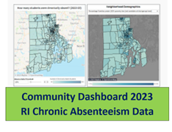
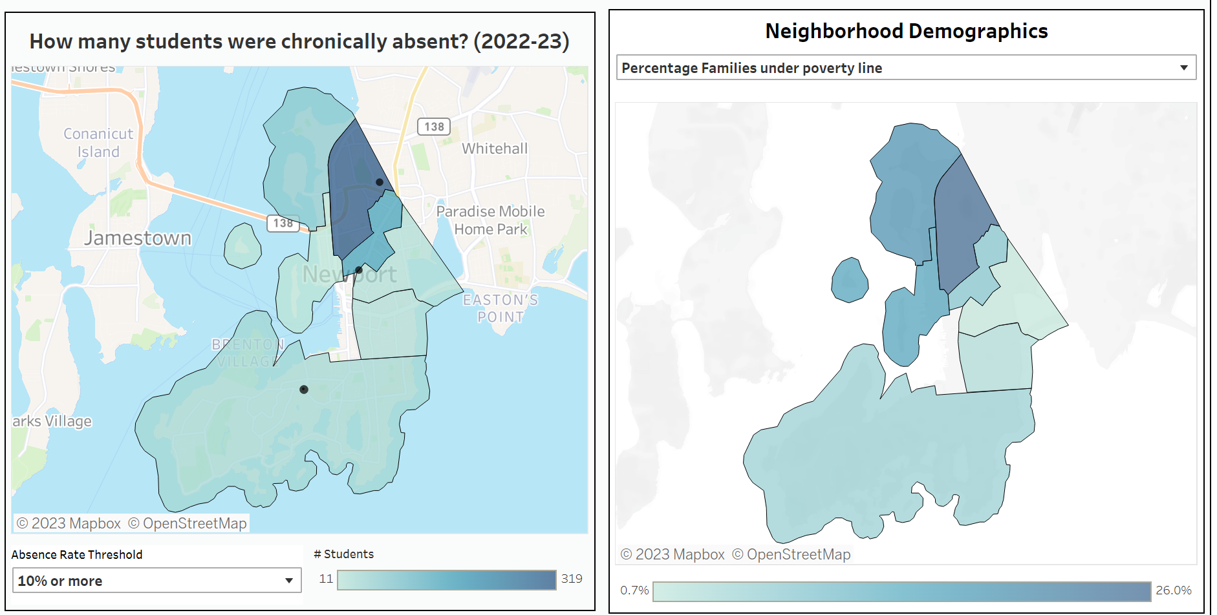
Barriers: Poverty & Chronic Absenteeism
Families Under Poverty Line
Newport Students
Absent More than 10% in 2022-23
THE REASONS
Notes:
We know that community factors matter. How do we address that?
Community dashboard allows you to examine data at the census tract and block group levels
You can see where your students are CA and see if poverty, home ownership or internet access, for example may be a contributing factor

Slide 12
The percentage of students, families, and administrators that answered favorably.
Misconceptions: Missing Two Days
THE REASONS
Notes:
Note that the RI Chronic Absenteeism for 2019 is 19.1%. The RI Chronic Absenteeism for 2023 is 28.9%
The data have been consistent for years
Building leaders know it matters, followed by educators
6-12 students don't think it matters at all
When talking about shared measurement, this is essential, because if we can't convince the school community that attendance matters, we will never move the needle

Slide 13
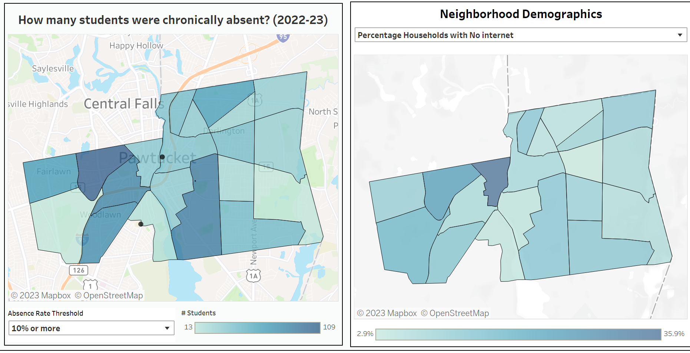
Barriers: Internet Access & Chronic Absenteeism
Pawtucket Students in Grades 9-12
Absent More than 10% in 2022-23
Pawtucket Students in Grades 9-12
No Internet
66
5.7%
109
38
68
24.4%
35.9%
86
11.2%
91
8.1%
78
14.2%
13.3%
THE REASONS
Notes:
We think everyone has access to the internet these days, but we can see this is not the case
These maps include only HS students in Pawtucket
In the 21st century, there are census tracts where more than a third of families do not have internet access

Slide 14
Aversion: Behavior Struggles
THE REASONS
Notes:
Coming out of COVID, students are struggling to focus on learning
Student behavior struggles also increased across all grades, making learning more difficult for students

Slide 15
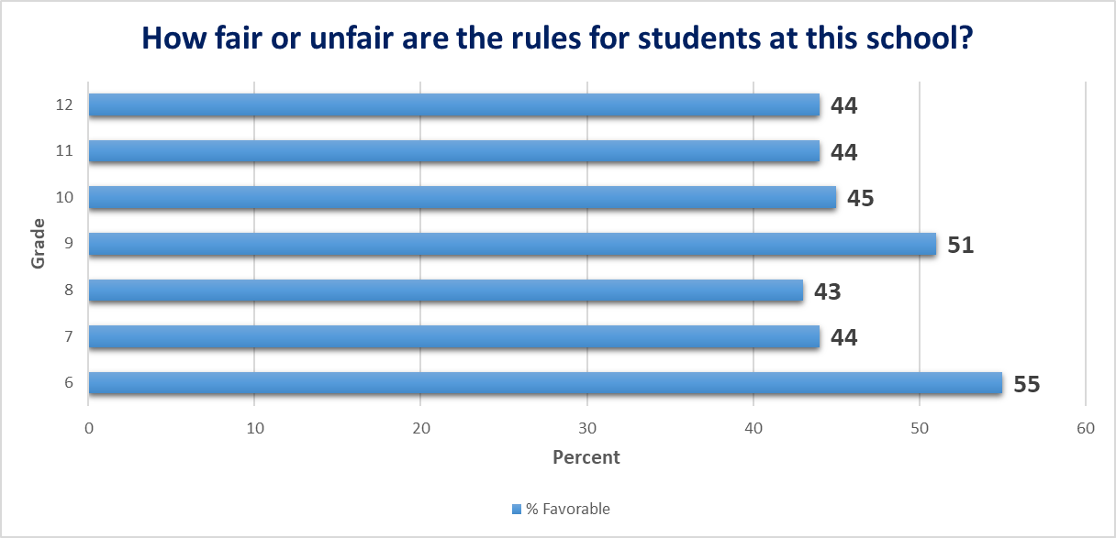
Aversion: Biased Discipline Practices
THE REASONS
Notes:
Close to half of all students in grades 6-12 do not the believe rules are fair.
Notice the transition grades.

Slide 16
Disengagement: Bored
THE REASONS
Notes:
This should be a wake-up call for all of us.
19% of students in grades 6-12 are excited about their classes.
These data are consistent from year to year.
The HS regs, we believe, are part of the answer but not the complete solution

Slide 17
Aversion: Anxiety
THE REASONS
Notes:
These results are troubling, but especially for our younger students, who are more stressed than middle and high school students
Nationally, the mental health challenges of our students have skyrocketed
As a state, we must face this issue head-on or our students and the state will struggle for years to come
This is an all hand-on deck effort. How would you help?

Slide 18
Disengagement: No Meaningful Adult Relationship
THE REASONS
Notes:
We all want to belong, whether it's work, a church, a neighborhood or a family. All students want to belong too
Less than 40% of all students statewide feel like they belong
How do we revive school communities – so that students want to be there because they feel like they are a part of something special

Slide 19
Aversion: Social and Peer Challenges
THE REASONS
Notes:
Bullying is an obstinate problem. The ever-increasing influence of social media has elevated bullying beyond the school walls.
These number have increased since the pandemic.

Slide 20
RICAS is administered to students in grades 3 through 8
Misconceptions: Attendance Only Matters in Older Grades
THE REASONS
Notes:
Research is crystal clear. If a student is absent in kindergarten, he/she is much more likely to continue to be CA in subsequent years.
86% of students that were chronically absent in 2022-03 did not meet the standard in RICAS math-

Slide 21
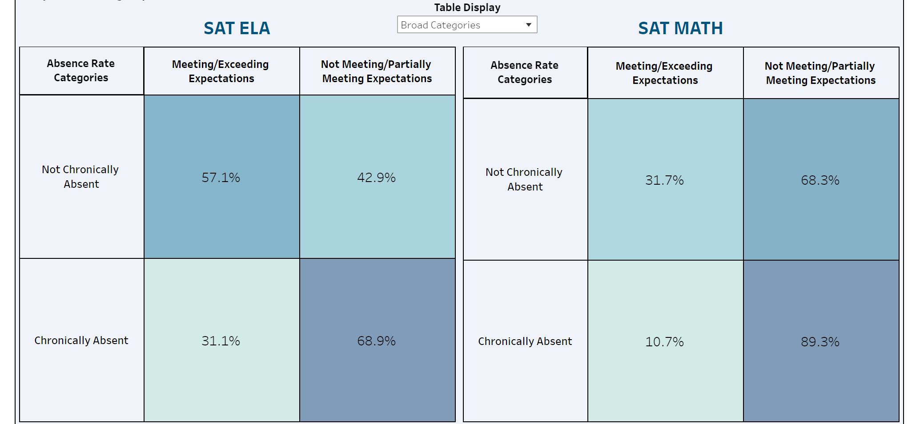
SAT is administered to all students in grade 11
Aversion: Academic Struggle
THE REASONS
Notes:
At the high school, students simply stop coming to school. Survey data tell us that students have given up. If they believe they will fail, they see no point in even showing up.

Slide 22
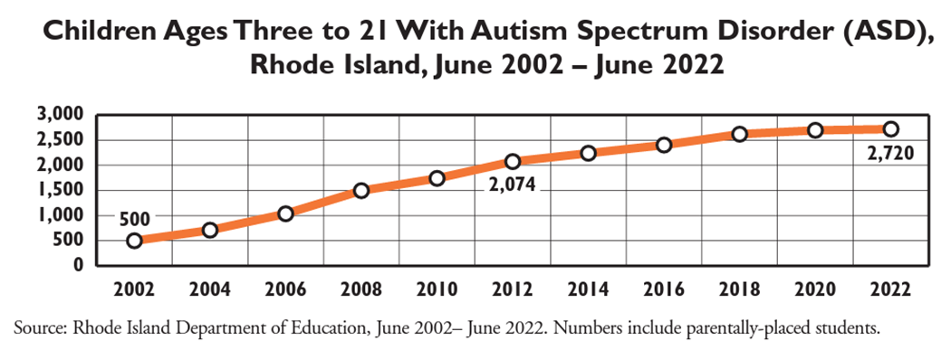
Aversion: Disability Accommodations
THE REASONS
Notes:
According to Kids Count, Autism Spectrum Order has steadily increased over the past 20 years.
Are these increases or are these students that have been historically undetected?
Are we missing still more students and how do we find them so we can help them?

Slide 23
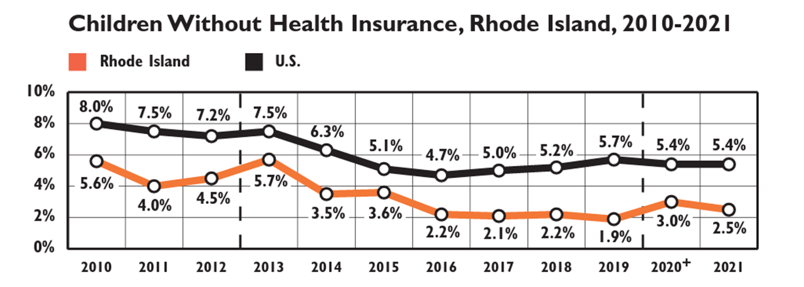
Barriers: Chronic and Acute Illness
THE REASONS
Notes:
While RI leads the nation in healthcare for children, some children and families are falling through the cracks.
Students cannot thrive in school if chronic and acute illness are not addressed.

Slide 24
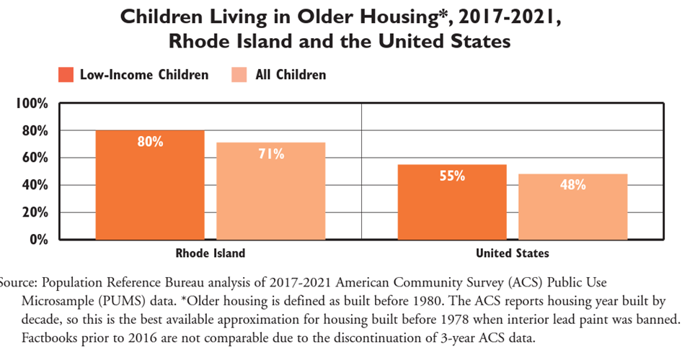
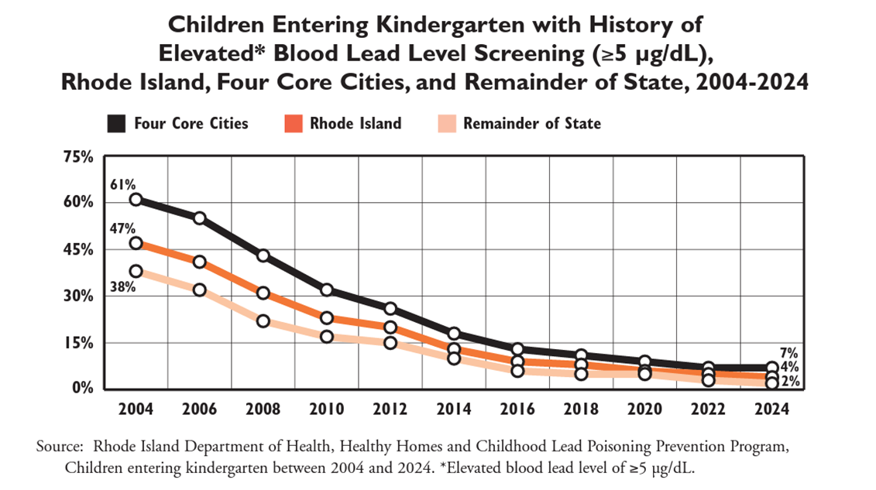
Barriers: Housing Insecurity
THE REASONS
Notes:
Research shows that children with elevated blood lead levels perform lower than students without high blood lead levels.
RI's housing stock is old and although the state won a lawsuit against lead paint companies, the efforts to address this have not been consistent
Young children continue to suffer

Slide 25
Barriers: Community Violence
THE REASONS
Notes:
184 children went to the emergency room as a results of gun violence.
This is one of many community violence indicators that will impact not only the directly affected child, but their friends, their families and their communities

Slide 26
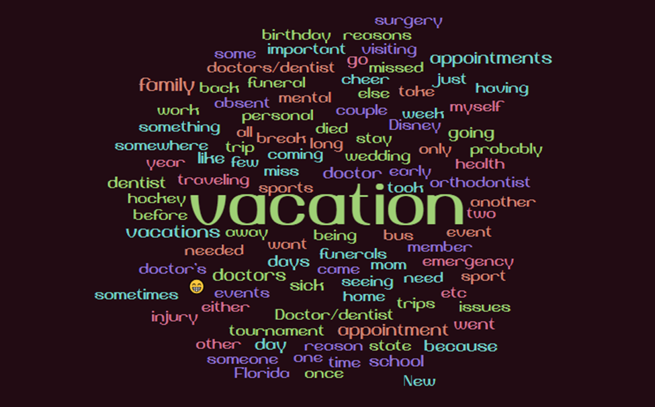
Misconceptions: Lose Track of Total Absences
THE REASONS
Notes:
Why were you absent from school?
Of the 54,000 students that answered this question, more than 18,000 answered some other reason. This word cloud is pretty clear. Tournaments, appointments, funerals, birthdays, injury – many reasons
But the #1 answer is VACATION.
Some mention 3 week vacations
Others say they want to be in school but family makes them go
Mental health was also prevalent but worded very differently so doesn't show as prominently

Slide 27
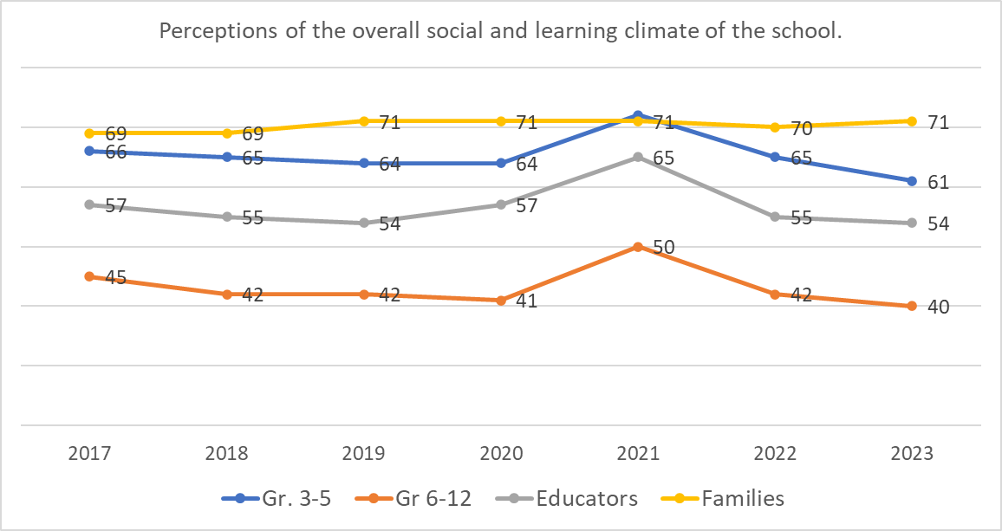
Aversion: Unwelcoming School Climate
THE REASONS
Notes:
This is a SurveyWorks topic that asks all stakeholders about respect, the energy of the school, how welcoming the school is for families and whether students enjoy going to school.
Data have been fairly consistent but has actually declined since the pandemic. MS and HS climate is particularly troubling.

Slide 28
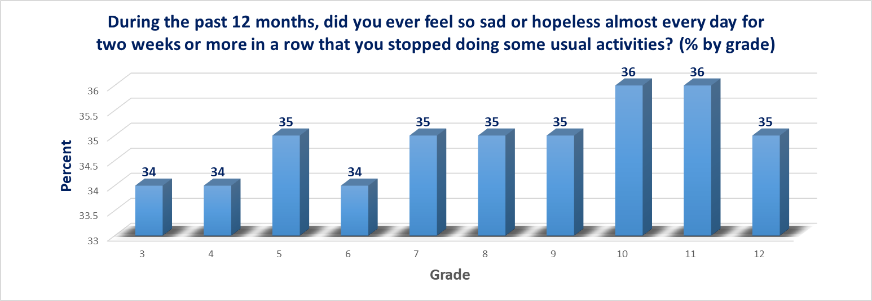
Barriers: Trauma
THE REASONS
Notes:
We think of depression as a problem for the middle and high school grades. But look at our elementary students
Additional COVID funds provided temporary support in the form of counselors and social workers – but those positions will go away.
All students need these supports every day

Slide 29
Disengagement: Lack of Enrichment Opportunities
THE REASONS
Notes:
Data tell us that students are not engaged. We know it. Teachers have ideas about how we might address it
Real world learning opportunities
Many of you may see yourself in these teacher suggestions

Slide 30
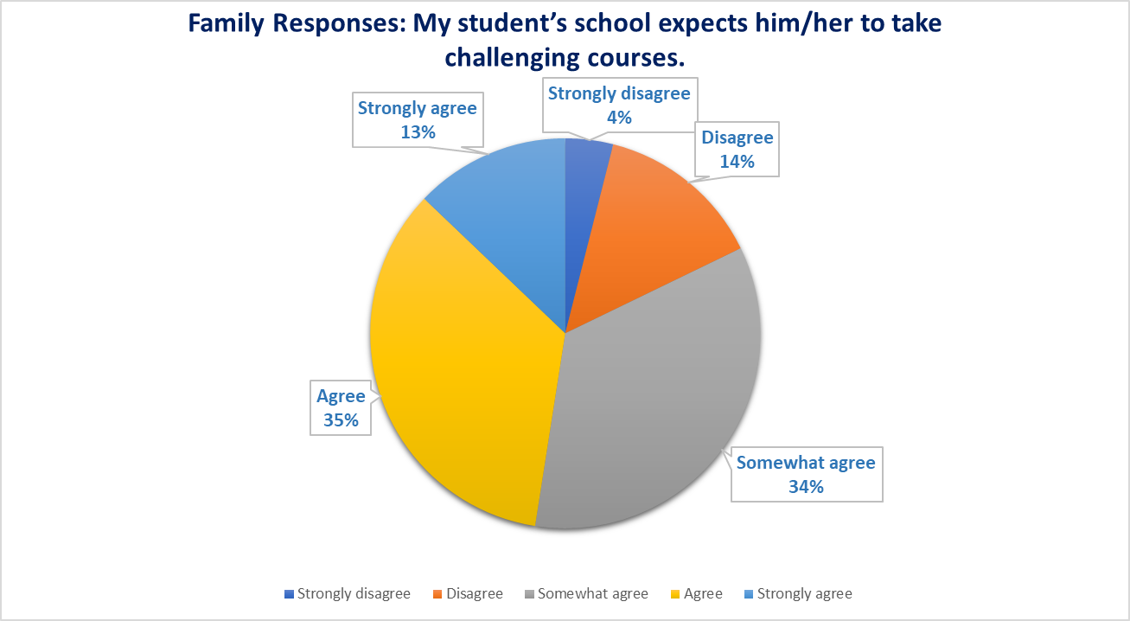
Disengagement: Lack of Academic Support
THE REASONS
Notes:
According to families, 52% of students are not receiving the academic coursework necessary to succeed in school.
Students agree

Slide 31
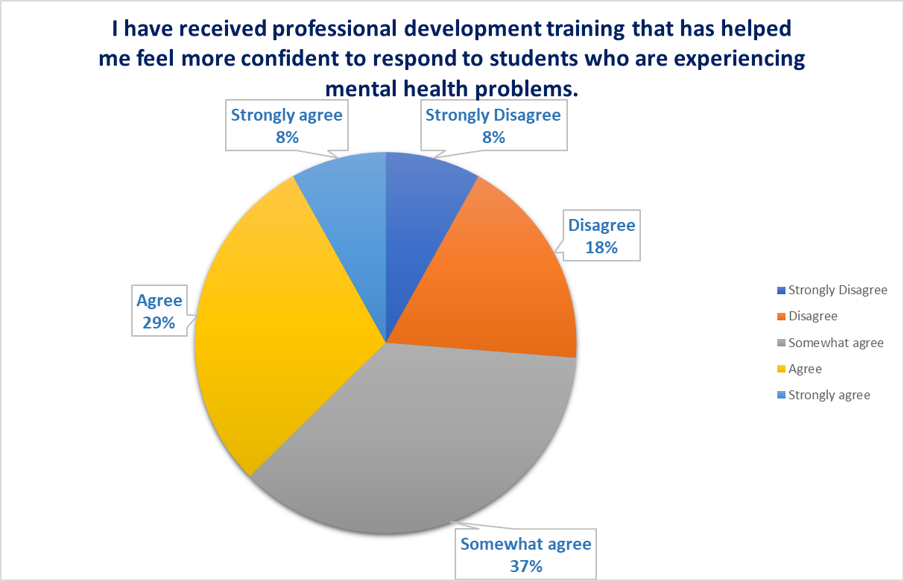
Disengagement: Lack of Behavioral Support
THE REASONS
Notes:
As these data make perfectly obvious, mental health is a real crisis
Not enough teachers feel equipped to help
Only 37% of of +9000 educators are confident that they can help

Slide 32
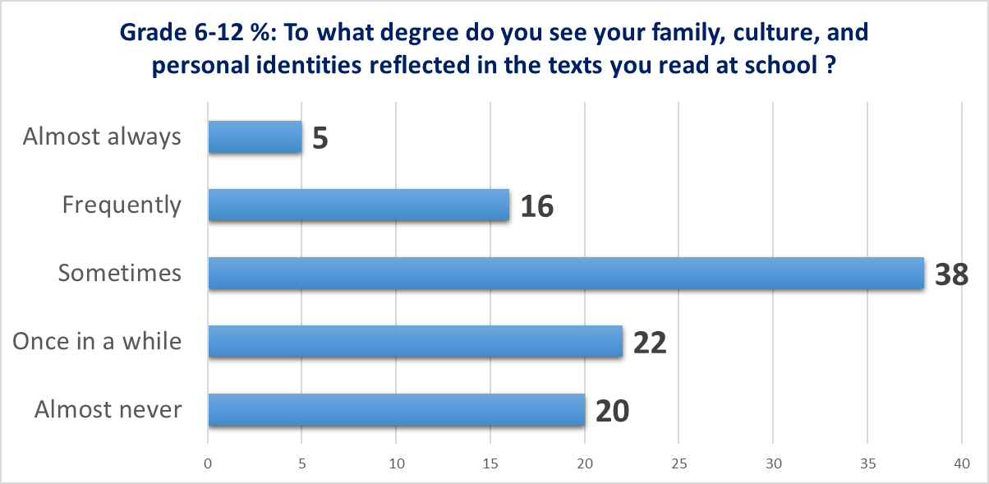
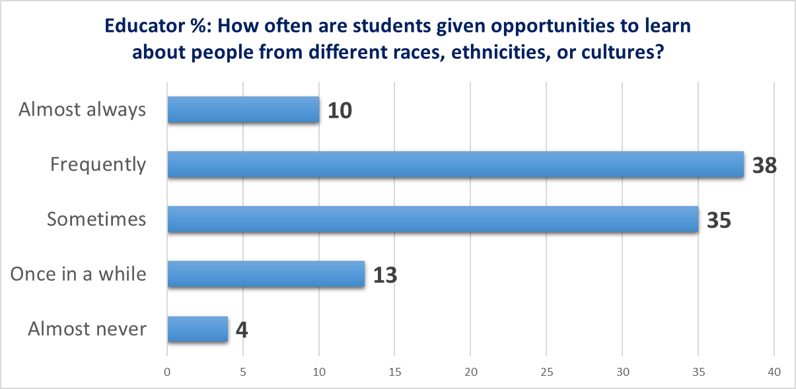
Disengagement: Lack Challenging Culturally Responsive Instruction
THE REASONS
Notes:
RI is diverse and we need all students to see themselves and their cultures in their daily school lives.
We all have work to do in this regard if we want students to engage in school

Slide 33
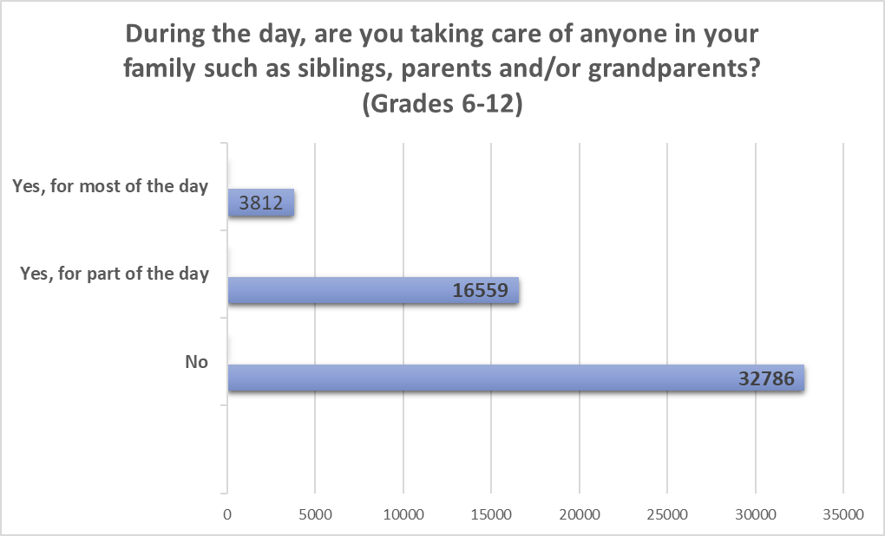
Barriers: Family Responsibilities
THE REASONS
Notes:
Often times students CANNOT be in school. We began asking this question during the Pandemic but have kept it because it is a window into challenges students face that are out of their control.
New HS regs are focused on this very issue
We must get creative when it comes to helping these students with family responsibilities

Slide 34
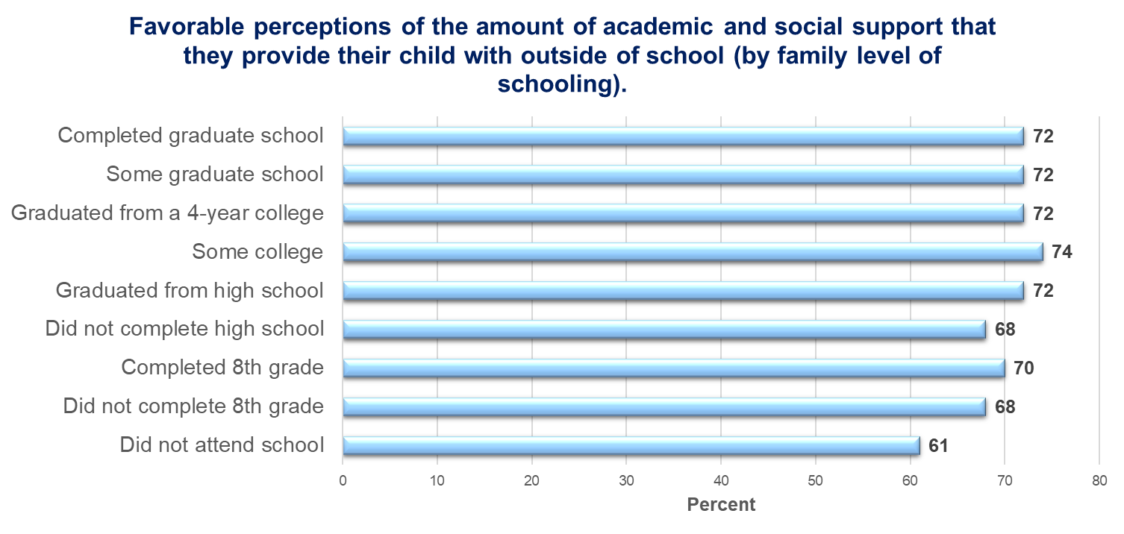
Aversion: Caregivers had Negative Educational Experience
THE REASONS
Notes:
When families complete SurveyWorks, we ask them to indicate their education level. Families with less education are less able to support their children academically or socially.
How do we help these families help their children?

Slide 35
Positive Conditions for Learning
Lead to Students Being Engaged and Attending Regularly
Physical and Emotional
Health and Safety
Adult and Student Well-Being and Emotional Competence
Belonging, Connection, and Support
Academic Challenge and Engagement
Relationships are Essential to Positive Conditions for Learning
Click the link to see the RI Data.
Click on the Positive Conditions button to return.
POSITIVE CONDITIONS
Notes:
There is no question that we've got lots to do, but the good news is we've already started. Specifically, we are addressing the 4 positive conditions for learning, outline by Attendance Works.

Slide 36
Positive Conditions Support Steps in the Right Direction
The chart below shows the number of students who were chronically absent by school year. The number of chronically absent students changed by -7,436 from 2021-22 to 2022-23. While the numbers are improving, we’ve got a long way to go.
POSITIVE CONDITIONS
Notes:
We are moving in the right direction.

Slide 37
Positive Conditions Support Steps in the Right Direction
The chart below shows the percentage of students who were chronically absent by school year. The number of chronically absent economically disadvantaged students decreased by 8.9% points between 2021-22 to 2022-23. While the numbers are improving, we’ve got a long way to go.
POSITIVE CONDITIONS
Notes:
This is great news. Also notable are the decreases in CA for Black, Hispanic and multi-lingual learners

Slide 38
Positive Conditions Support Steps in the Right Direction
52
LEAs had more than 15% of their students chronically absent during the 2021-2022 school year
30
Of the LEAs included a goal or initiative to improve student attendance and chronic absenteeism in their Strategic Plan (July 1, 2023)
64
RI Department of Education is supporting ALL LEAs to understand the complexity of chronic absenteeism and how to develop an action plan to reduce it
POSITIVE CONDITIONS
Notes:
Schools and districts are taking action

Slide 39
Positive Conditions Support Steps in the Right Direction
Examples the ways that RI LEAs are working to reduce chronic absenteeism:
Attendance teams and being consistent with a tight process with your team
Student incentives, communication and rapport with families
Tiered systems of supports, outreach, walking school bus
Parent/student ownership of successful schools
Advisory and
student-led binders/conferences
How to help new MLL students feel welcome, especially newcomers, make friends, and make learning accessible
Saturday school program
Working collaboratively with the RI Truancy program to engage families, monitor attendance and access intensified intervention
Battling chronic absenteeism through engaging CTE curricula
POSITIVE CONDITIONS
Notes:
RIDE surveyed more than 700 school educators and leaders. Here is a sampling of what is already happening to address CA. We plan to host a statewide conference where we can learn from our colleagues across the state.

Slide 40
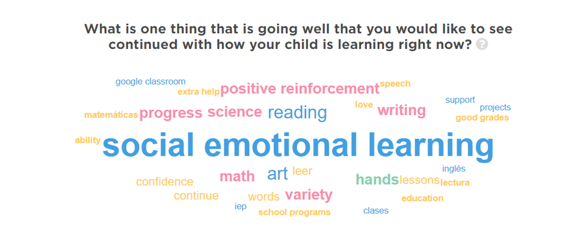
Positive Conditions for Learning
POSITIVE CONDITIONS
Notes:
Families appreciate all that schools are trying to do to address social emotional learning for their children. While we know more needs to be done, the will and the need is there

Slide 41
Understanding the Reason & Building the Plan
Absence Reason Category
Reason
Specific Cause
Source (of data)
Problem
Initiative and/or Action
Needed Resources and/or Supports
Contact Leading the Work
Research/Evidence

